Slide 1
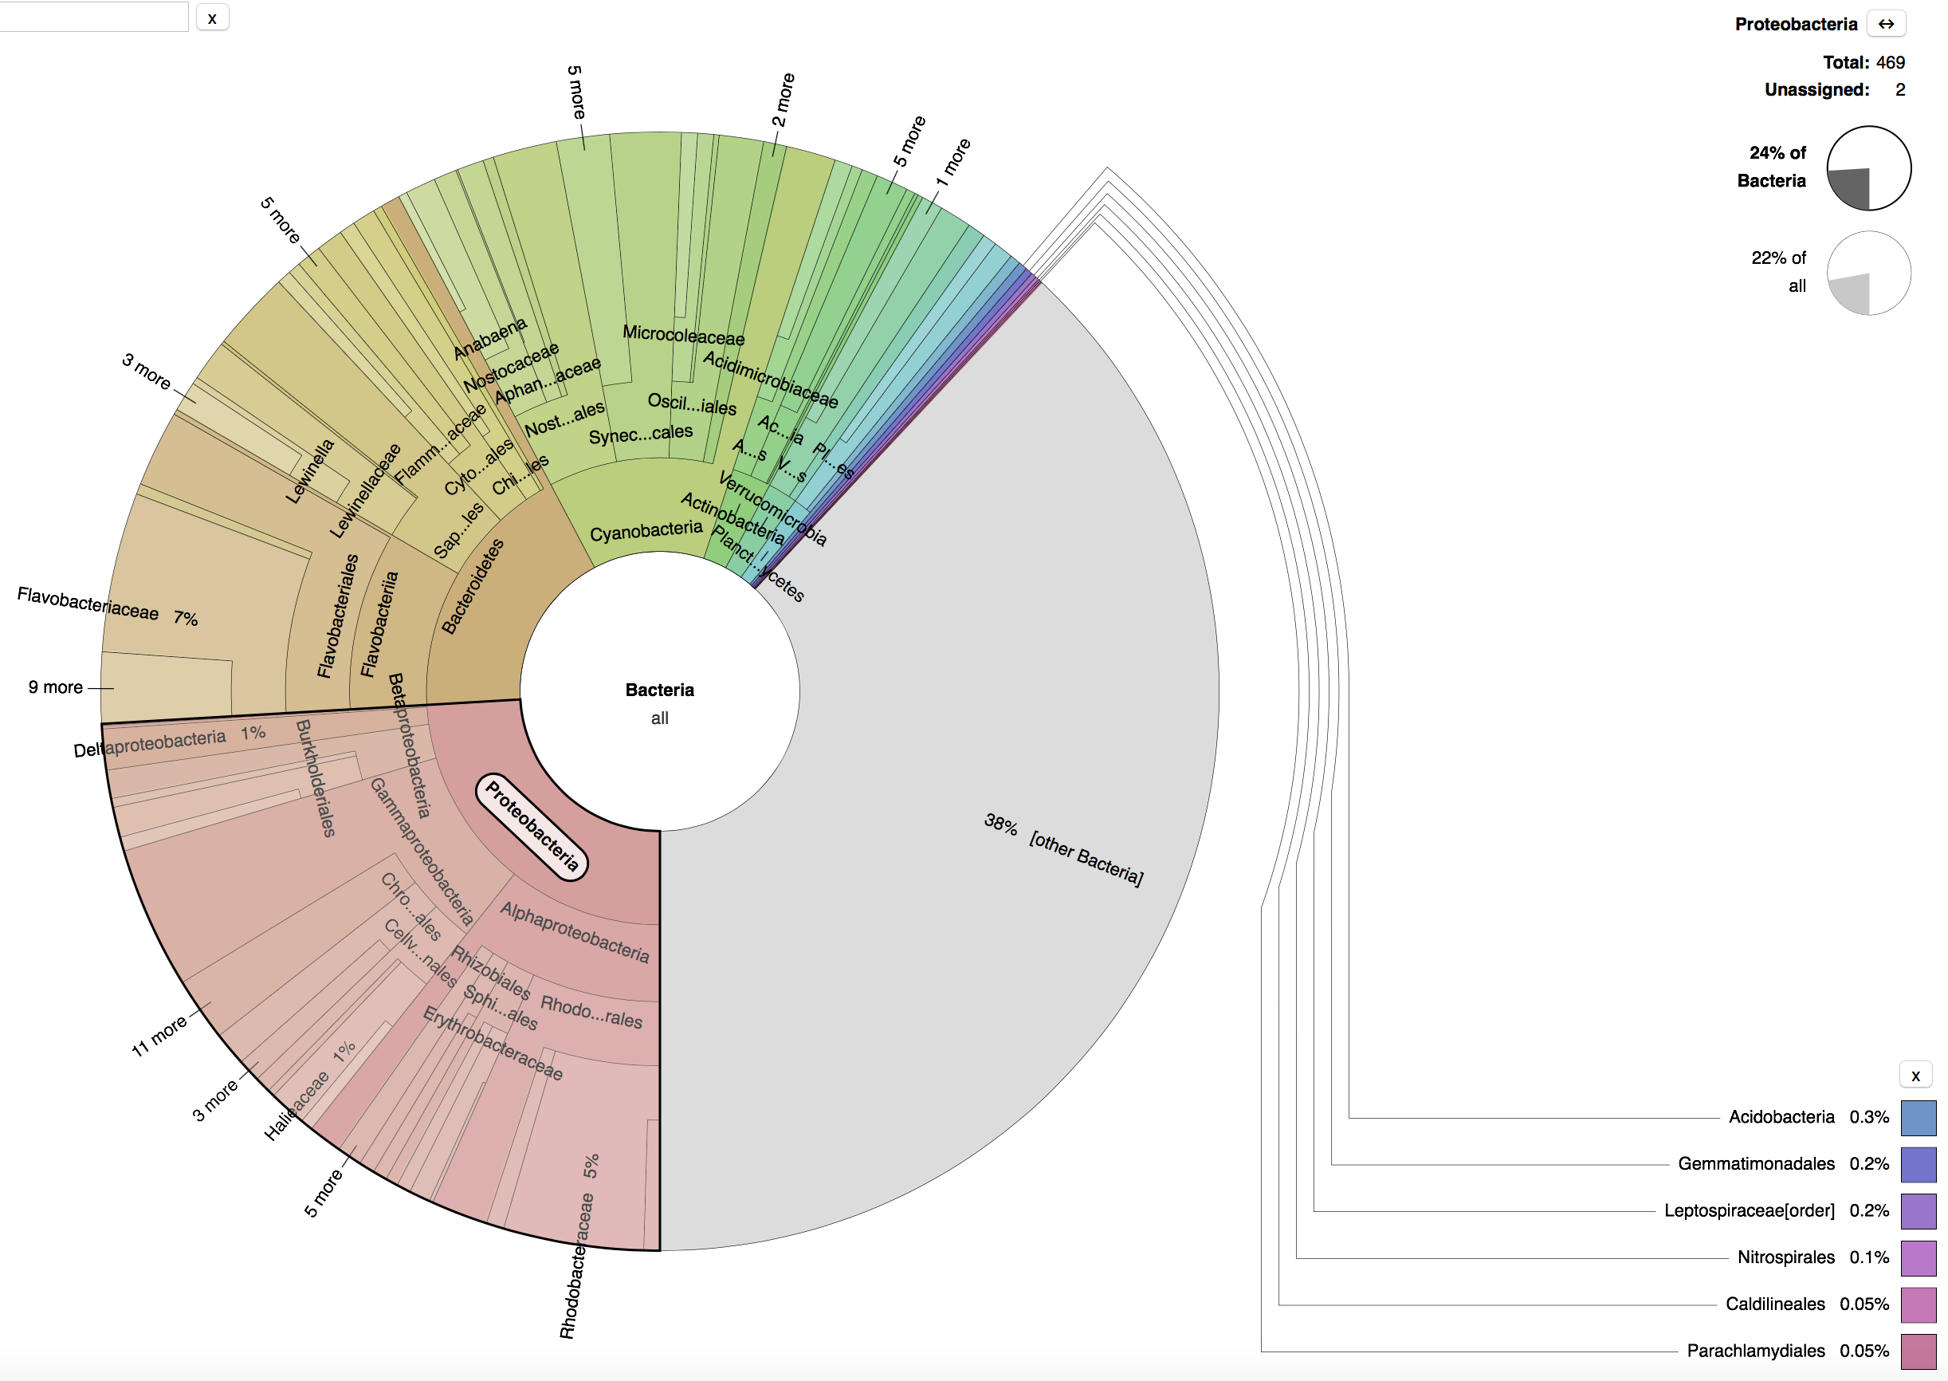
Sample Fv7
16S
24% Proteobacteria

Slide 2
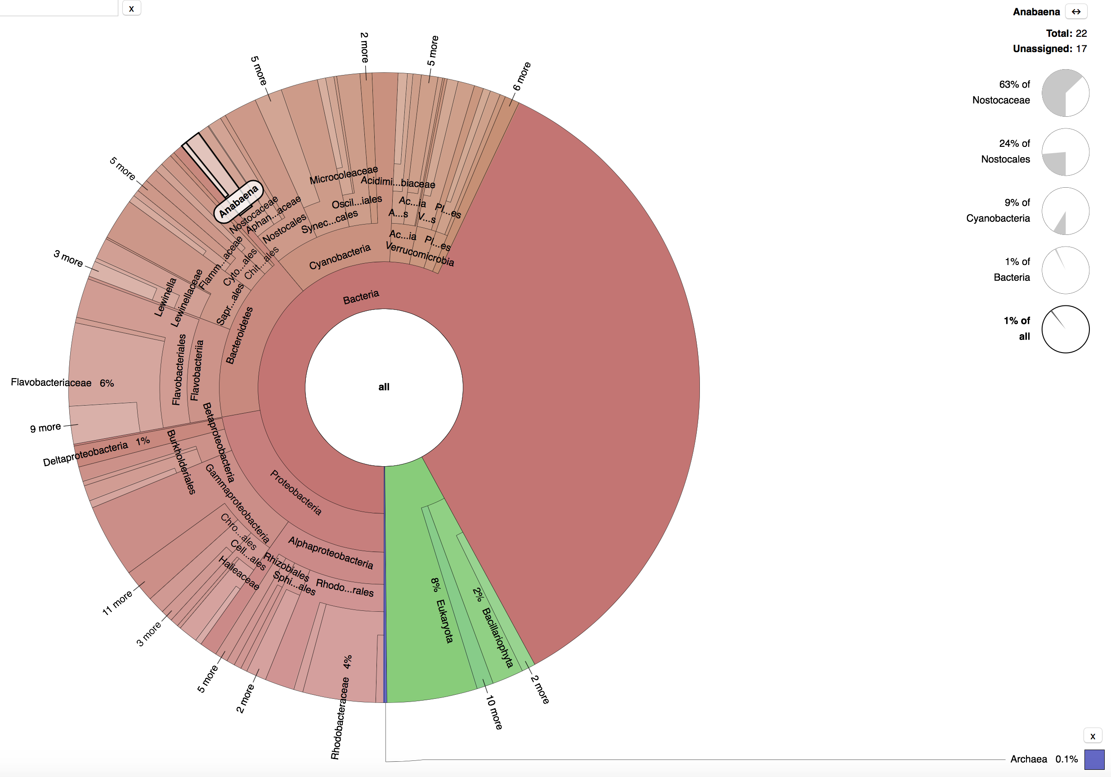
Sample Fv7
16S
1.13 % Anabena

Slide 3
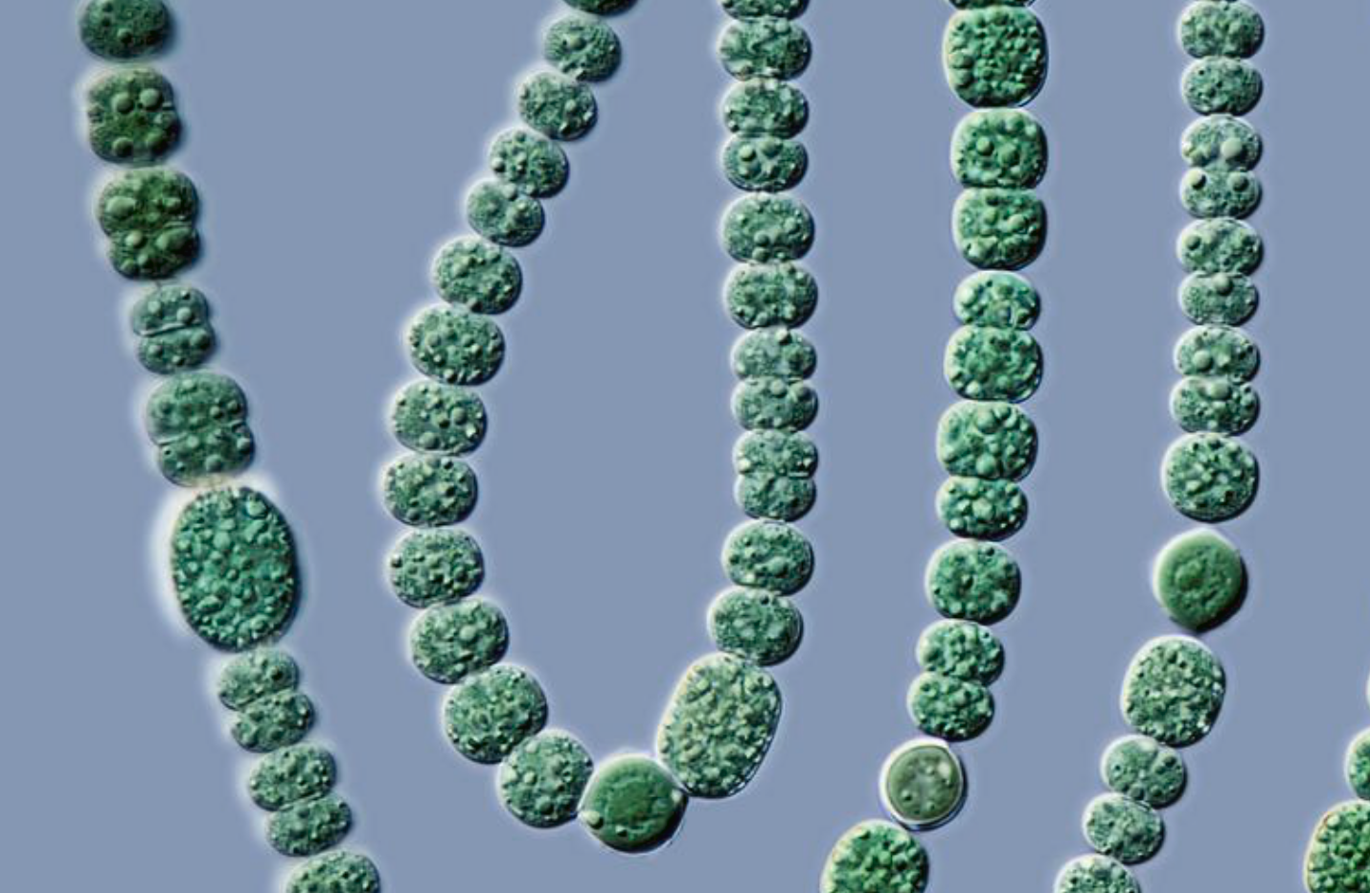
Anabena

Slide 4
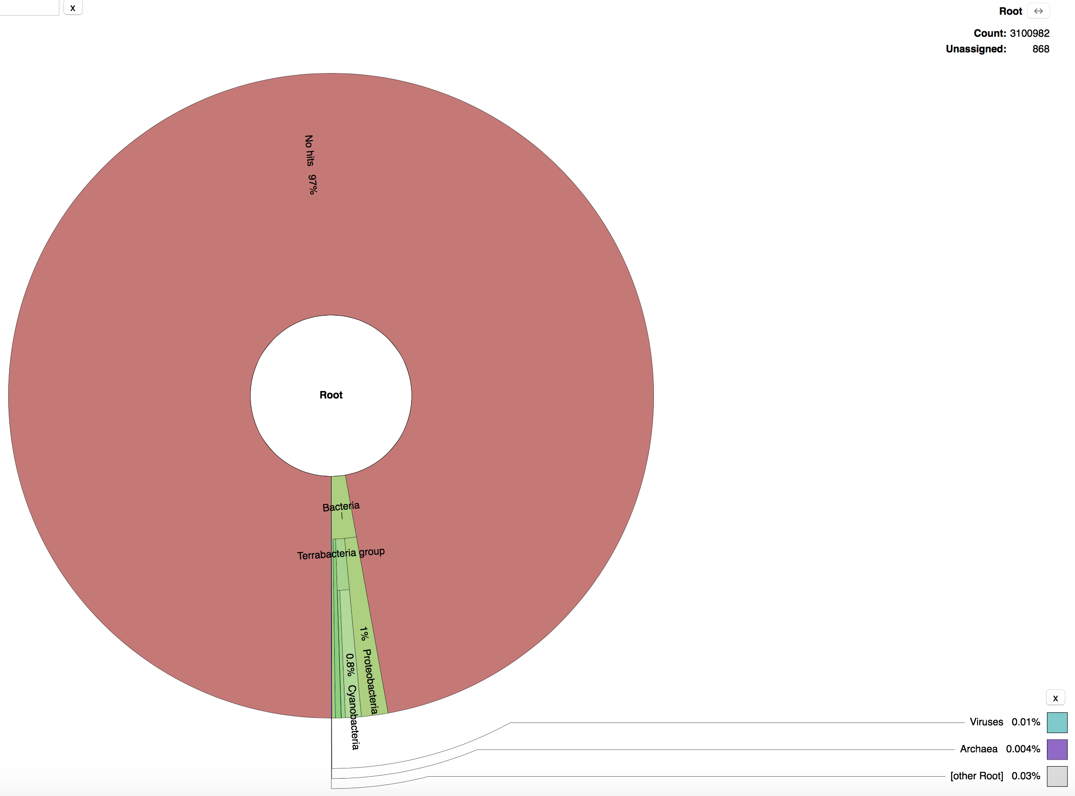
Sample Fv7
Kraken
97% No hits

Slide 5
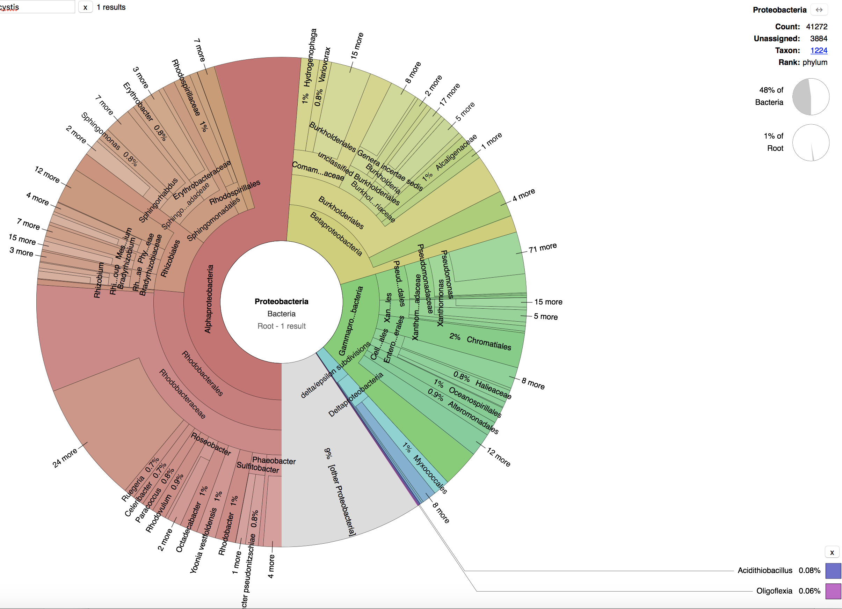
Sample Fv7
Kraken
48% Proteobacteria

Slide 6
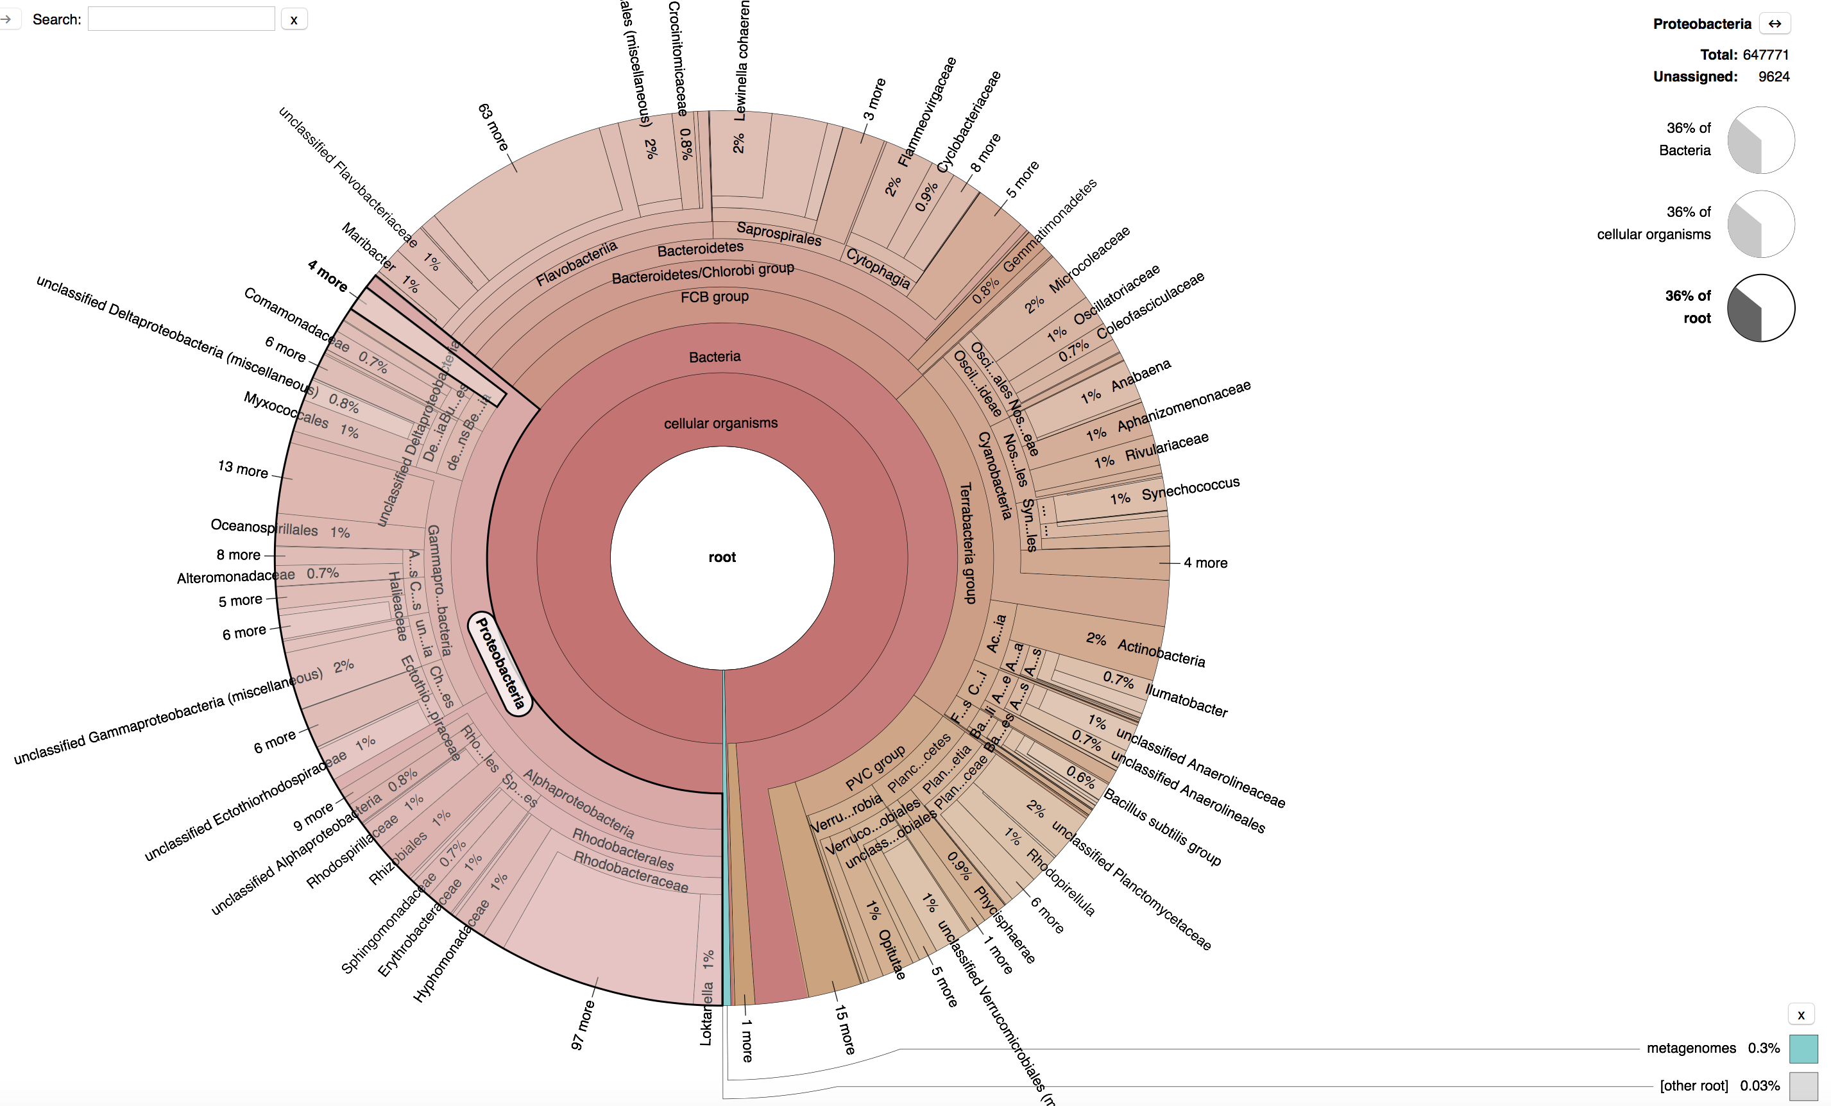
Sample Fv7
Kaiju
36% Proteobacteria

Slide 7
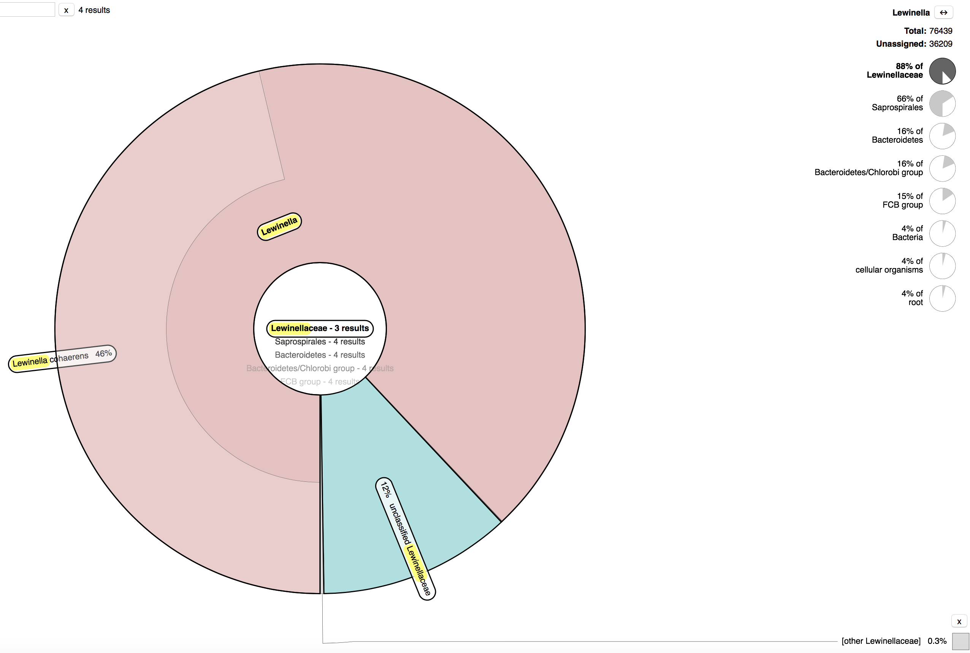
Sample Fv7
Kaiju
Genus Lewinella
Total 76439 reads

