Slide 1

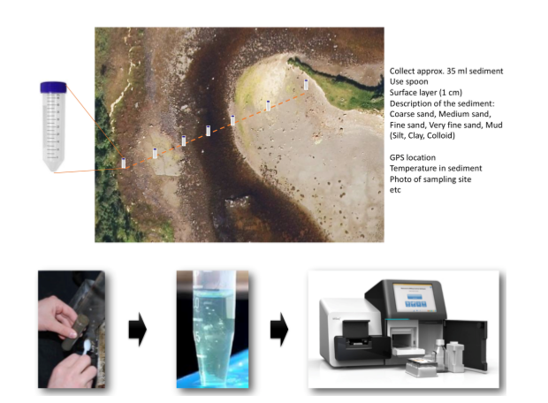
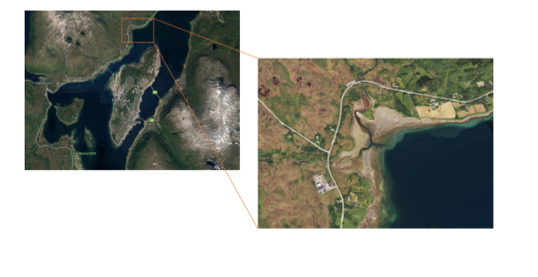
Taxonomic and functional analysis of shotgun metagenomic
data retrieved from surface sediment in a tidal zone near Tromsø
Kristin, Inga, Felipe, Vincent

Slide 2
Taxonomic assignment
Without processing
Bin
Taxonomic assignment on a bin

Slide 3
Describe the taxonomic composition
of this environment without forming bins
Methods
1. Taxonomic classification using reads with 16S rRNA
2. Taxonomic classification using reads using a reference database of protein sequences
3. Taxonomic classification using reads using a k-mer based method

Slide 4
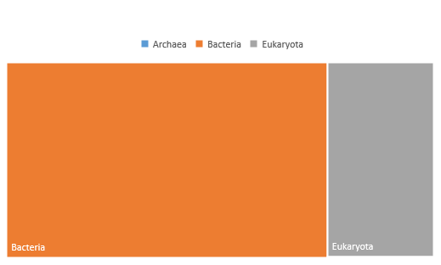
Taxonomic classification using reads with 16S rRNA

Slide 5
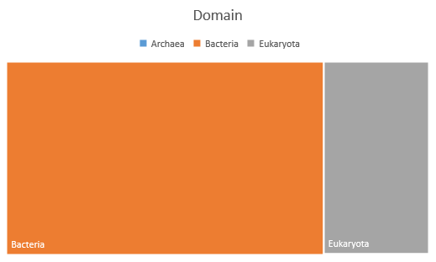
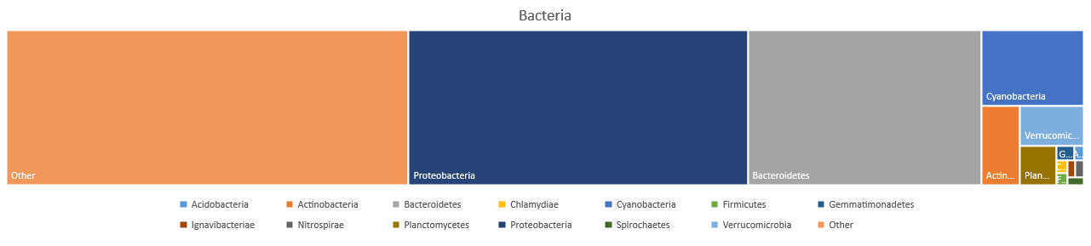
Taxonomic classification using reads with 16S rRNA

Slide 6
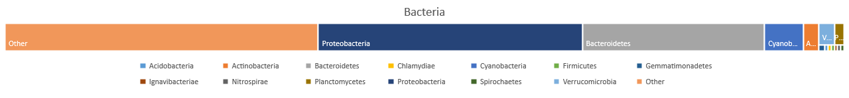
Taxonomic classification using reads with 16S rRNA

Slide 7
Taxonomic classification using reads with 16S rRNA

Slide 8

Taxonomic classification using reads using a reference
Database of protein sequences

Slide 9
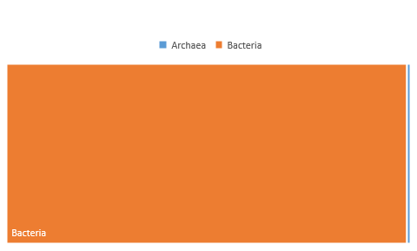
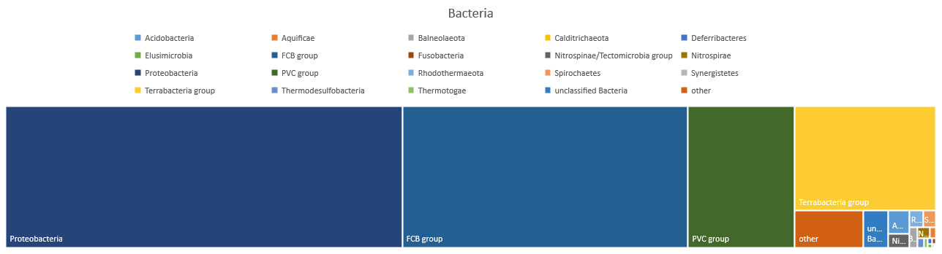
Taxonomic classification using reads using a reference database of protein sequences

Slide 10
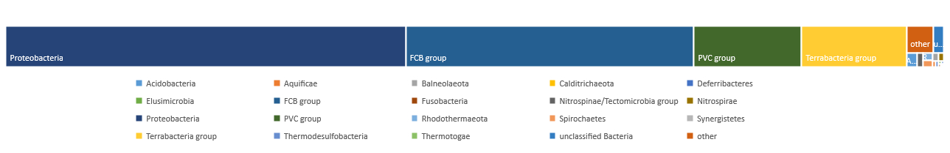
Taxonomic classification using reads using a reference database of protein sequences

Slide 11
Taxonomic classification using reads using a reference database of protein sequences

Slide 12
Taxonomic classification using reads using a reference database of protein sequences

Slide 13
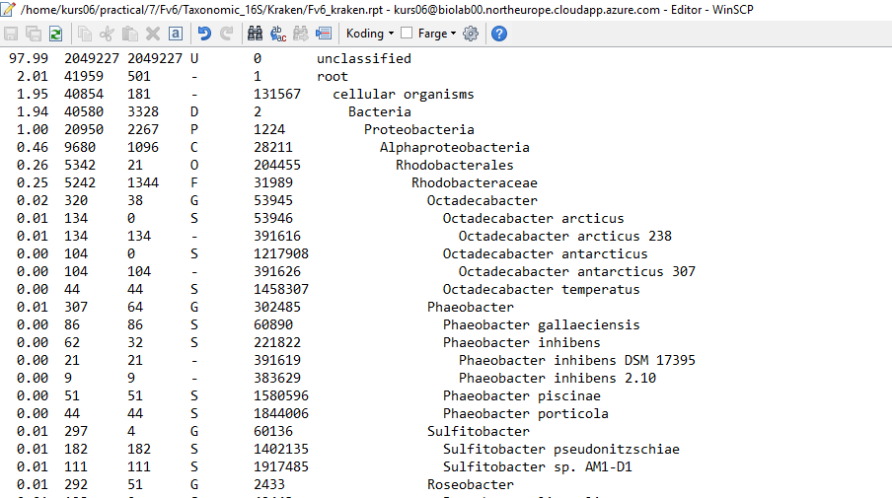
Taxonomic classification using reads using a k-mer based method
v
v

Slide 14
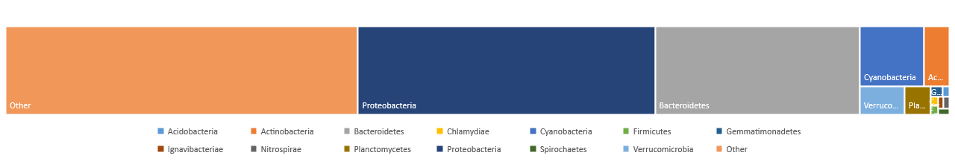
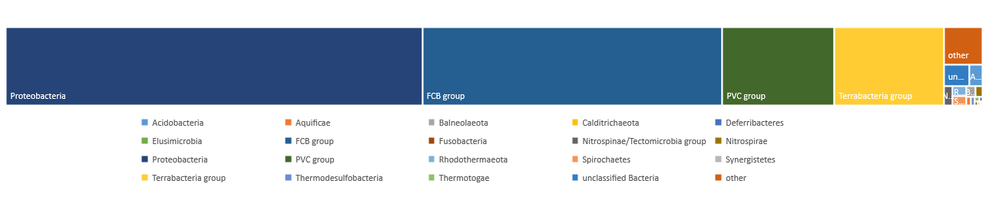
Comparison of the community assemblage observed between methods
16S RNA

Slide 15
Describe the taxonomic composition
of this environment with forming bins

Slide 16
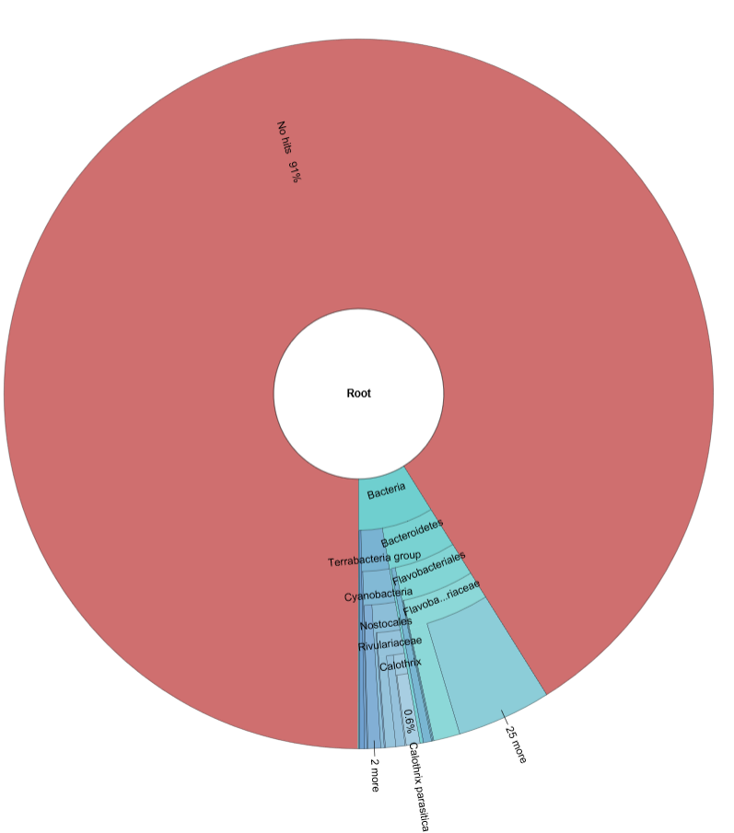
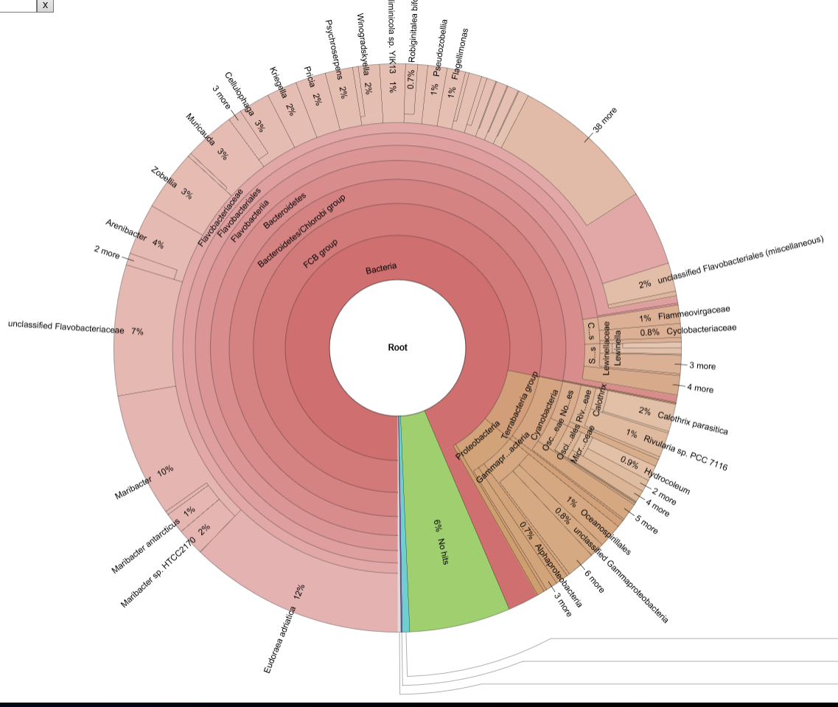
Taxonomy of most complete bin
Kraken
Kaiju

Slide 17
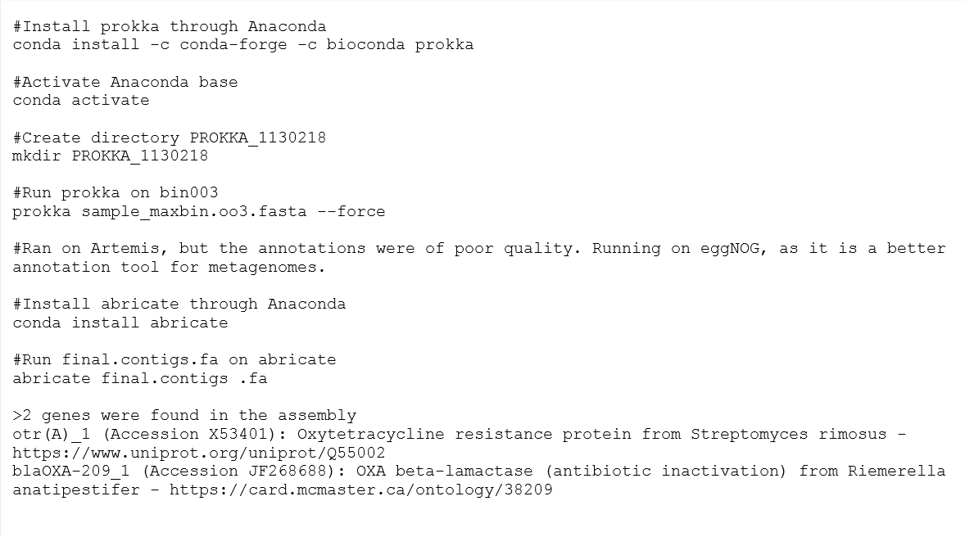
2. Perform functional analysis of the most complete
genome in the sample

