Slide 1
Group 3 - Fv5
4.2 million reads (2.1 megaread-pairs)
Contigs
  5742 > 1000 bases
  7.3 megabases in total
  Longest: 5568 bases
Binning
  5 bins
  Best bin:
    67.5% complete
    2.85 Mbp

Slide 2
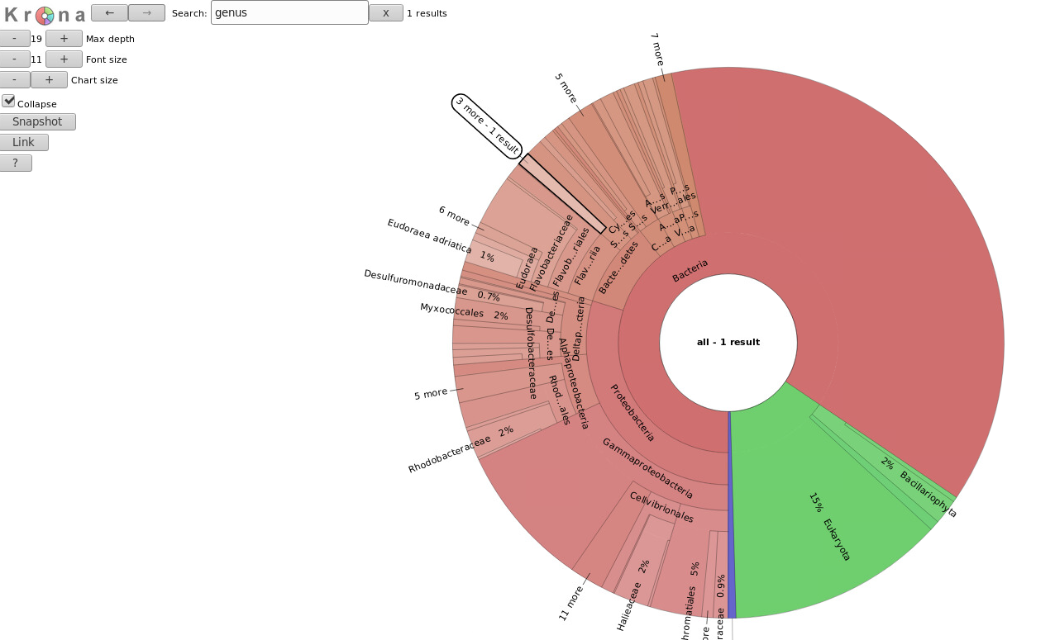

Slide 3
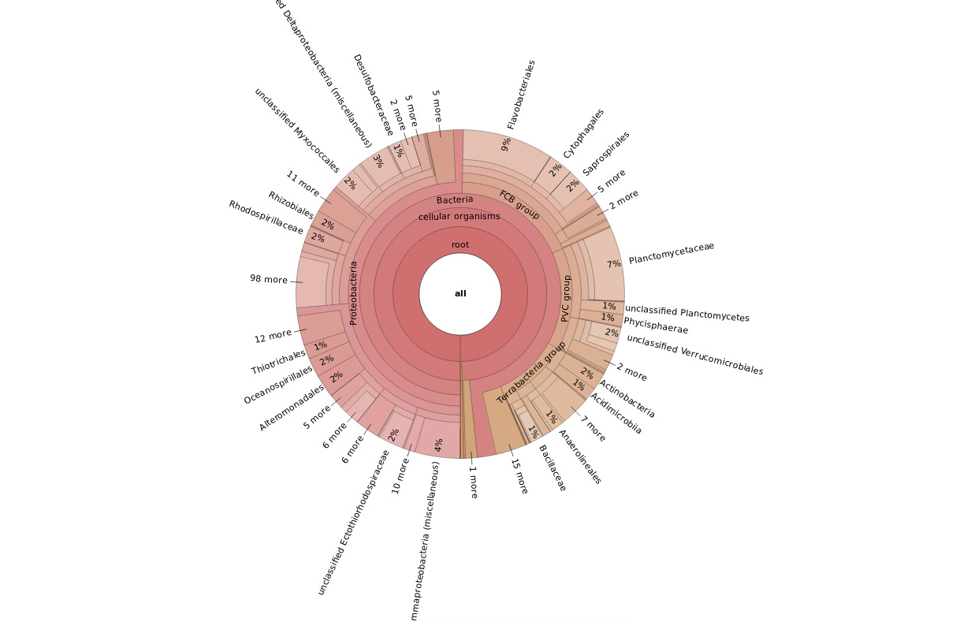

Slide 4
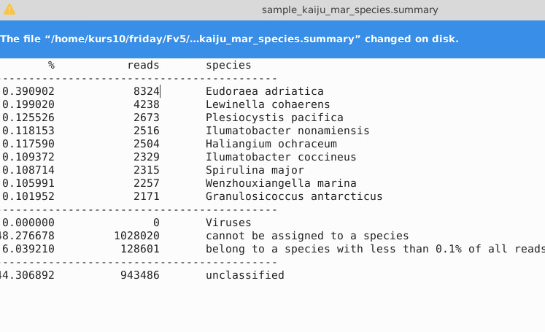

Slide 5
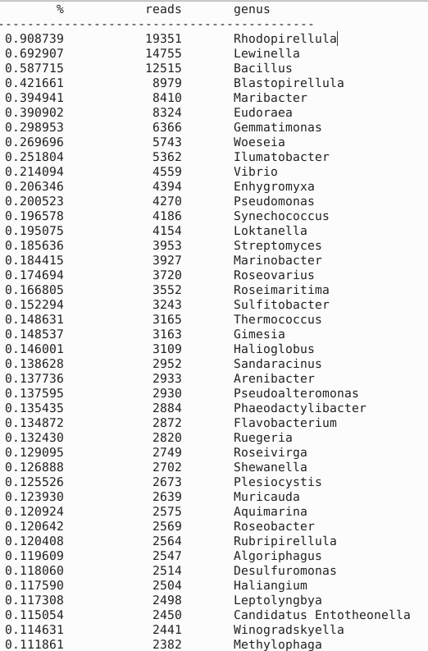

Slide 6
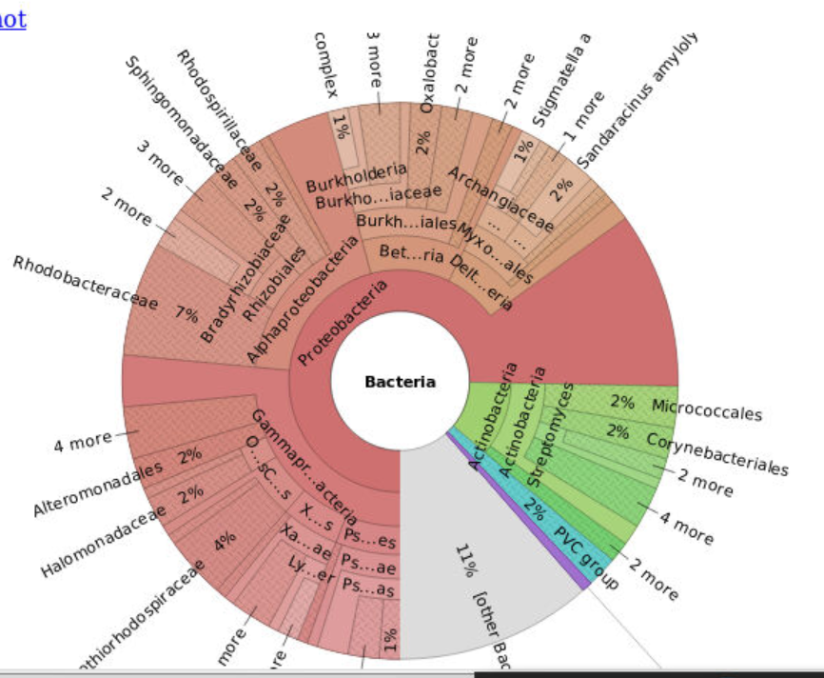

Slide 7
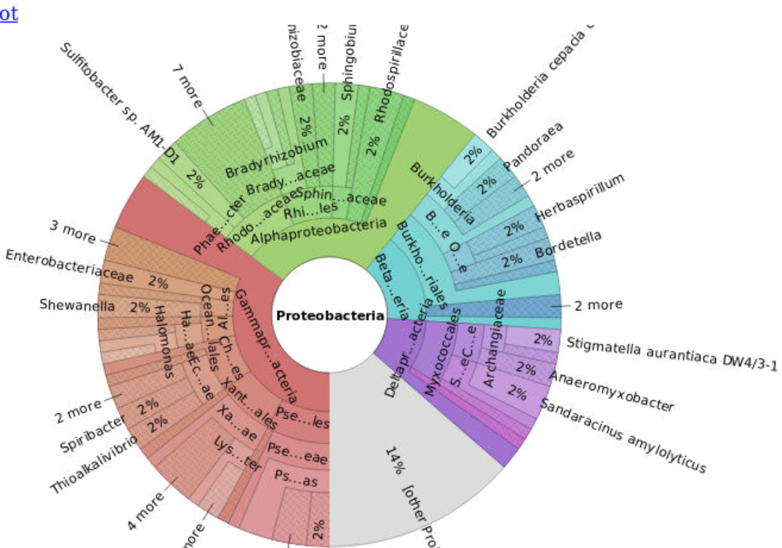

Slide 8
Functional genes
3638 predicted genes (prokka)
  2661 hypothetical protein
We found 1 antimicrobial resistance gene
  Otr(A)_1

