Slide 1
Plant Data Analysis & Visualisation Bundle
ELIXIR Increasing Implementation Study

Slide 2
Agenda
Short overview of the bundle | Kristina GrudenNational Institute of Biology, Slovenia
Technical background and practical use of knowledge graphs
KnetMiner | Keywan Hassani-Pak ^{Rothamsted Research, UK}
AgroLD | Pierre Larmande University of Montpellier / South Green Bioinformatics Platform, France
SKM | Carissa Bleker National Institute of Biology, Slovenia
FAIDARE | Carissa Bleker on behalf of Cyril Pommier Université Paris-Saclay, INRAE, URGI, France
Break (10 min)
Visualisation of data – technical background and use case
MapMan | Sebastian Beier Forschungszentrum Jülich GmbH, Germany
DiNAR | Maja Zagorščak National Institute of Biology, Slovenia
Integrated pipeline use case | Kristina Gruden National Institute of Biology, Slovenia
Discussion

Slide 3
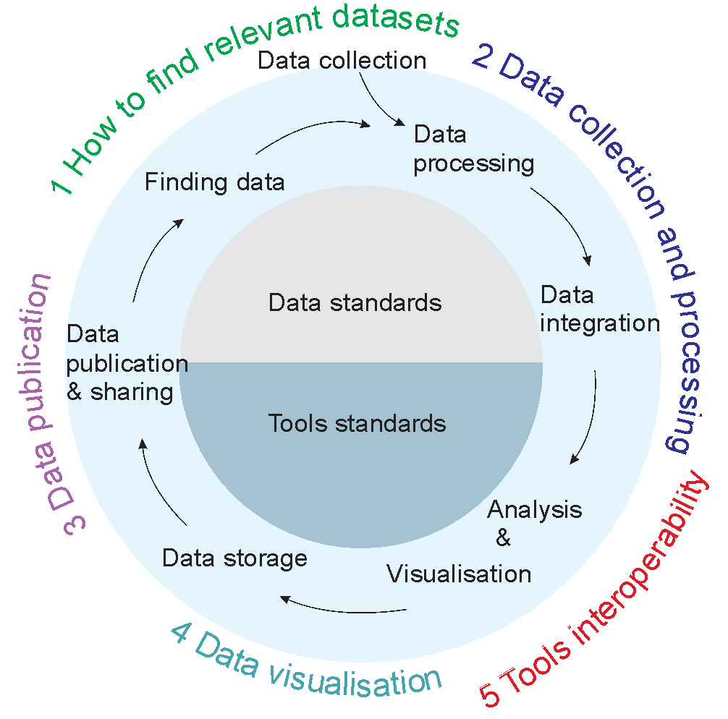
ELIXIR Plant Sciences Community
RoadMap 2019-2023
Implementation study organised to help bridge the gaps - INCREASING
These workshops are the final cornerstone

Slide 4
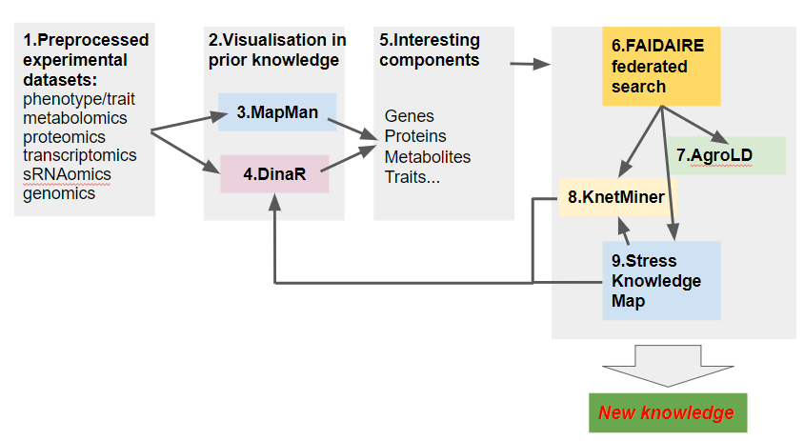
Plant Data Analysis & Visualisation bundle
Set of linked tools
all registered on bio.tools
integrated user manual available at PlantDataAnalysisVisualisationBundle - Google Docs
the workshop materials will be registered on TeSS
link to the video sent also via email to registered participants

Slide 5
Agenda
Short overview of the bundle | Kristina GrudenNational Institute of Biology, Slovenia
Technical background and practical use of knowledge graphs
KnetMiner | Keywan Hassani-Pak ^{Rothamsted Research, UK}
AgroLD | Pierre Larmande University of Montpellier / South Green Bioinformatics Platform, France
SKM | Carissa Bleker National Institute of Biology, Slovenia
FAIDARE | Carissa Bleker on behalf of Cyril Pommier Université Paris-Saclay, INRAE, URGI, France
Break (10 min)
Visualisation of data – technical background and use case
MapMan | Sebastian Beier Forschungszentrum Jülich GmbH, Germany
DiNAR | Maja Zagorščak National Institute of Biology, Slovenia
Integrated pipeline use case | Kristina Gruden National Institute of Biology, Slovenia
Discussion

Slide 6
KnetMiner

Slide 7
What is KnetMiner?
Knowledge Graph-based data exploration platform.
Integrates biological and agricultural datasets.
Enables interactive exploration and discovery.
Supports decision-making in research and development.
Hassani-Pak et al., 2021
https://onlinelibrary.wiley.com/doi/10.1111/pbi.13583

Slide 8
What is KnetMiner?
Knowledge Graph-based data exploration platform.
Integrates biological and agricultural datasets.
Enables interactive exploration and discovery.
Supports decision-making in research and development.
Complete KnetMiner presentation linked here:
https://drive.google.com/file/d/19Xo7P7q8PGObSWlPfvnmMnC2ZLSmMVdy/

Slide 9
AgroLD
Dr. Pierre LARMANDE
French Institute of Research for Sustainable Development - IRD

Slide 10
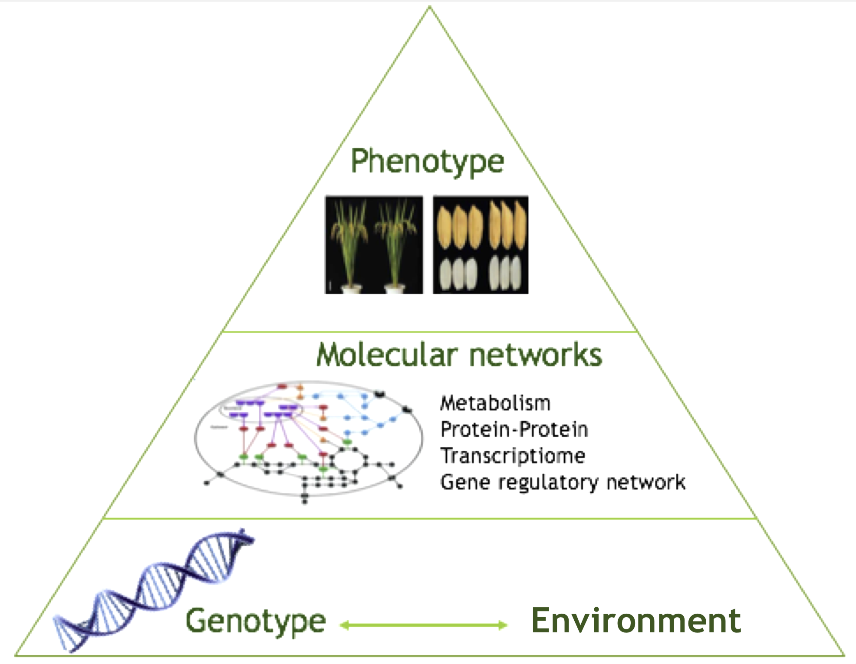
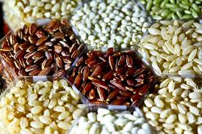
Genotype - Phenotype interactions
Understanding molecular mechanisms controlling phenotypes
What are Key Genes for plant adaptation to climate changes ?
How these Genes interacts together to control phenotype ?

Slide 11
Data particularities
Complex networks
Big Data
Heterogenous, incomplete, distributed, multi-scales

Slide 12
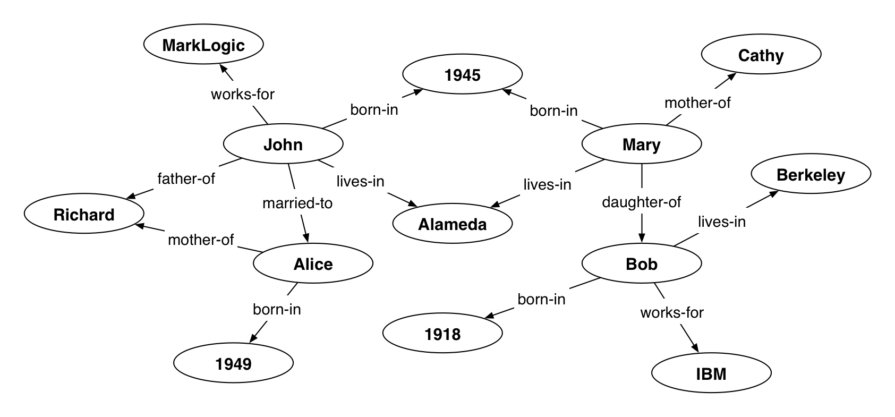
AgroLD uses Semantic Web
RDF Triple
RDF Graph
Source: https://jp.marklogic.com/blog/making-new-connections-ml-semantics

Slide 13
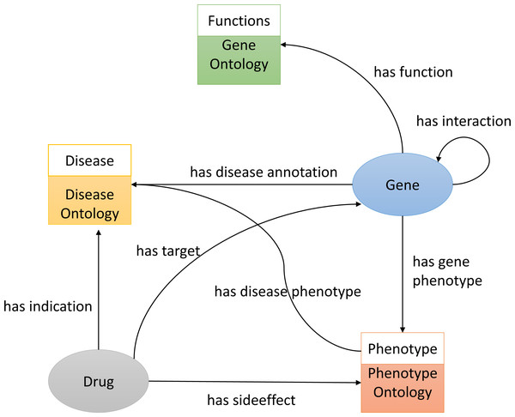
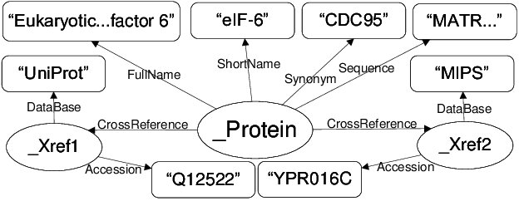
Semantic Web (2)
Data are linked with ontologies
Source:https://espace.library.uq.edu.au/view/UQ:188605
https://peerj.com/articles/13061/

Slide 14
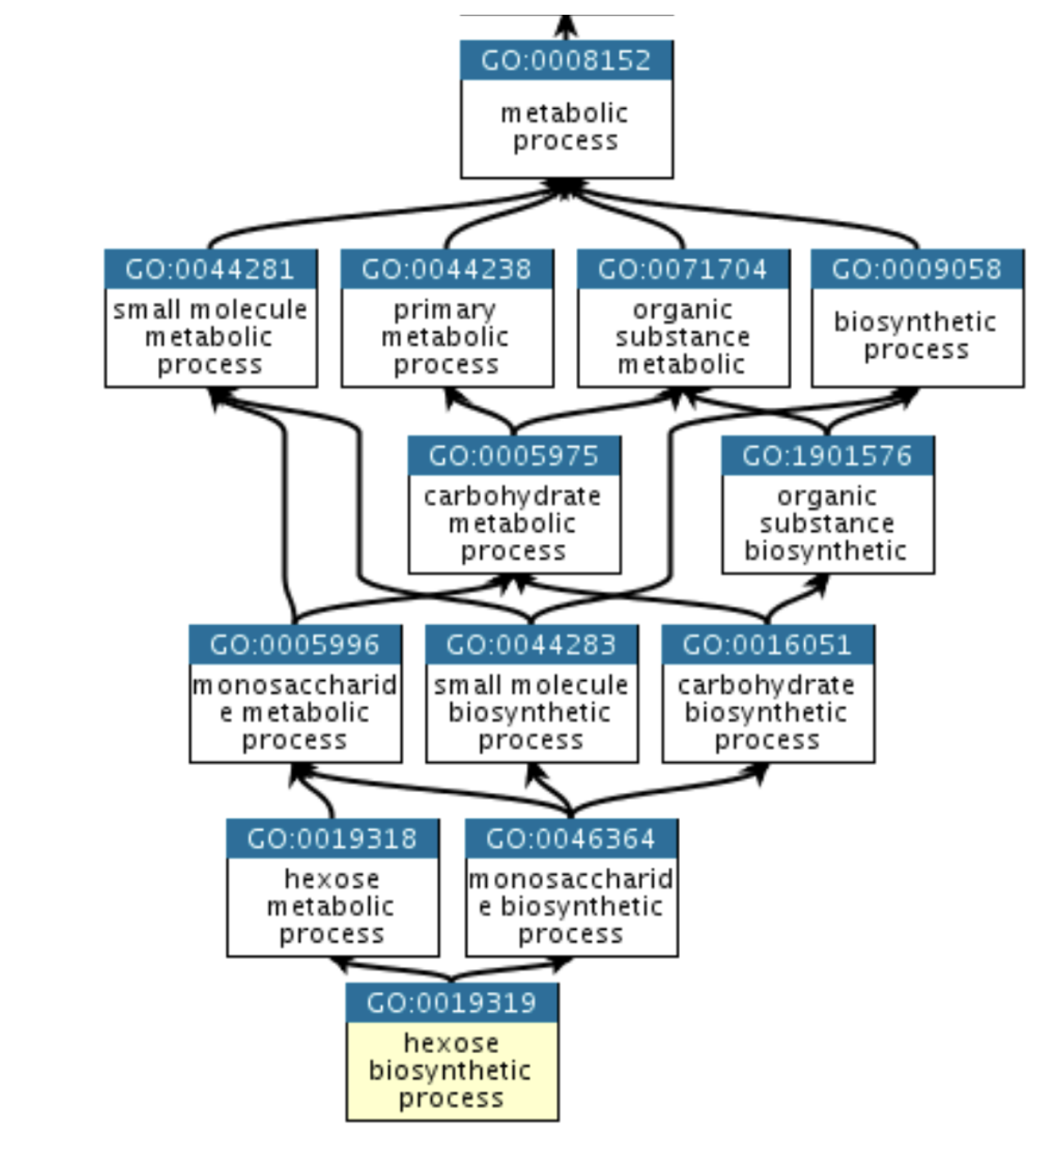
Ontologies are structured domain knowledge
Semantic annotation
Data integration
Reasoning
Classification
Enrichment
The Gene Ontology Graph (http://geneontology.org)

Slide 15
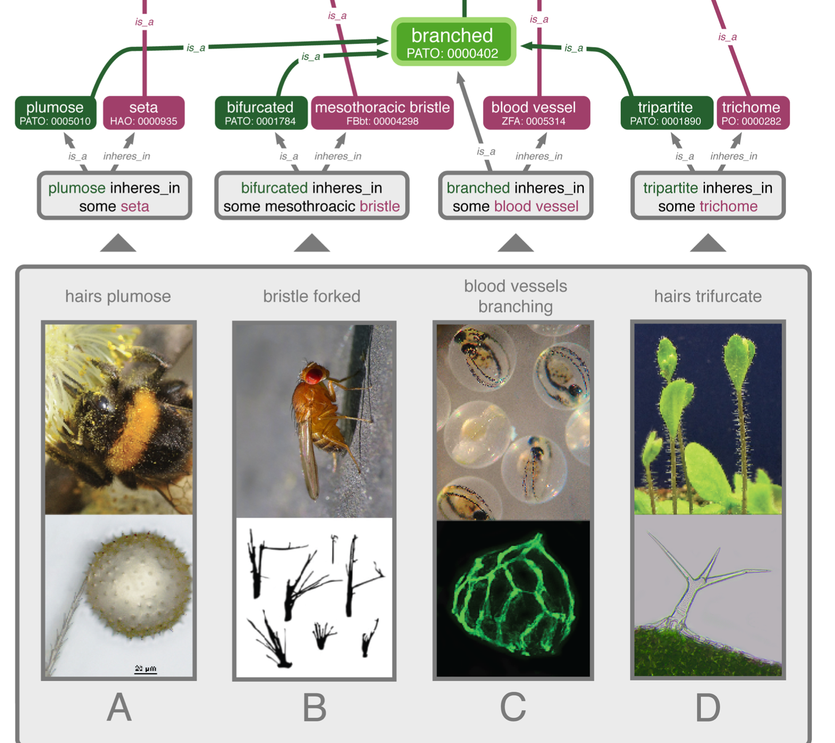
Using ontologies to compare phenotype data across species
Retrieve key genes involved
Functional comparisons
at the trait level
at the genetic level
Deans et al. 2015. Plos Biol

Slide 16
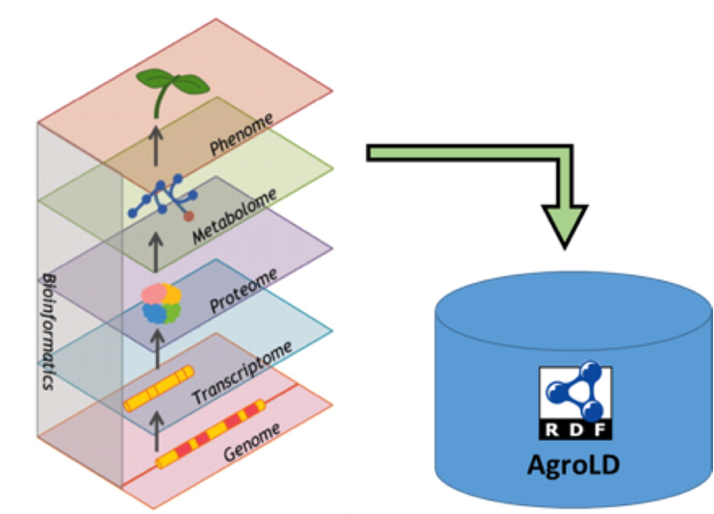
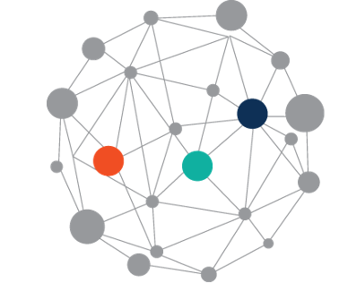
AgroLD : knowledge graph for plant molecular interactions
Problematic
multi-scale data integration on heterogeneous data
Answer complex biological questions
Develop user-friendly access to knowledge graph
Aims
Improve gene functional annotations
Reveal genotype-phenotype interactions
Help in variants/genes prioritisation
Larmande et al, 2022, SPRINGER book in bioinformatics
Larmande et al, 2021, ISWC proceedings
Venkatesan et al, 2017, PLOS ONE
Tagny et al, 2016, Ingénierie des Systèmes d’Information

Slide 17
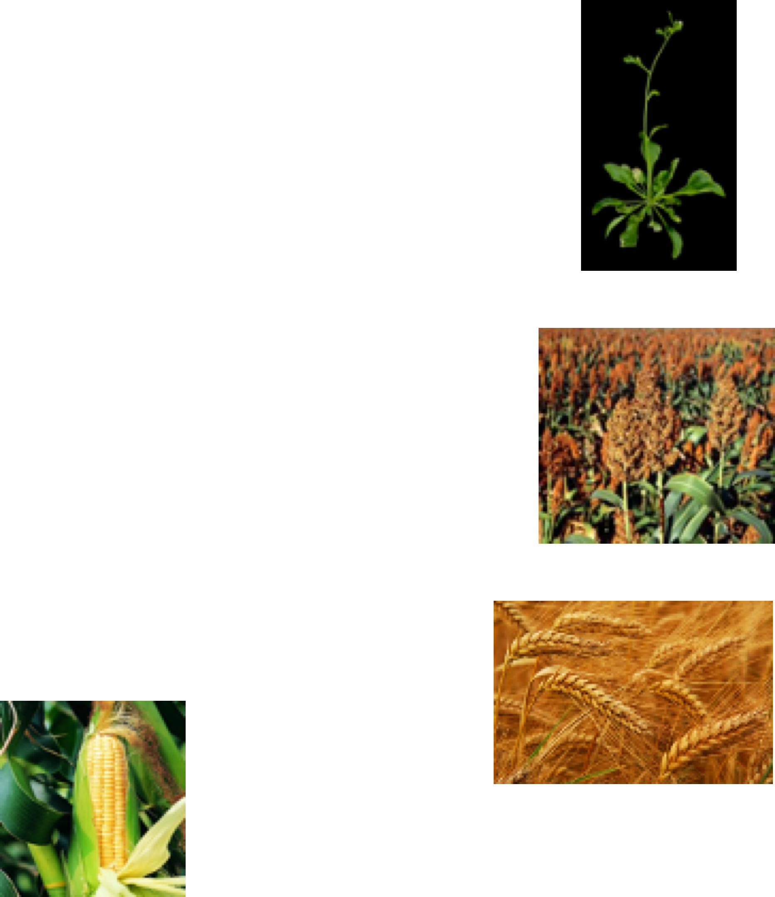
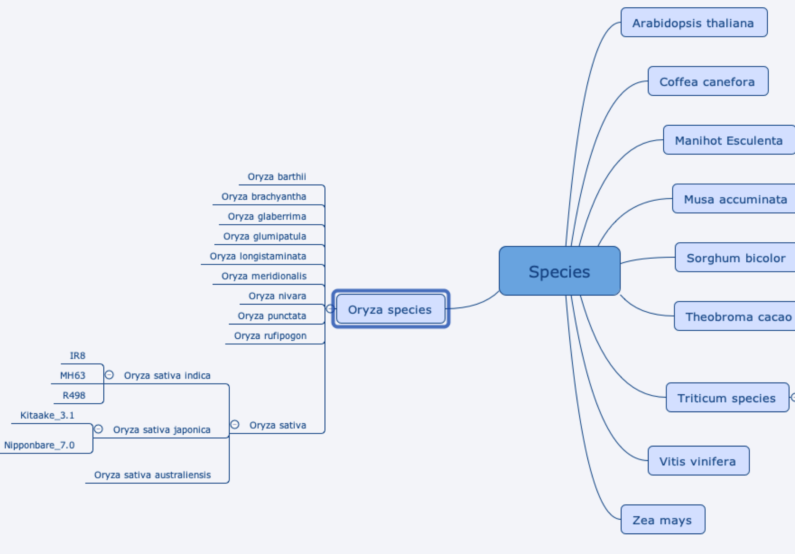
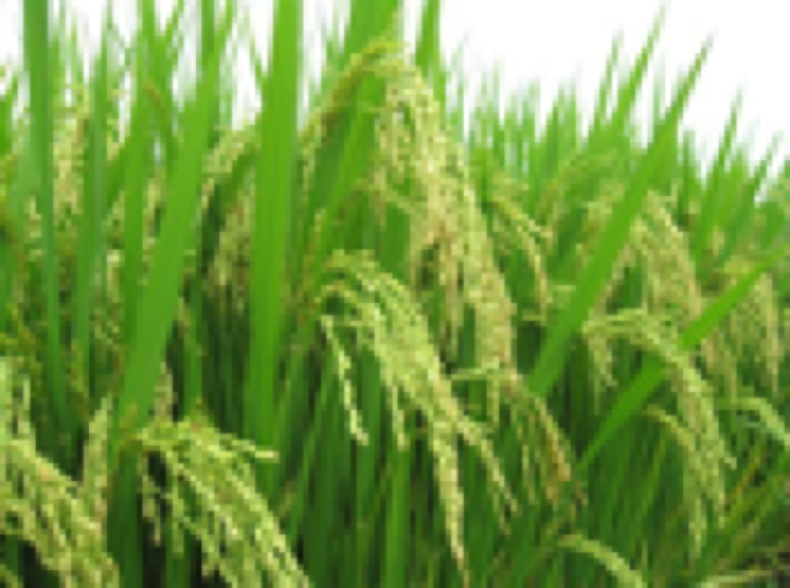
Available Species

Slide 18
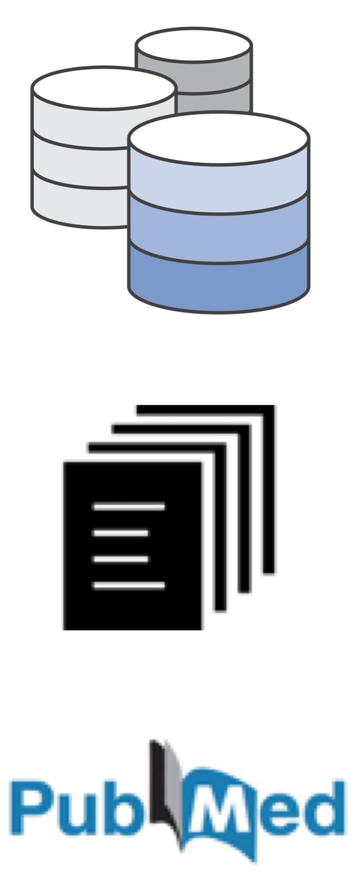
Data sources and data types
Databases
Data standards
12 tropical crop species
100 datasets integrated from 15 public databases
~ 930 Millions de triples
~ 335 Downloads (2023)
~ 50 users / month (2023)
~ 20 citations
Articles

Slide 20
www.agrold.org

Slide 21
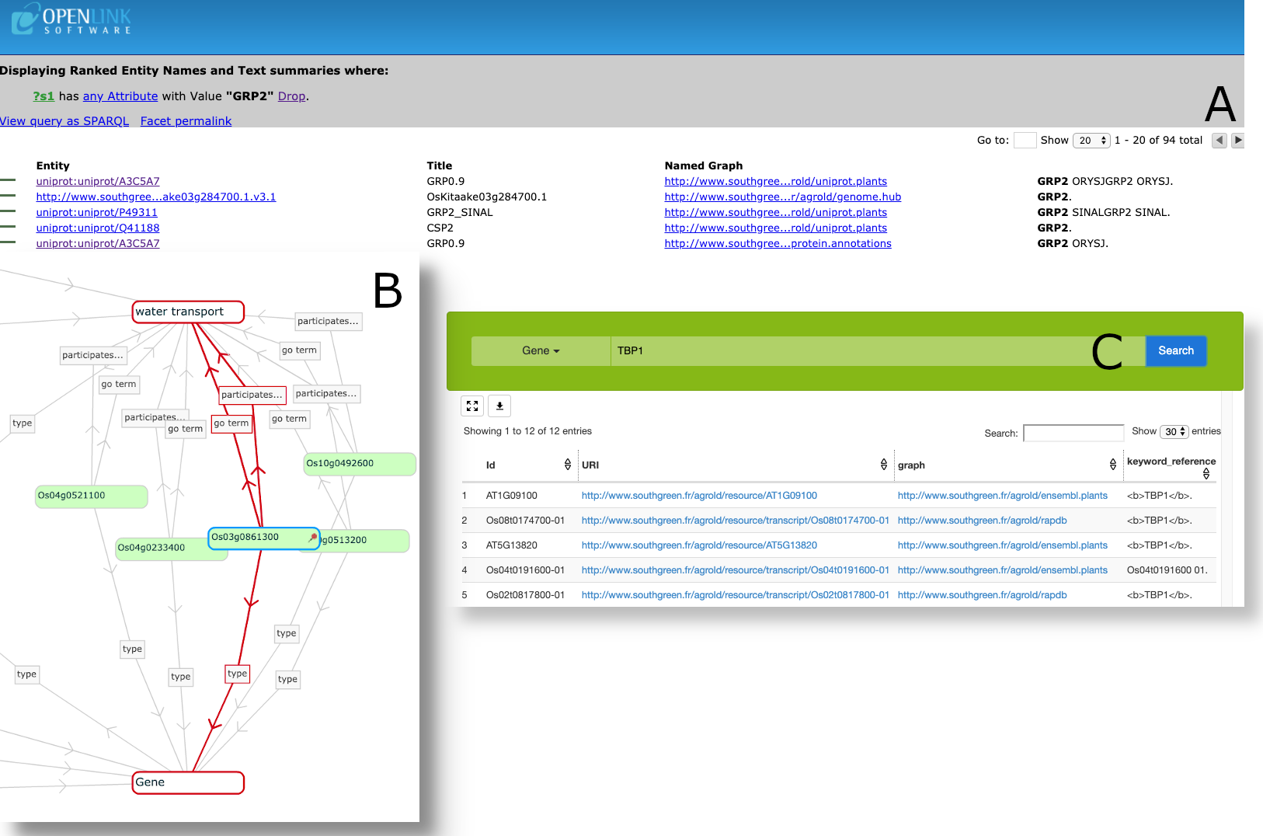
Query engine and visualisation

Slide 22
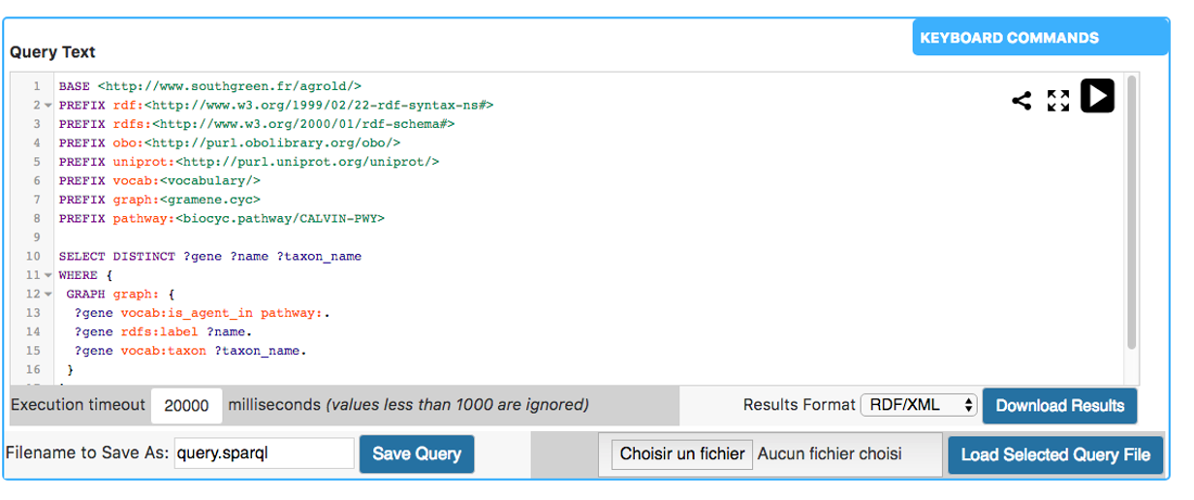
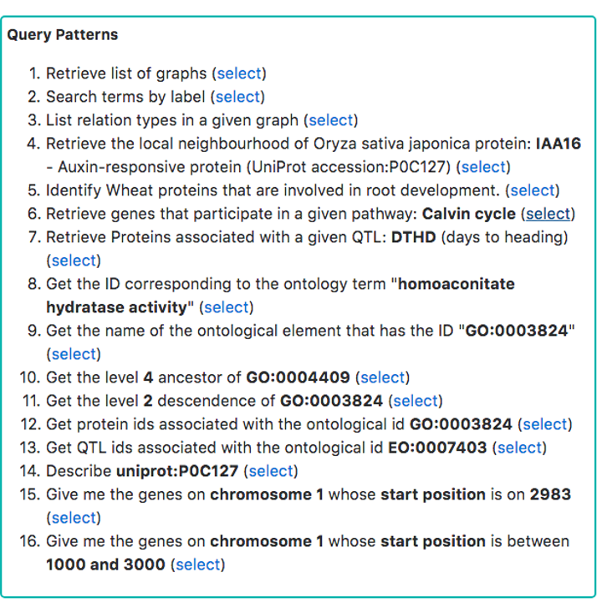
Sparql query editor

Slide 23
Acknowledgements
Mikael Lucas
Bill Happi Yann Pomie Julien Pascual
Quan Do
Cyril Pommier
Clement Jonquet
Raphael Flores
Francois Scharffe
Jerome Azé
Konstantin Todorov
Ensie Raoufi
Guilhem Sempere
Manuel Ruiz

Slide 24
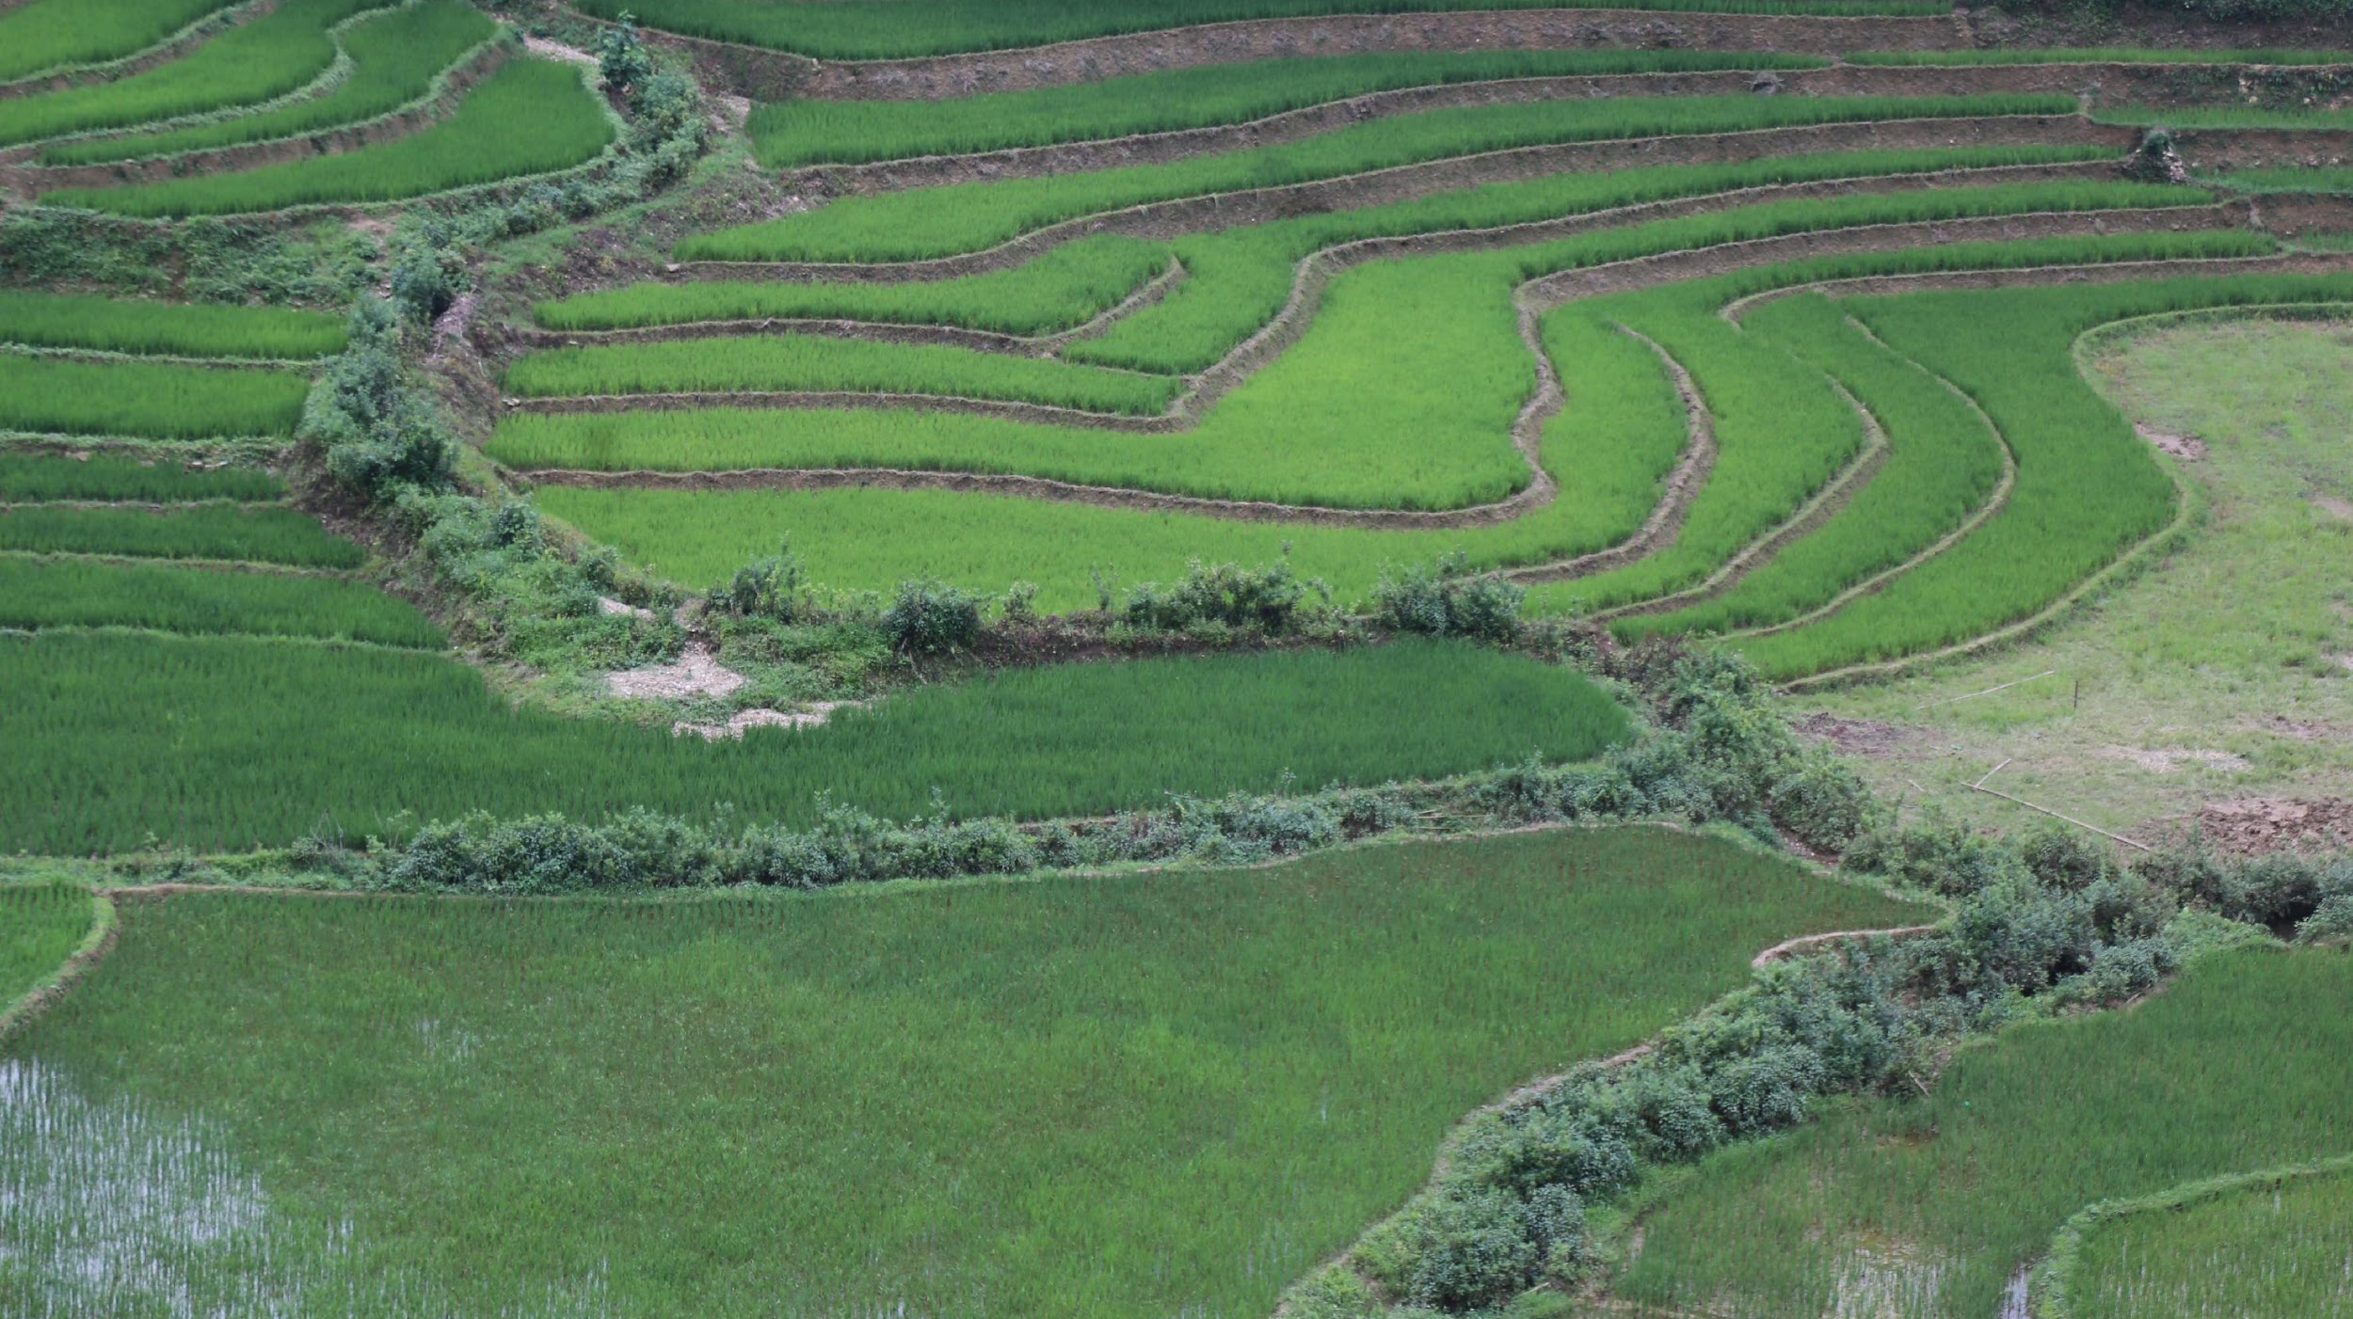
Thanks for your attention

Slide 25
SKM
Stress Knowledge Map

Slide 26
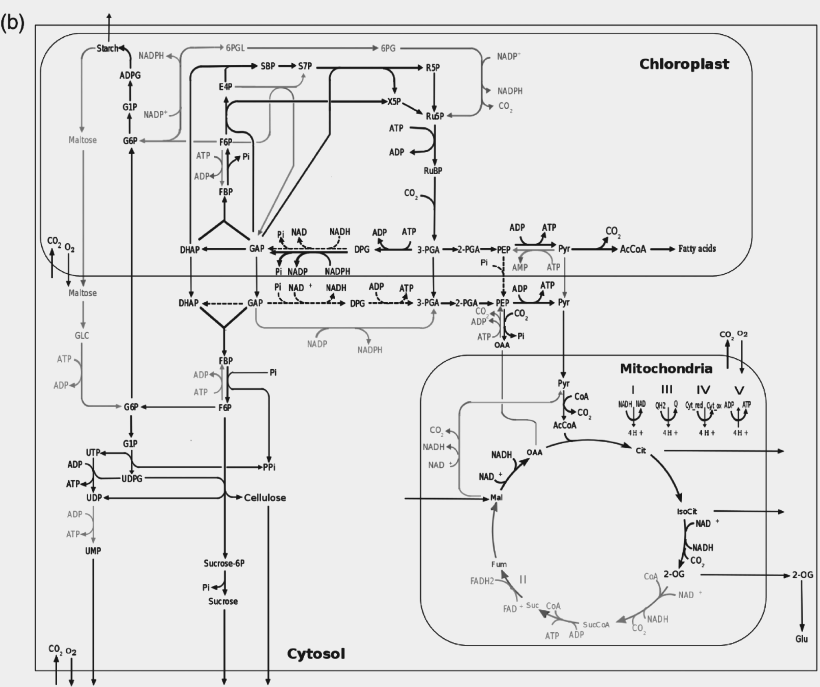
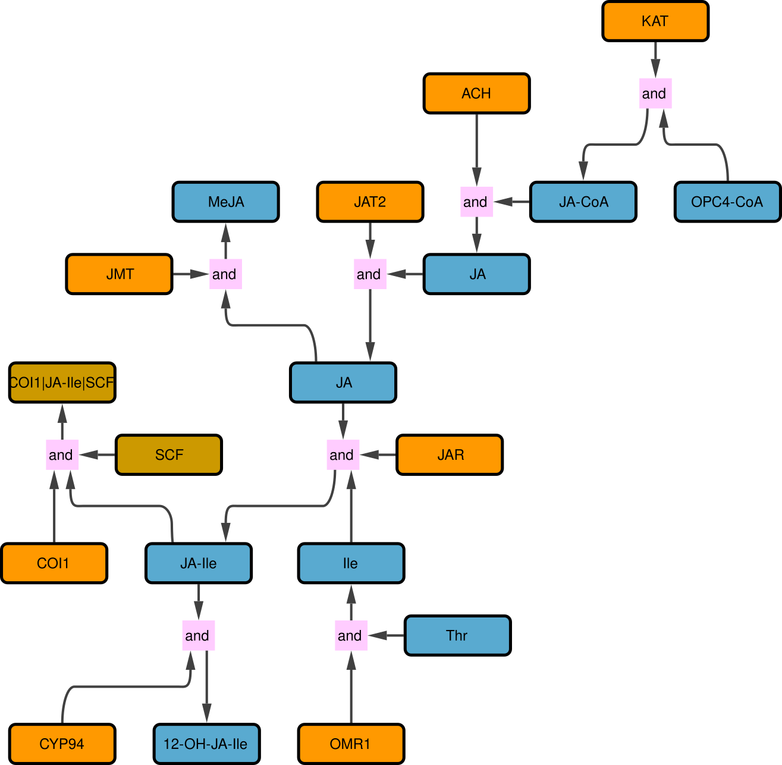
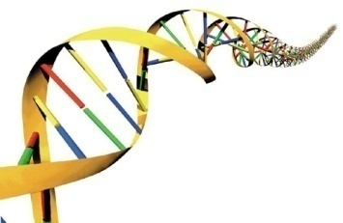
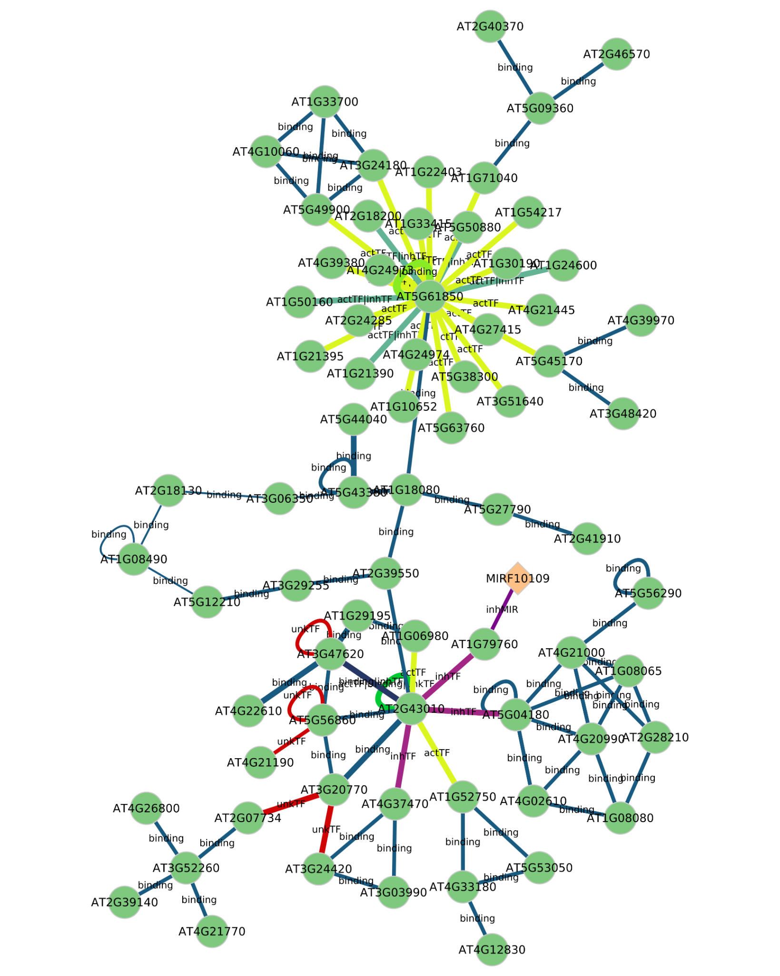
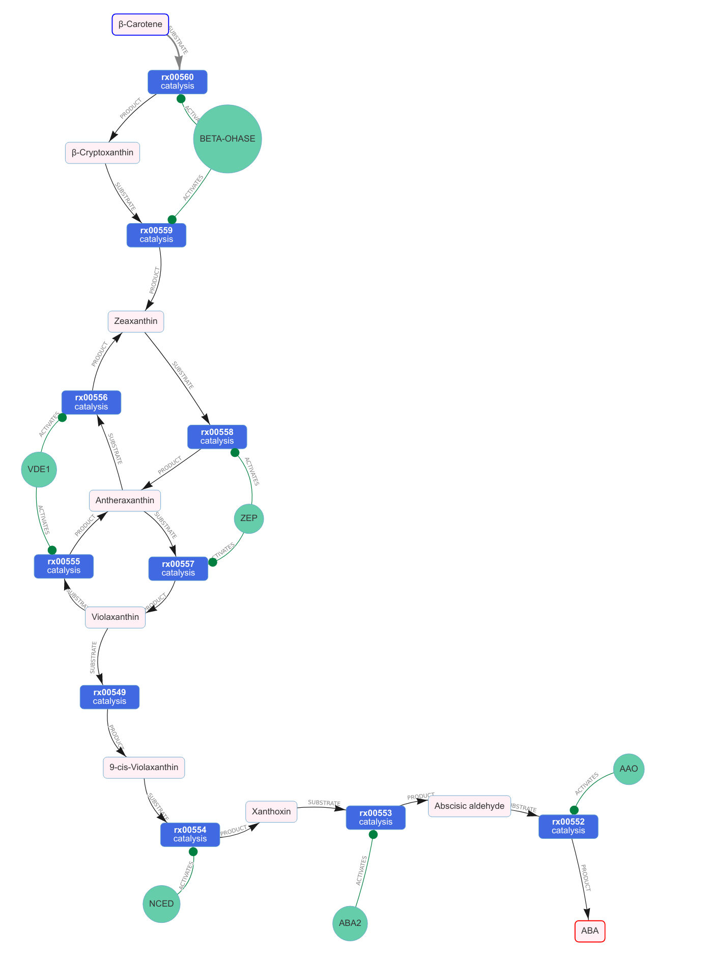
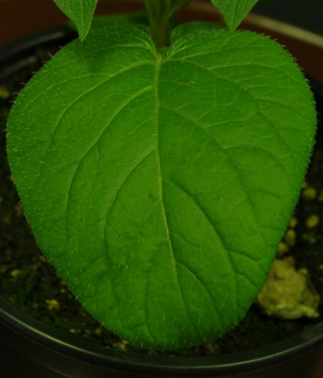
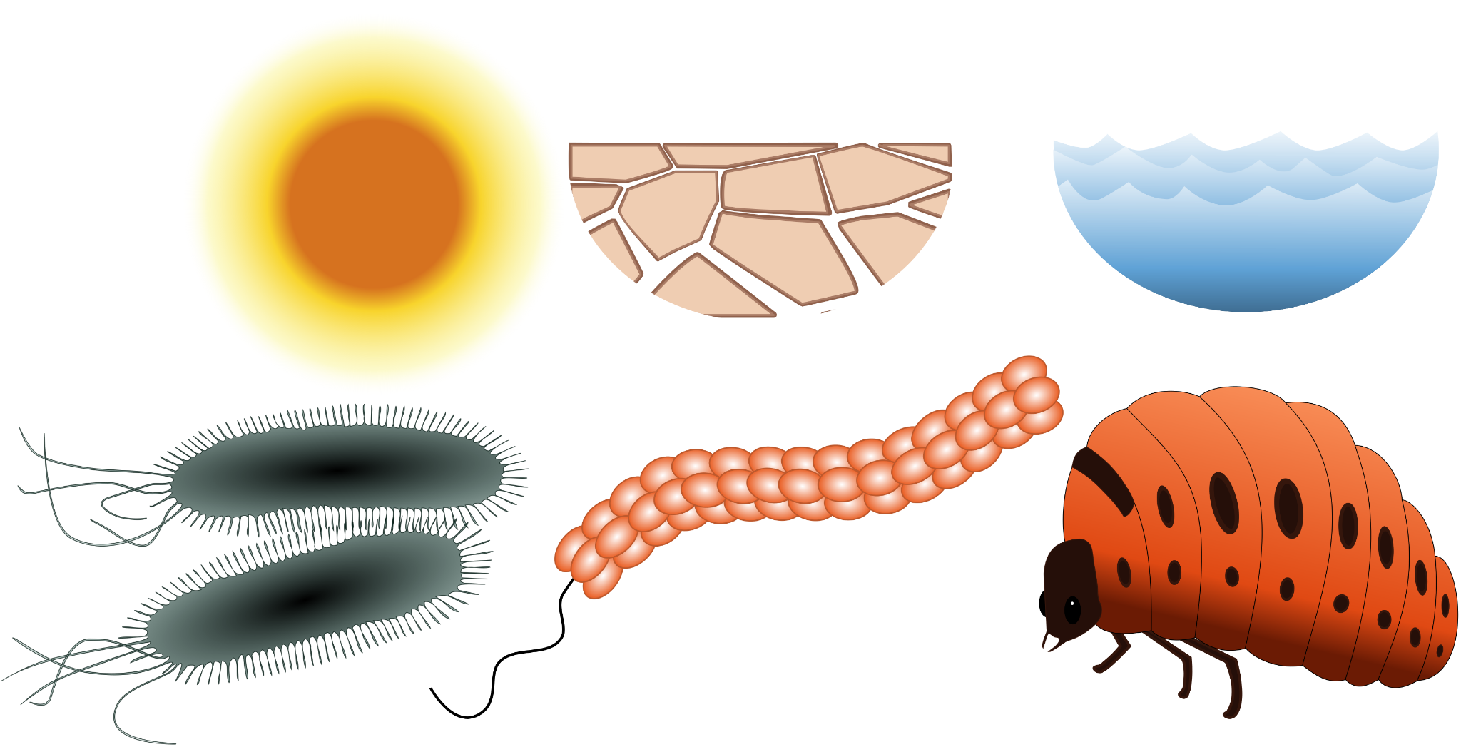
Purpose - determining the molecular interactions behind observed phenotypes
Genotype
X
Environment
Phenotype

Slide 27
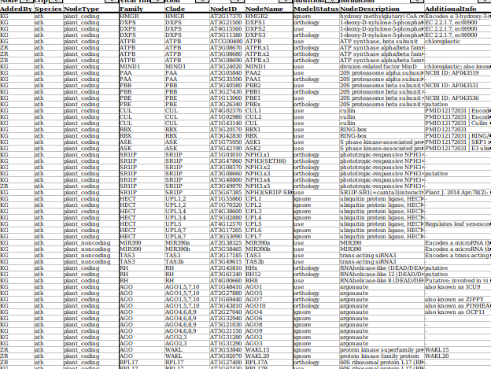
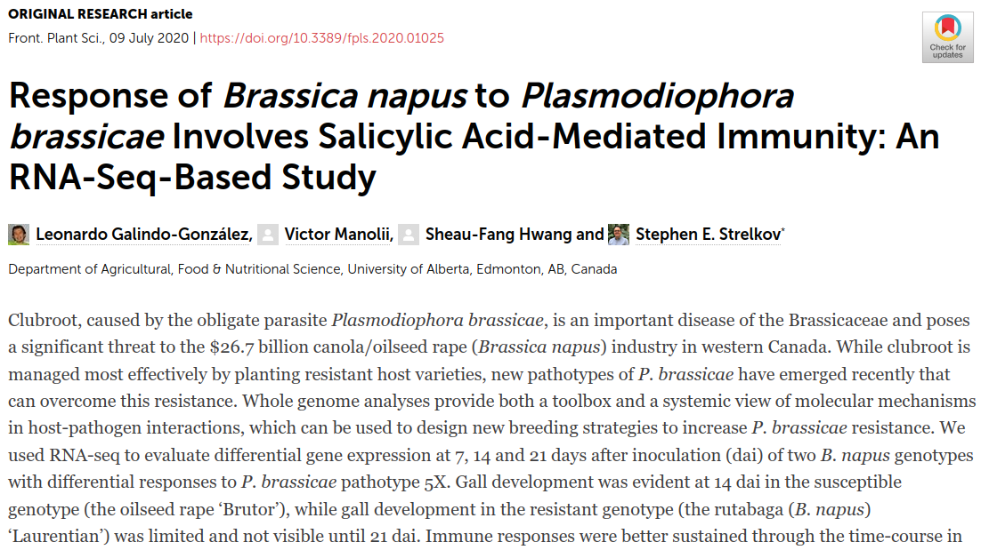
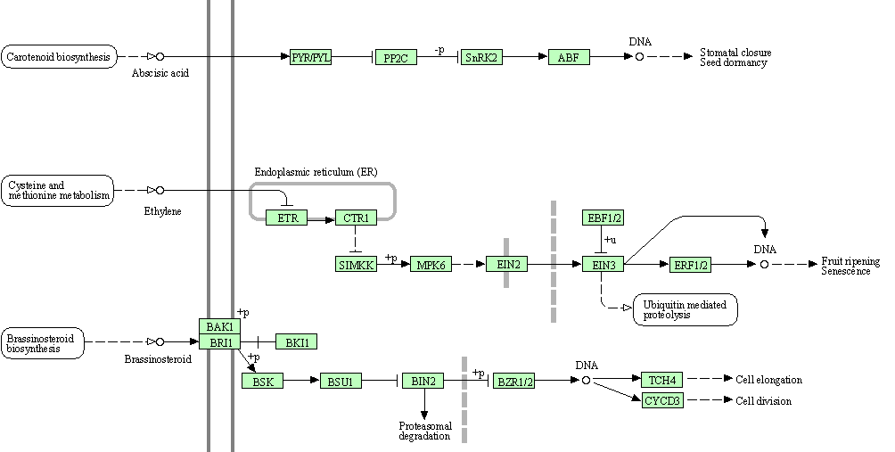
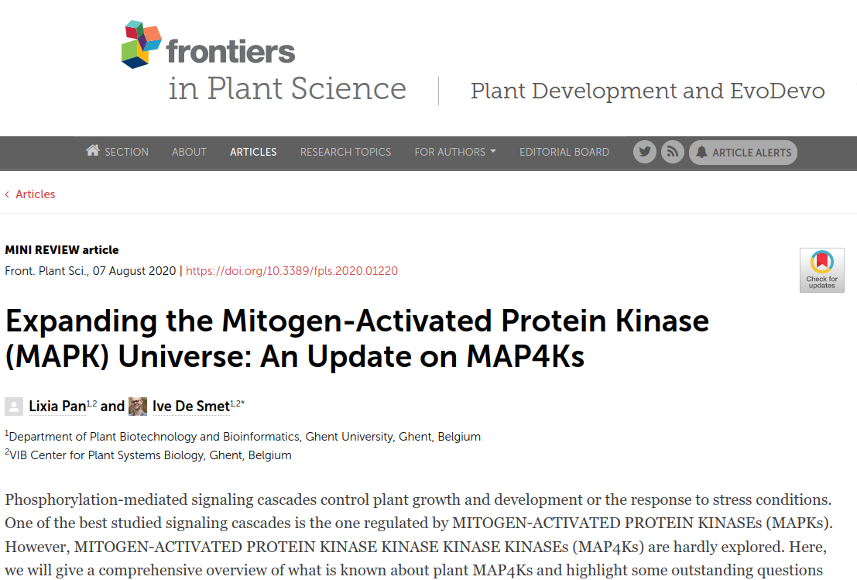
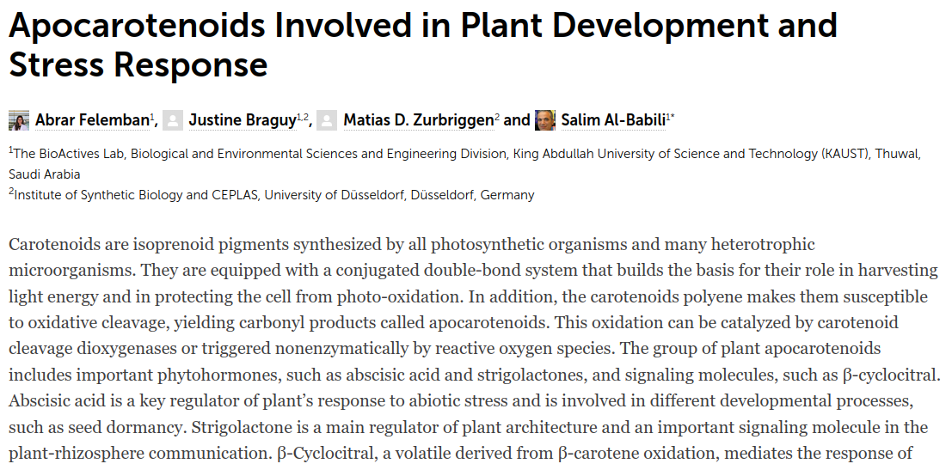
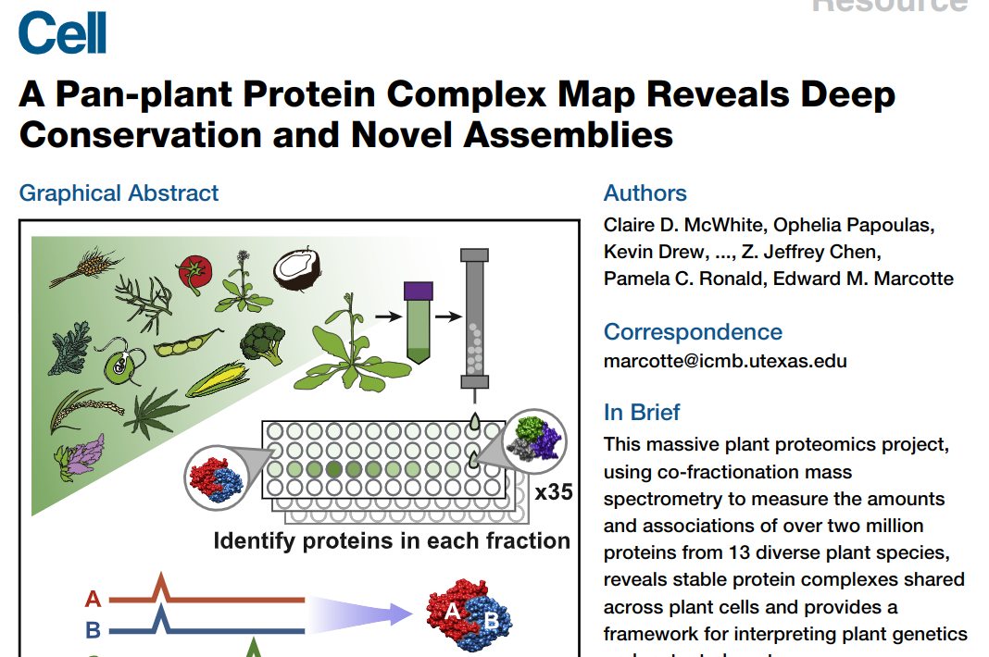
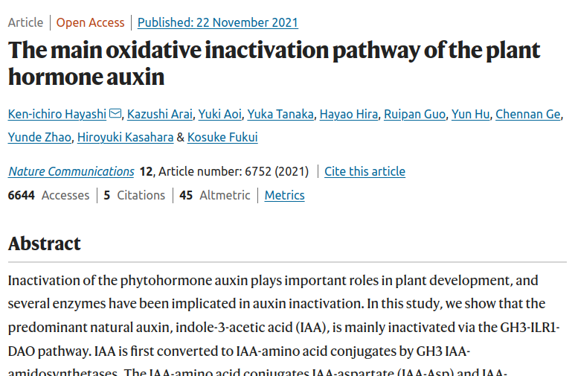
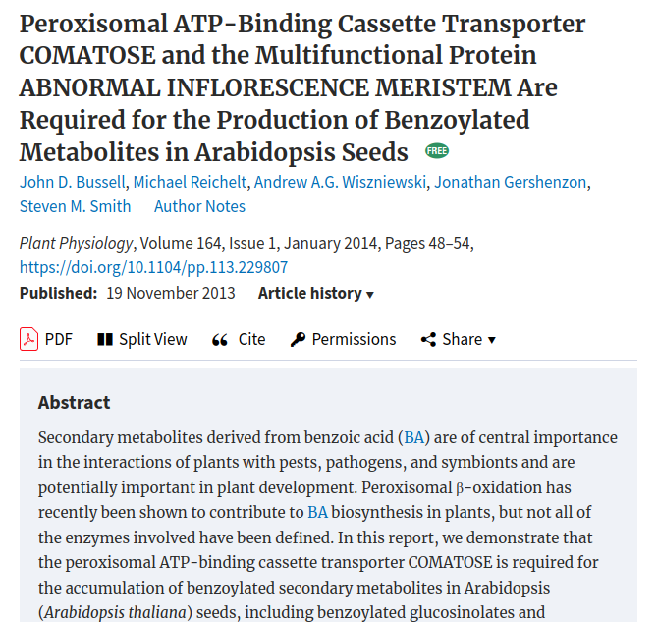
Sources of SKM resources
Interactions compiled by experts
Databases – KEGG, AraCyc, MetaCyc, String, IntAct, miRTarBase, etc …
Literature – published articles and results
Literature – high throughput experiments
…
Notes:
Our knowledge of this network comes from various sources, including tables compiled by experts over many years,
Databases such as KEGG or MetaCyc, and articles about individual interactions and high throughput experiments
This information comes in many different formats and formulations, we have unconnected results, and missing context,
making integrating this knowledge a difficult task.

Slide 28
SKM web application
https://skm.nib.si
SKM is a platform for the integration of knowledge on molecular interactions in plants, including abiotic and biotic stress signalling responses
Contribute
Explore & Visualise
Download

Slide 29
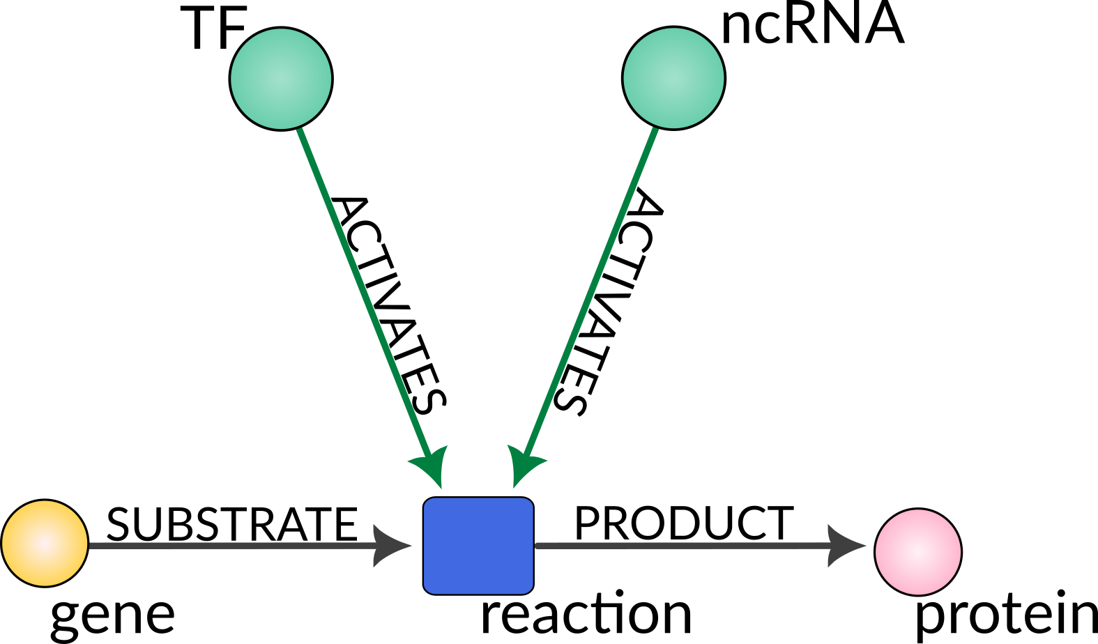
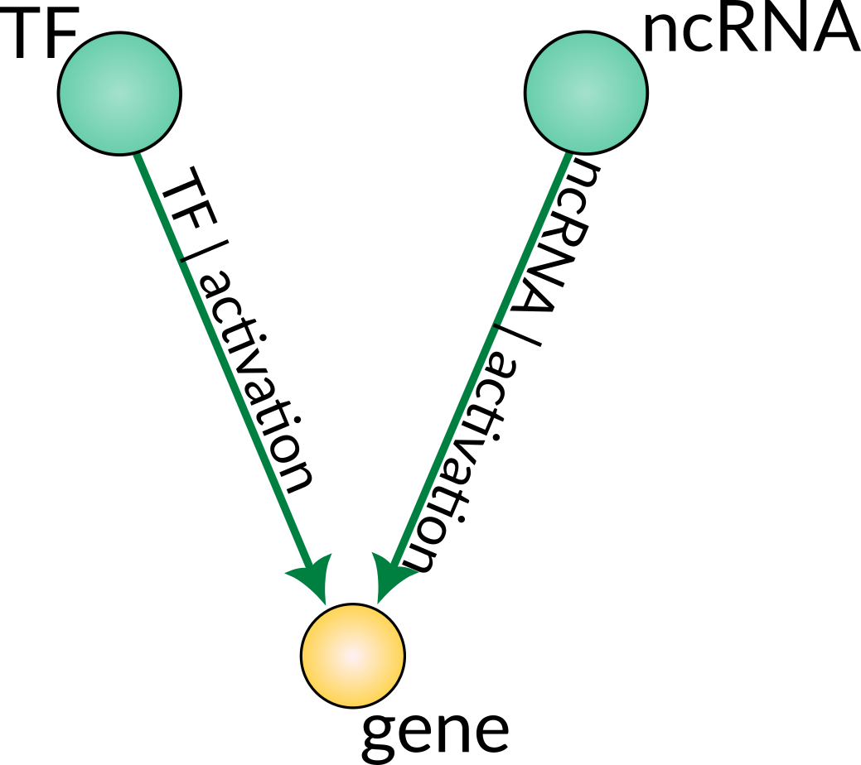
SKM data representation

Slide 30
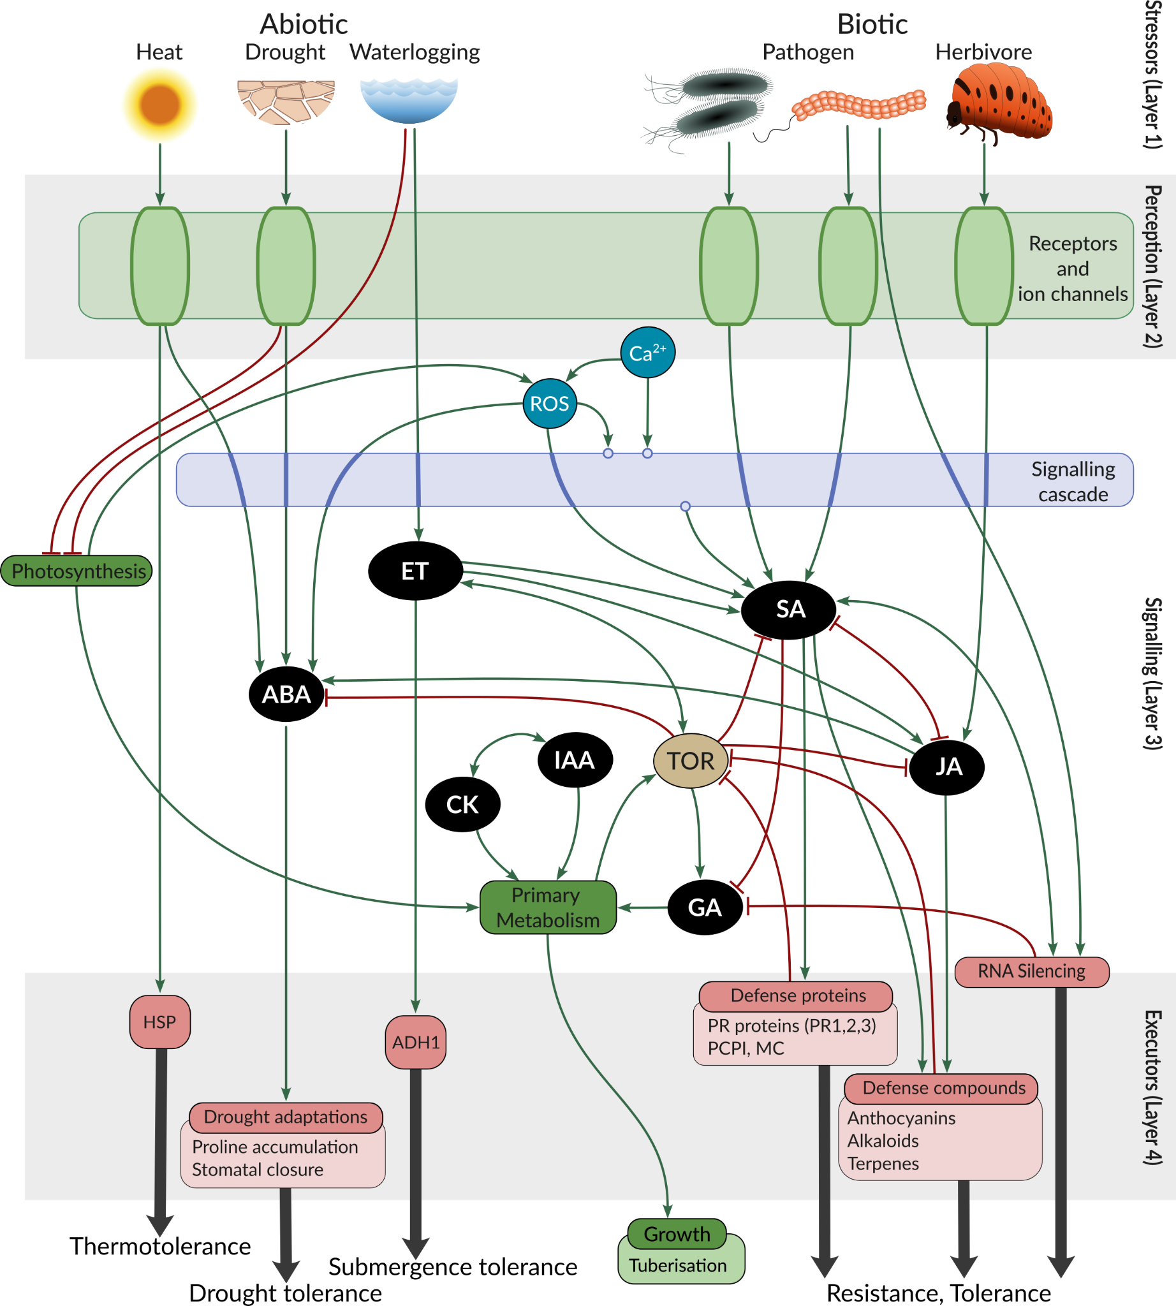
SKM resources: The Plant Stress Signalling model (PSS)
Detailed mechanistic model of plant stress signalling
Manual curation of highly reliable, confirmed (physical) reactions and interactions
~ 1k entities, 3k edges, >500 reactions

Slide 31
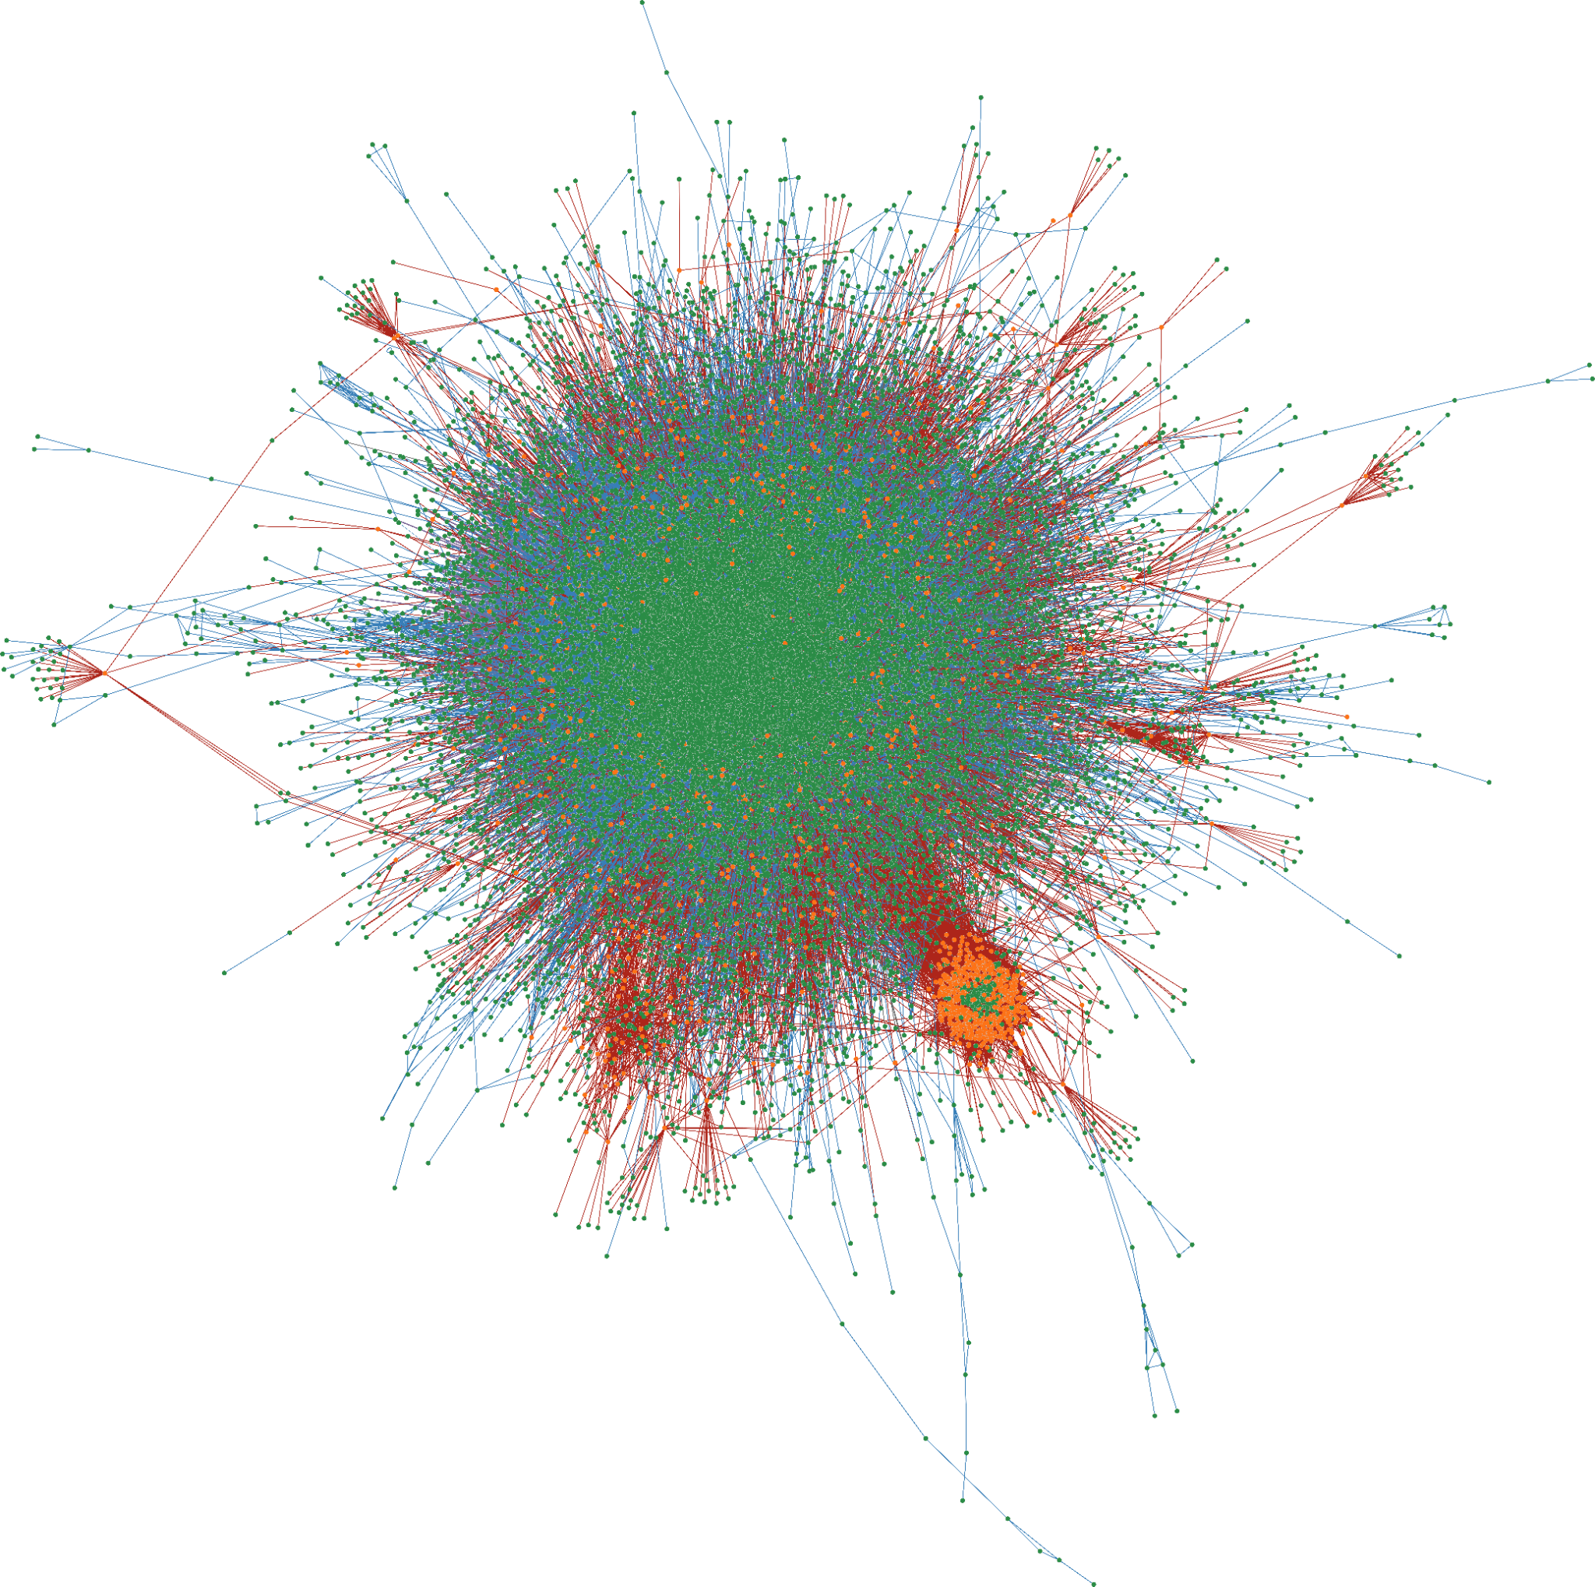
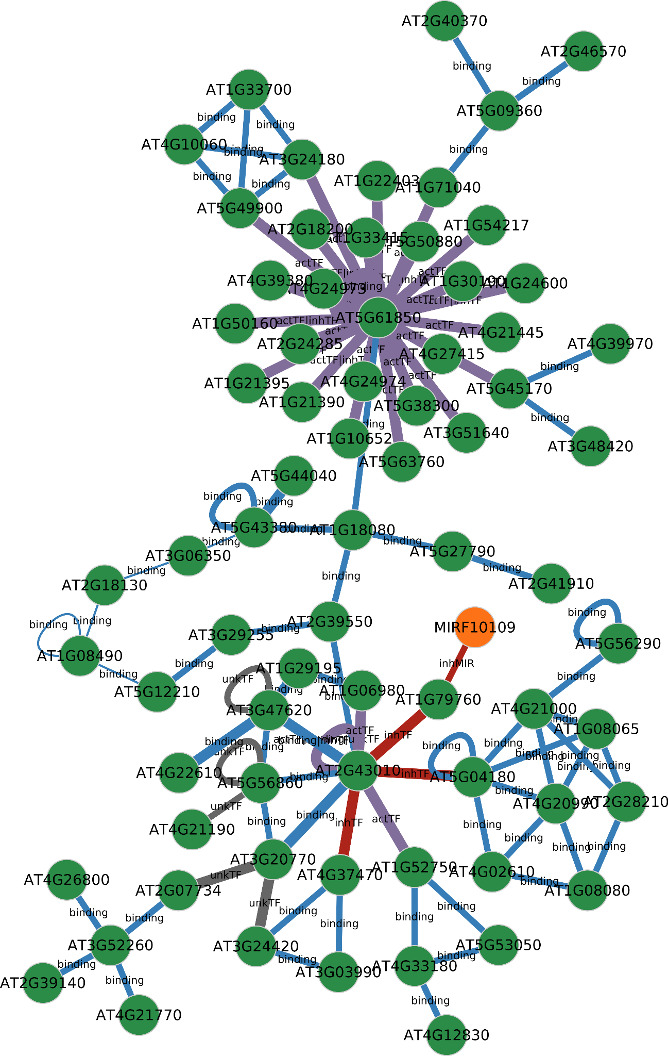
SKM resources: The Arabidopsis Comprehensive Knowledge Network (CKN)
Condition agnostic assembly of current knowledge in Arabidopsis
Diverse knowledge sources combined into a single interaction network
Contains information from high-throughput experiments and knowledge bases
~ 26k entities, 480k connections

Slide 32
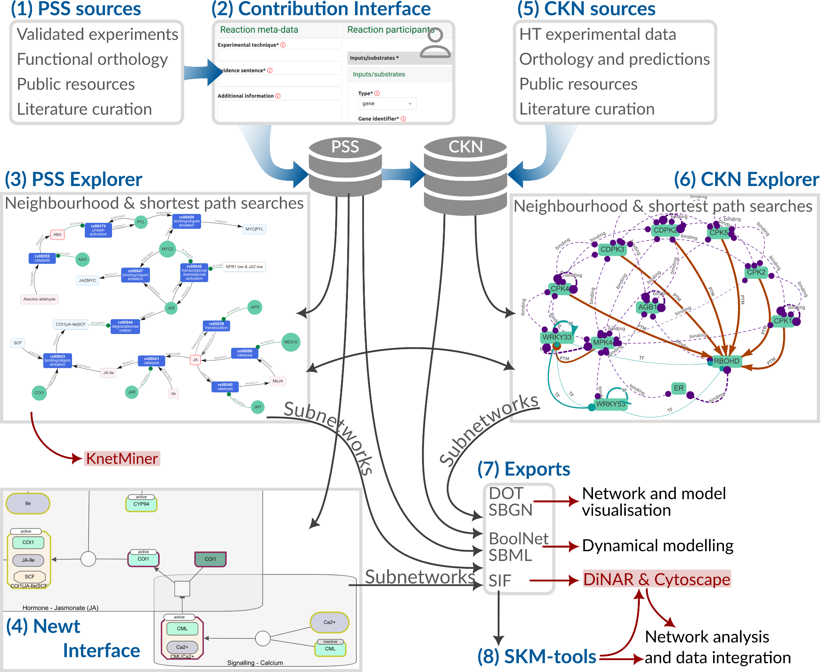
SKM environment
Data provenance & external links:
DOI, PMID, ChEBI, KEGG, AraCyc, GoMapMan, TAIR, KnetMiner

Slide 33
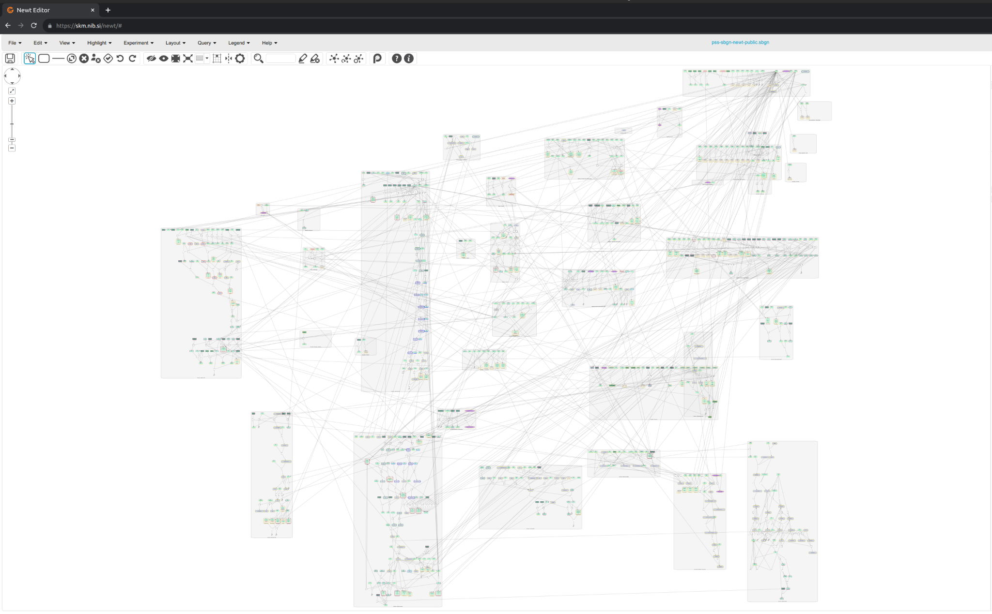
PSS Newt
Overview of PSS
Pathway oriented
Uses SGBN standard
Editable

Slide 34
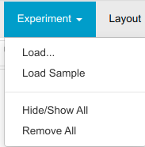
PSS Newt
Overview of PSS
Pathway oriented
Uses SGBN standard
Editable
Overlay experimental data

Slide 35
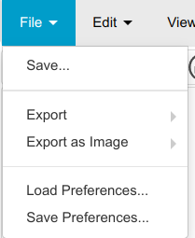
PSS Newt
Overview of PSS
Pathway oriented
Uses SGBN standard
Editable
Download edits

Slide 36
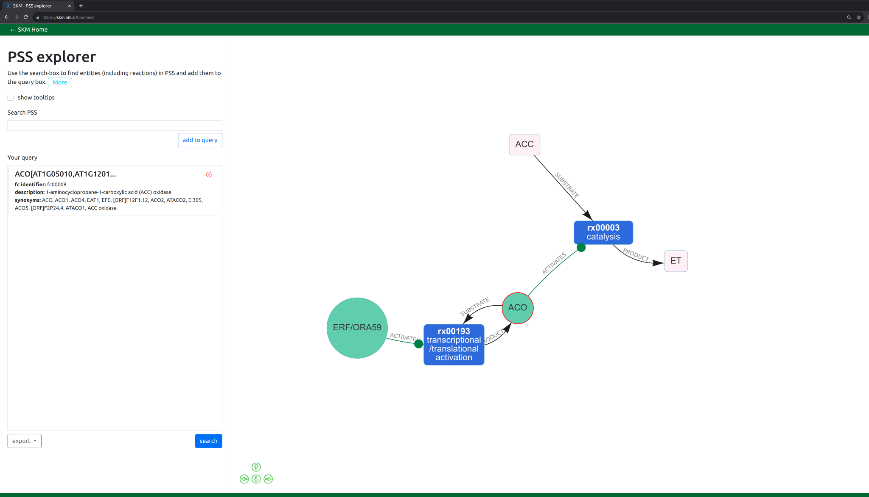
PSS Explorer
Interactive exploration of PSS
Neighbours, shortest paths
Subnetwork download

Slide 37
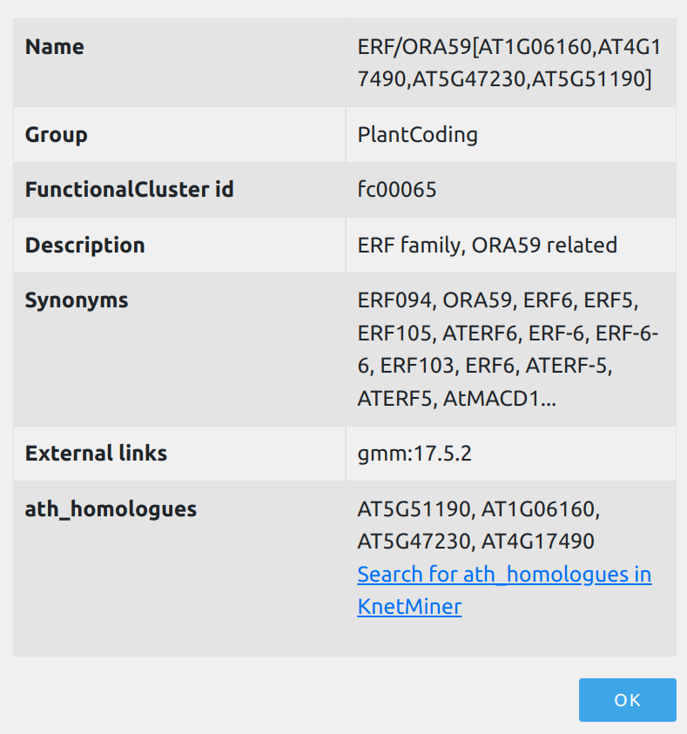
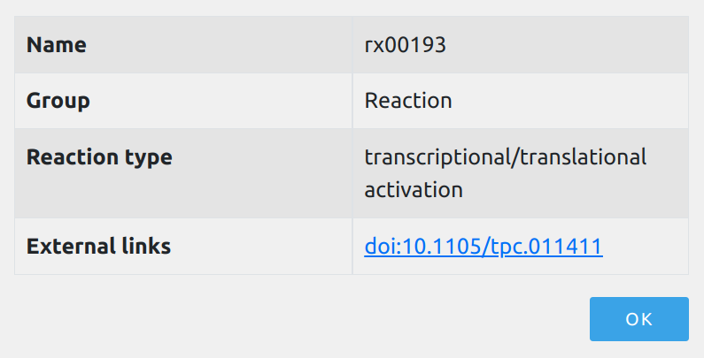
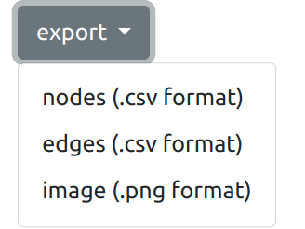
PSS Explorer
Interactive exploration of PSS
Neighbours, shortest paths
Subnetwork download
Additional explanations
Search
Save subnetwork

Slide 38
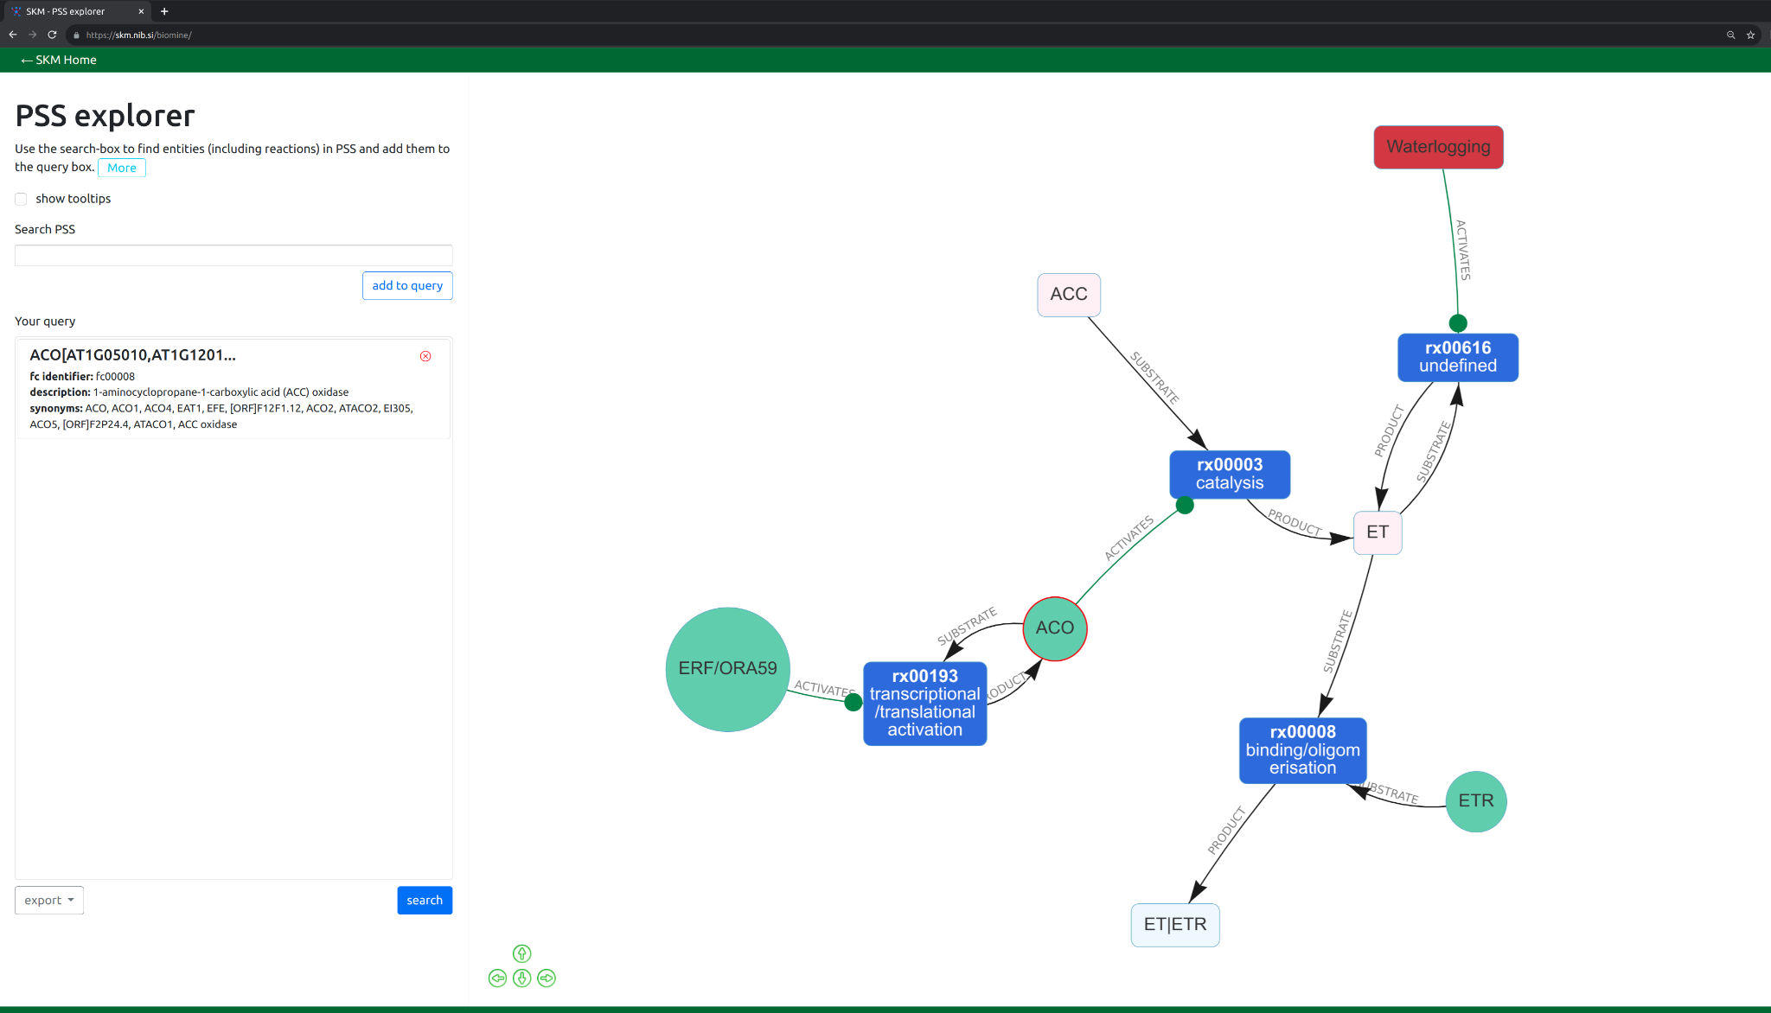
PSS Explorer
Interactive exploration of PSS
Neighbours, shortest paths
Subnetwork download
Additional explanations
Search
“Expand”
Save subnetwork

Slide 39
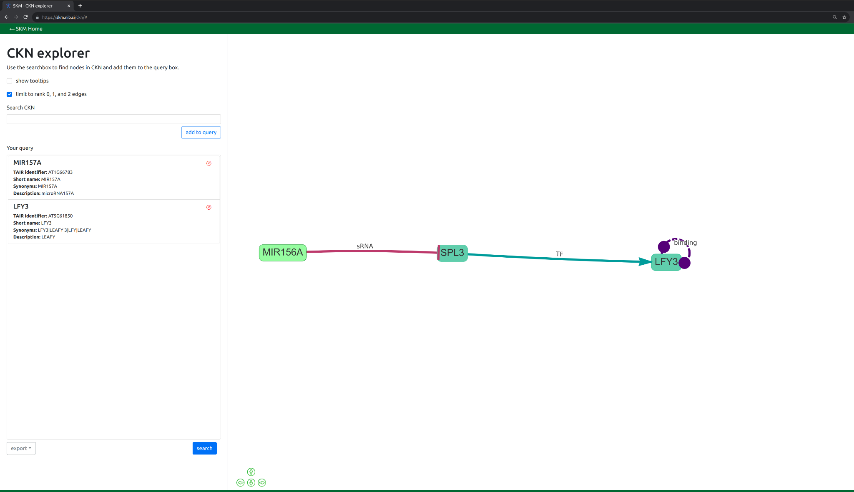
CKN Explorer
Interactive exploration of CKN
Neighbours, shortest paths
Subnetwork download

Slide 40
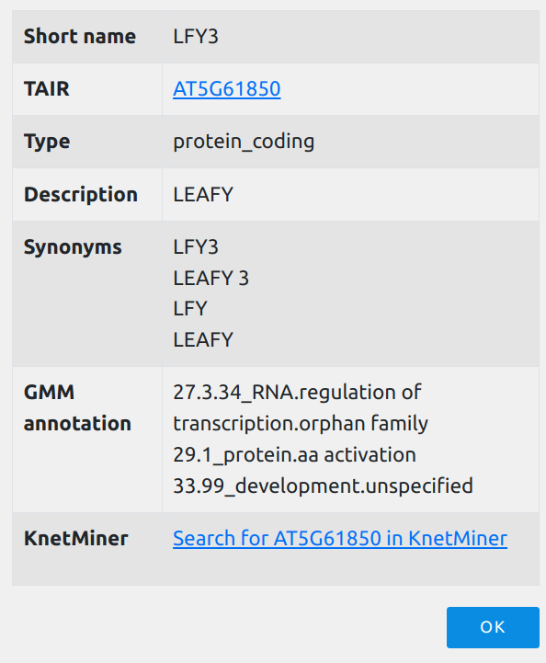
CKN Explorer
Interactive exploration of CKN
Neighbours, shortest paths
Subnetwork download
Edge reliability
Search
Save subnetwork

Slide 41
CKN Explorer
Interactive exploration of CKN
Neighbours, shortest paths
Subnetwork download
“Expand”

Slide 42
SKM Downloads
Automated (up-to-date) exports in multiple formats
SBGN | Systems Biology Graphical Notation XML | Visualizations tools – NEWT
SBML | Systems Biology Markup Language XML | Modelling – Simulations
SIF/LGL | Simple interaction format | Cytoscape & network analysis DiNAR app for differential network analysis
Boolnet | Boolean network | Boolean network analysis and modelling

Slide 43
SKM uses…
Mechanistic explanations of experimental results
Multi-omic data integration
Large-scale hypothesis generation
semi-quantitative dynamics

Slide 44
SKM-tools Python toolkit to maximise re-usability of SKM resources as networks
Directly create a networkX graph object – allowing access to a multitude of graph analysis operations,
Network filtering – filtering edges or nodes that are not relevant to the biological question at hand,
Inclusion of experimental data – importing experimental data as context to the networks, and
Cytoscape Automation – loading and styling network analysis results to the Cytoscape interface.
https://github.com/NIB-SI/skm-tools

Slide 45
Example 1 (PSS)
Load network
↓
Filter
↓
Identify paths
↓
Visualize

Slide 46
Example 2 (CKN)
Load network
↓
Filter
↓
Identify paths
↓
Visualize

Slide 47
Links & Acknowledgements
Links:
https://skm.nib.si
https://github.com/NIB-SI/skm-tools
Acknowledgements:
“Omics&modelling” group Department of Biotechnology and Systems Biology, National Institute of Biology, Slovenia
Vid Podpečan
Jozef Stefan Institute, Department of Knowledge Technologies, University of Ljubljana, Slovenia
This work has been performed with funding from the European Union's Horizon 2020 research and innovation programme under grant agreement No. 862858 (ADAPT) and with funding from the Slovenian Research Agency under grant agreements No. P4-0165, No. Z7-1888 and No. J4-1777.

Slide 48
FAIDARE – FAIR Data-finder for Agronomic REsearch

Slide 49
FAIR Data-finder for Agronomic REsearch – https://urgi.versailles.inra.fr/faidare/
Federated search engine, indexing multiple plant science resources

Slide 50
Agenda
Short overview of the bundle | Kristina GrudenNational Institute of Biology, Slovenia
Technical background and practical use of knowledge graphs
KnetMiner | Keywan Hassani-Pak ^{Rothamsted Research, UK}
AgroLD | Pierre Larmande University of Montpellier / South Green Bioinformatics Platform, France
SKM | Carissa Bleker National Institute of Biology, Slovenia
FAIDARE | Carissa Bleker on behalf of Cyril Pommier Université Paris-Saclay, INRAE, URGI, France
Break (10 min)
Visualisation of data – technical background and use case
MapMan | Sebastian Beier Forschungszentrum Jülich GmbH, Germany
DiNAR | Maja Zagorščak National Institute of Biology, Slovenia
Integrated pipeline use case | Kristina Gruden National Institute of Biology, Slovenia
Discussion

Slide 51
Agenda
Short overview of the bundle | Kristina GrudenNational Institute of Biology, Slovenia
Technical background and practical use of knowledge graphs
KnetMiner | Keywan Hassani-Pak ^{Rothamsted Research, UK}
AgroLD | Pierre Larmande University of Montpellier / South Green Bioinformatics Platform, France
SKM | Carissa Bleker National Institute of Biology, Slovenia
FAIDARE | Carissa Bleker on behalf of Cyril Pommier Université Paris-Saclay, INRAE, URGI, France
Break (10 min)
Visualisation of data – technical background and use case
MapMan | Sebastian Beier Forschungszentrum Jülich GmbH, Germany
DiNAR | Maja Zagorščak National Institute of Biology, Slovenia
Integrated pipeline use case | Kristina Gruden National Institute of Biology, Slovenia
Discussion

Slide 52
MapMan
Visualisation of Plant Omics Data
Sebastian Beier, Oct-06-2023, ELIXIR-DE

Slide 53
What is MapMan?
The term MapMan refers to two different concepts:
A framework for the classification of plant protein functions (MapMan4 framework used in Mercator4)
A standalone desktop application for the visualisation of omics data

Slide 54
MapMan4 Framework
Hierarchical framework consisting of 30-top-level categories (also called BINs). One additional pseudo top-level category for proteins that could not be classified „35 not assigned“. Each child node is more specialised than its parent. Protein sequences are assigned to leaf level.
Protein annotation tool

Slide 55
MapMan Desktop Application
Graphical tool:
Pathway visualization
Testing for enriched pathways and processes
Interactive data exploration
Expression Data
Pathway Visualization
Enrichment testing
Interactive data
Exploration

Slide 56
Requirements for MapMan Visualisations
Protein function annotation
Gene expression data
Pathway diagram
Run Mercator4 on genome assembly
Differential gene expression (RNA-Seq, Microarray data)
Pathway you are interested in, available on the plabipd website
Important Note: Gene identifier must be identical between annotation and expression data

Slide 57
User Interface
Help, License and Manual
Context menu and settings
Main window
File structure
Select Pathway
Select Mapping
Select Experiment
Memory consumption and loading time
Add new data

Slide 58
Pathways
Always make sure that you select correct version of diagrams! (All legacy files also available on the page)
Current Mercator4 version 5 diagrams consist of 13 basic diagrams (including primary and secondary metabolism), as well as five custom-made diagrams for specialised biosynthesis pathways not found in all plants.
Each diagram comes with an image file and the protein mapping used by MapMan software to associate the appropriate BIN.

Slide 59
Enrichment Test with PageMan
MapMan allows statistical tests with PageMan:
Rank-based test (Wilcoxon signed-rank test)
ORA analysis (chi-square statistic, Fisher‘s exact test, hypergeometric test)
Average
Multiple tests error correction with Benjamini-Hochberg, Benjamini Yekutieli, Bonferroni

Slide 60
Data Exploration - Cluster Experimental Data
MapMan allows to cluster genes with similar behavior over multiple measurements

Slide 61
Data Exploration - Venn Diagram
MapMan can give a quick comparison of multiple data columns with Venn diagram visualisation

Slide 62
Download and Installation
https://www.plabipd.de/mapman_main.html
Follow the installation wizard instructions (Linux or Windows)
MacOS X: Install Java, run MapMan jar from terminal

Slide 63
References and Acknowledgements
Thimm et al. (2004)
MapMan: a user-driven tool to display genomics data sets onto diagrams of metabolic pathways and other biological processes. Plant J. 2004 Mar, 37(6): 914-939.
https://www.plabipd.de/mapman_main.html
Rainer Schwacke
Marie Bolger
Axel Vogel
Björn Usadel
Usadel et al. (2005)
Extension of the visualization tool MapMan to allow statistical analysis of arrays, display of corresponding genes, and comparison with known responses. Plant Physiol. 2005 Jul, 138(3): 1195-1204.
Bolger, M., Schwacke, R., Usadel, B. (2021). MapMan Visualization of RNA-Seq Data Using Mercator4 Functional Annotations. In: Dobnik, D., Gruden, K., Ramšak, Ž., Coll, A. (eds) Solanum tuberosum. Methods in Molecular Biology, vol 2354. Humana, New York, NY.

Slide 64
DiNAR
Differential Network Analysis in R
https://github.com/NIB-SI/DiNAR

Slide 65
DiNAR concept
Prior knowledge/background
nodes/molecules
edges/reactions
Experimental data
multi-conditional setup
time-series
strength/response/expression level
measure of statistical significance
Condition specific network
Latent effects

Slide 66
Prior knowledge/background

Slide 67
Prior knowledge/background
PSS v2

Slide 68
Prior knowledge/background
CKN v1

Slide 69
Prior knowledge/background + experimental data

Slide 70
Help

Slide 71
Features
https://nib-si.shinyapps.io/DiNAR/

Slide 72
Custom Network
https://github.com/NIB-SI/DiNAR/tree/master/subApps
https://github.com/NIB-SI/DiNAR/tree/master/CKNs https://github.com/NIB-SI/DiNAR/tree/master/PIS
https://github.com/NIB-SI/DiNAR/tree/master/PEPN

Slide 73
Custom Network

Slide 74
Custom Network - from STRING DB
https://github.com/NIB-SI/DiNAR/tree/master/subApps/pre-processing/examples/

Slide 75
Custom Network - using GMM-SKM-KnetMiner
https://github.com/NIB-SI/DiNAR/tree/master/subApps/GMM-SKM-KnetMiner

Slide 76
Bonus
https://github.com/NIB-SI/DiNAR/blob/master/Custom%20Animations%20-%20What%20%26%20How.md
https://plantmethods.biomedcentral.com/articles/10.1186/s13007-018-0345-0#Sec12
https://github.com/NIB-SI/DiNAR/tree/master/GEODataAnalysis
https://github.com/NIB-SI/DiNAR/tree/master/IDprioritization
https://statsandr.com/blog/how-to-publish-shiny-app-example-with-shinyapps-io/

Slide 77
References and Acknowledgements
Miljkovic D et al. (2012) Signalling Network Construction for Modelling Plant Defence Response. PLOS ONE. https://doi.org/10.1371/journal.pone.0051822
https://github.com/NIB-SI/DiNAR
https://NIB-SI.shinyapps.io/DiNAR
https://nib-si.shinyapps.io/pre-processing/
https://nib-si.shinyapps.io/clustering/
https://nib-si.shinyapps.io/GMM-SKM-KnetMiner/
Ramšak Ž et al. (2018) Network Modeling Unravels Mechanisms of Crosstalk between Ethylene and Salicylate Signaling in Potato. Plant Physiol. doi:10.1104/pp.18.00450
Zagorščak et al. (2018) DiNAR: revealing hidden patterns of plant signalling dynamics using Differential Network Analysis in R. Plant Methods. https://doi.org/10.1186/s13007-018-0345-0
Foix, L et al. (2021) Prunus persica plant endogenous peptides PpPep1 and PpPep2 cause PTI-like transcriptome reprogramming in peach and enhance resistance to Xanthomonas arboricola pv. pruni. BMC Genomics. https://doi.org/10.1186/s12864-021-07571-9
Special thanks
GMM,
SKM, and
KnetMinner
developers

Slide 79
Integrated pipeline use case

Slide 80
Integrated use of the bundle

Slide 81
Questions
Are the mentioned methods also useful for the interpretation of proteomics data?

