Slide 1
Plant Phenotyping data publication using MIAPPE, Dataverse and e!DAL-PGP
CP
Based on the guidelines published in RDMkit and the FAIR Cookbook
Cyril Pommier, Erwan Le Floch, Daniel Arend

Slide 2
Agenda
Introduction (CP)
Knowledge Hub introduction
RDMkit tool assemblies (DA)
FAIR Cookbook recipes (ElF)
Questions
Data publication
e!DAL-PGP (DA)
Dataverse (ElF)
Questions
MIAPPE
MIAPPE introduction (CP)
MIAPPE @ Dataverse (CP)
MIAPPE @ e!DAL-PGP (DA)
Questions
Perspectives
MIAPPE Wizard (DA)
MIAPPE Template, validation and FAIRDOM (ElF)
Questions

Slide 3
Introduction
CP
Phenotype Data Management challenge
Dedicated and generalists repository

Slide 4
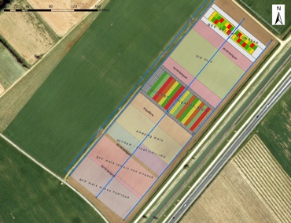
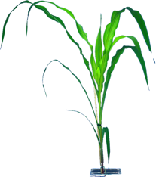
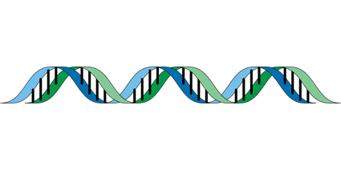
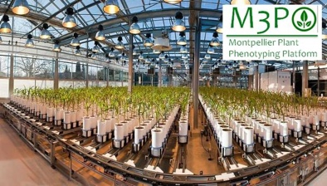
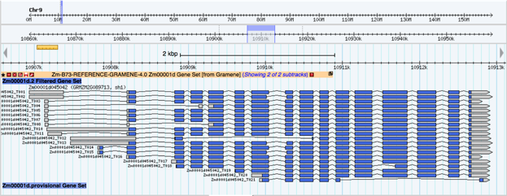
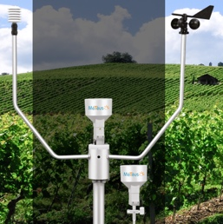
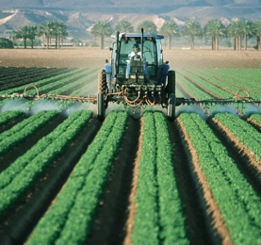
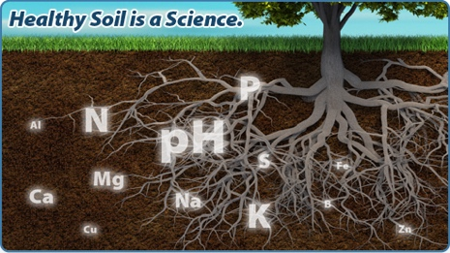
Plant Phenotype Publication Challenges
CP
Phenomics
Genetics
Genomics
Omics
Plant Breeding
Genetic variations by Traits
Mostly centralized
Homogenous data
Heterogenous metadata
Dispersed
Heterogenous
Getting Standardized
Climate Change Studies
Genotype by Environment
Environment
Dispersed
Heterogenous

Slide 5
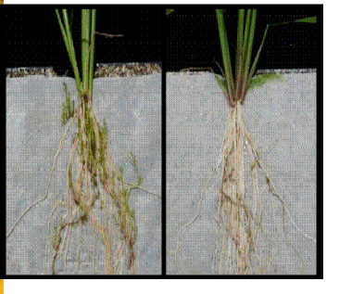
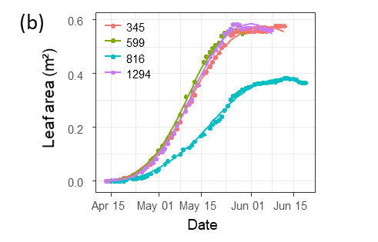
Phenotype data lifecycle
CP
Data Acquisition
Data computation
« Raw » data, pheno/env measurement, variables
« Derived» data,
computed, reduced, indicators
Soissons x high N
Charger x high N
Charger x low input
Soissons x high N
Charger x high N
Soissons x low input
Soissons x low input
Soissons x high N
Derivation, Reduction
Soissons x low input
Charger x low input
Charger x high N
Soissons x high N
Soissons x high N
Genotype | Treatment | N input | Date | Rep | Fusariose
Soissons | low input | 15,3225129 | 15/11/2011 | 1 | 5
Soissons | low input | 15,3430556 | 16/11/2011 | 2 | 7
Genotype | Treatment | Fusariose
Soissons | low input | 6

Slide 6
Phenotype data lifecycle
CP
Data Acquisition
Data computation
Knowledge
« Raw » data, pheno/env measurement, variables
« Derived» data,
computed, reduced, indicators
Variety charger is resistant to fusariose under intensive cultural practice
Soissons x high N
Charger x high N
Charger x low input
Soissons x high N
Charger x high N
Soissons x low input
Soissons x low input
Soissons x high N
Derivation, Reduction
Publication
Soissons x low input
Charger x low input
Charger x high N
Soissons x high N
Soissons x high N
Genotype | Treatment | N input | Date | Rep | Fusariose
Soissons | low input | 15,3225129 | 15/11/2011 | 1 | 5
Soissons | low input | 15,3430556 | 16/11/2011 | 2 | 7
Genotype | Treatment | Fusariose
Soissons | low input | 6
Wilkinson et al.
The FAIR Guiding Principles for scientific data management and stewardship.
Scientific Data 3 (2016)

Slide 7
Phenotype data lifecycle
CP
Data Acquisition
Data computation
Knowledge
« Raw » data, pheno/env measurement, variables
« Derived» data,
computed, reduced, indicators
Variety charger is resistant to fusariose under intensive cultural practice
Soissons x high N
Charger x high N
Charger x low input
Soissons x high N
Charger x high N
Soissons x low input
Soissons x low input
Soissons x high N
Derivation, Reduction
Publication
Soissons x low input
Charger x low input
Charger x high N
Soissons x high N
Soissons x high N
Genotype | Treatment | N input | Date | Rep | Fusariose
Soissons | low input | 15,3225129 | 15/11/2011 | 1 | 5
Soissons | low input | 15,3430556 | 16/11/2011 | 2 | 7
Genotype | Treatment | Fusariose
Soissons | low input | 6
INDICATORS
New computation for each scientific question
One experimental dataset → many derived dataset
DESCRIPTEURS PRIMAIRES
Caractérisation Phenodes Accessions
VARIABLES
Raw Measures Pheno & Env
Data cleaning
Traceability, Reproducibility & Provenance
Raw data long term conservation

Slide 8
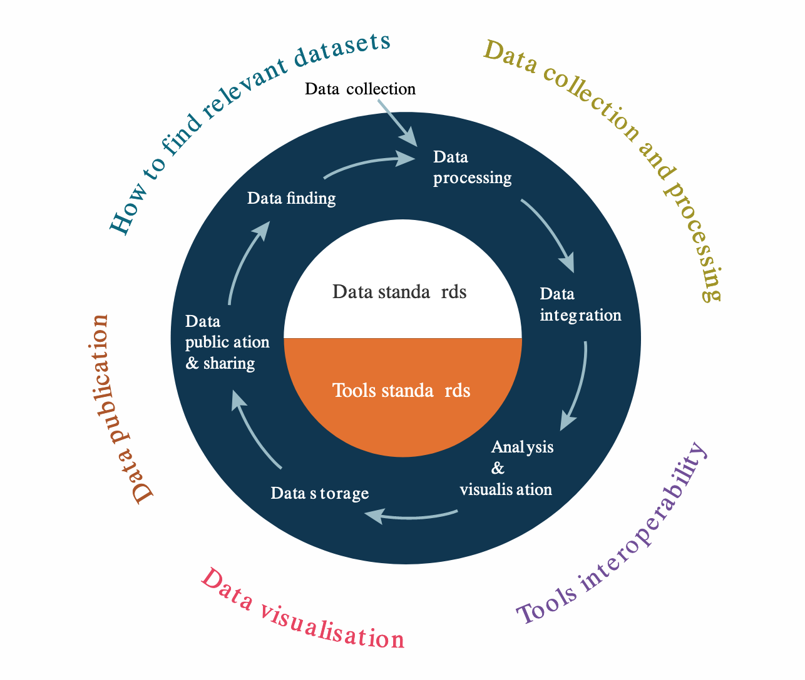
FAIR For plant science
CP
Phenotyping: Raw and derived data
Genotyping: Computed data (plus option for Raw data).
Applies to other OMICS
Solutions on the data lifecycle
Data standardisation
Data repositories for publication
Data findability / discovery

Slide 9
Data repositories
CP
Thematic repositories
Opened
Access Control
Generalist repositories
Publisher repository
Institutes Repositories
National Repositories
Community Repositories
+ partners
+ partners

Slide 10
Data repositories
CP
Thematic data repositories
Pros
Precise dataset description and metadata
Good quality
Cons
Not available for all data types (e.g. phenotyping)
Time-consuming publication/curation of data
Generalist repositories
Pros
Any data type ⇒ flexible
Minimal publication metadata
author, title, description, DOI
Rapid submission/publication
Cons
Weak description (biological material, methods, etc.)
Non-standard formats
FAIR reduced (less Findability, Interoperability, Reusability)
Need for Guidance and optional validators

Slide 11
Knowledge Hub introduction : RDMKit & FAIRCookbook
DA

Slide 12
Plant Pheno publication Guidelines
DA
Ecosystem of knowledge documentation portals
RDMkit: entry point, with links to registries & recipes, provides best practices & guidelines to make your data FAIR
FAIR Cookbook: detailed recipes repository, that help to make & keep data FAIR
https://rdmkit.elixir-europe.org/
https://faircookbook.elixir-europe.org

Slide 13
RDMkit - Best practices & guidelines to make your data FAIR
DA
A “wikipedia-like” knowledge base website, free and open
Describes how to manage research outputs according to FAIR principles
Portal to other online resources used by RDM professionals and researchers
→ it is no peer-review journal, repository, registry or manual, but it provides you information & links
URL: https://rdmkit.elixir-europe.org/
Recommended in the Horizon Europe Program Guide as the “resource for Data Management guidelines and good practices for the Life Sciences”
Notes:
What RDMkit is

Slide 14
RDMkit in numbers
DA
Contributors are experts in RDM and/or in scientific domain in ELIXIR and beyond
ELIXIR Node service in 3 Nodes/Countries
Managed by an editorial board composed of 16 ELIXIR members from several Nodes and the lead for “FAIR Data & Resources​” at the Office of Data Science Strategy at NIH
The content is curated by members of the ELIXIR RDM Community
from March 2021 until September 2023
Notes:
Why RDMkit
- who is using it
- how is it sustained

Slide 15
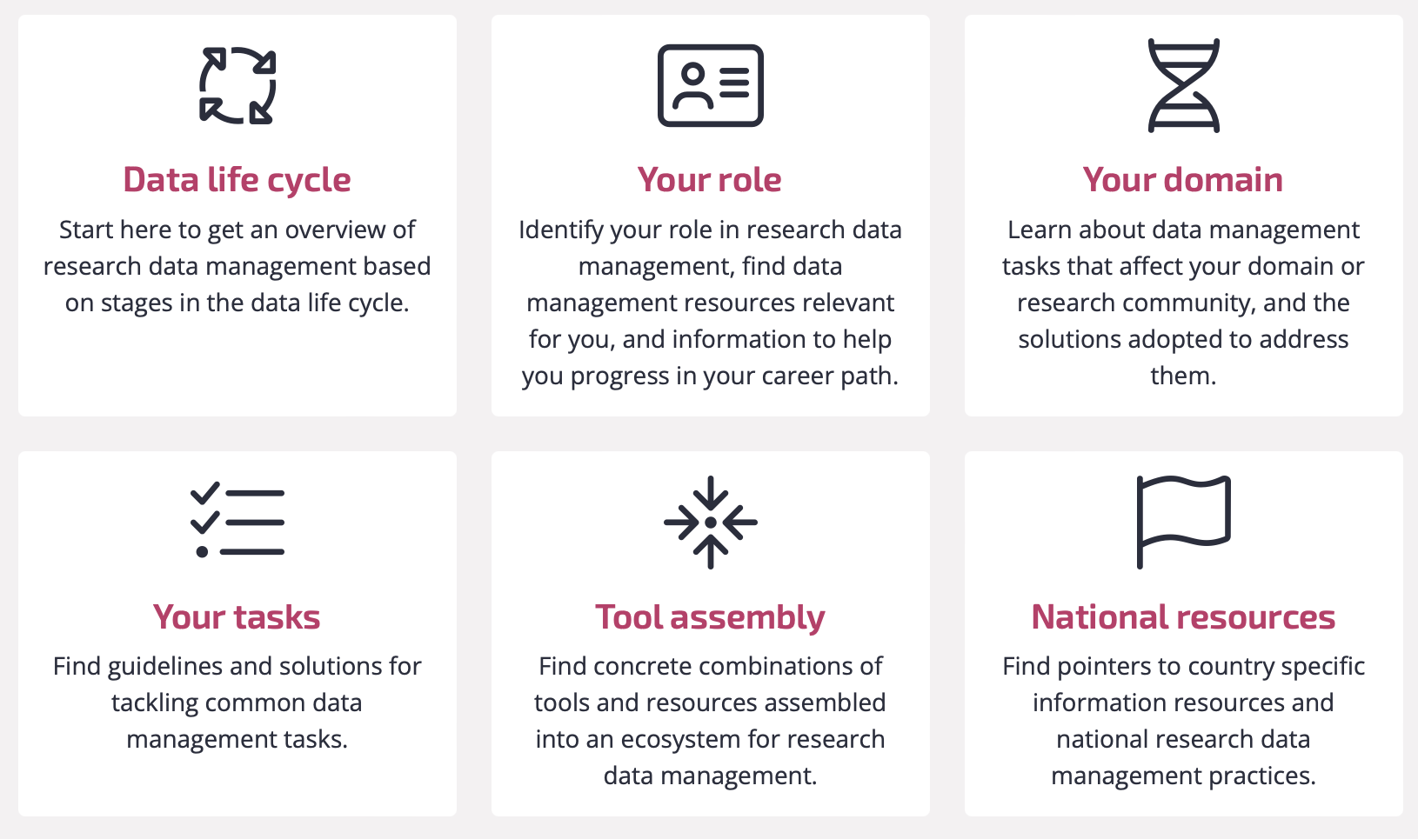
RDMkit: content organisation
DA

Slide 16
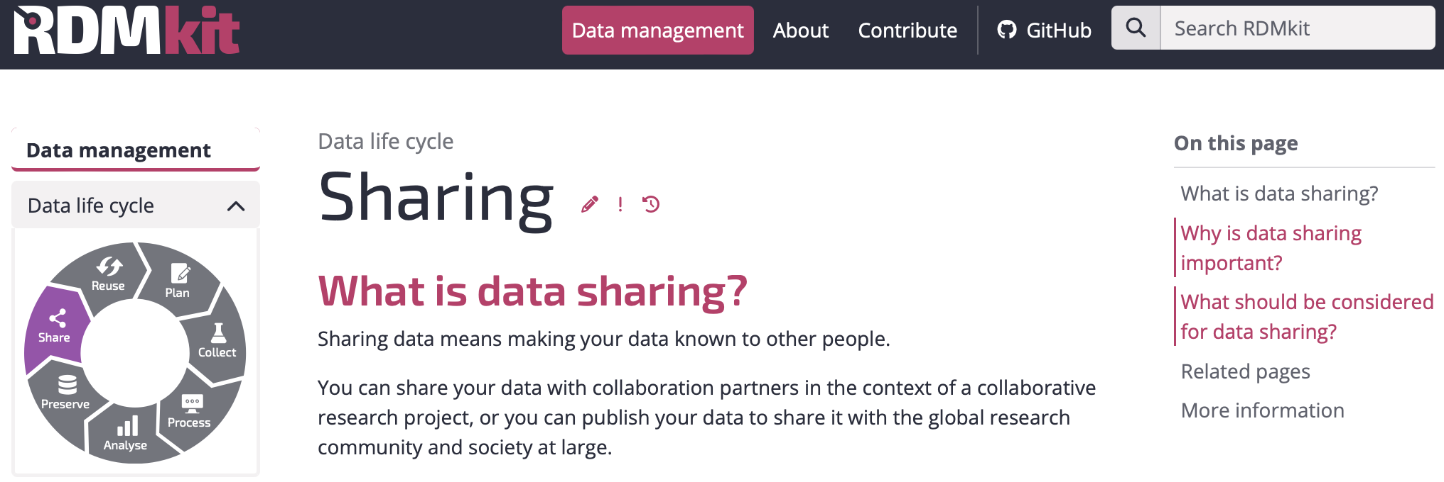
Data life cycle
DA
General definitions and considerations for each stage of the data life cycle

Slide 17
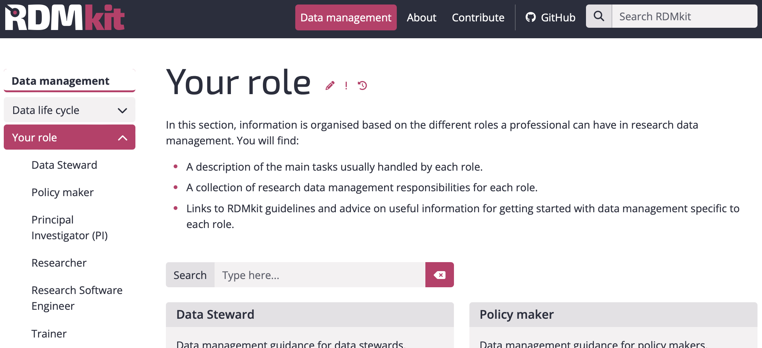
Your role
DA
Role-specific tasks in frame of research data management

Slide 18
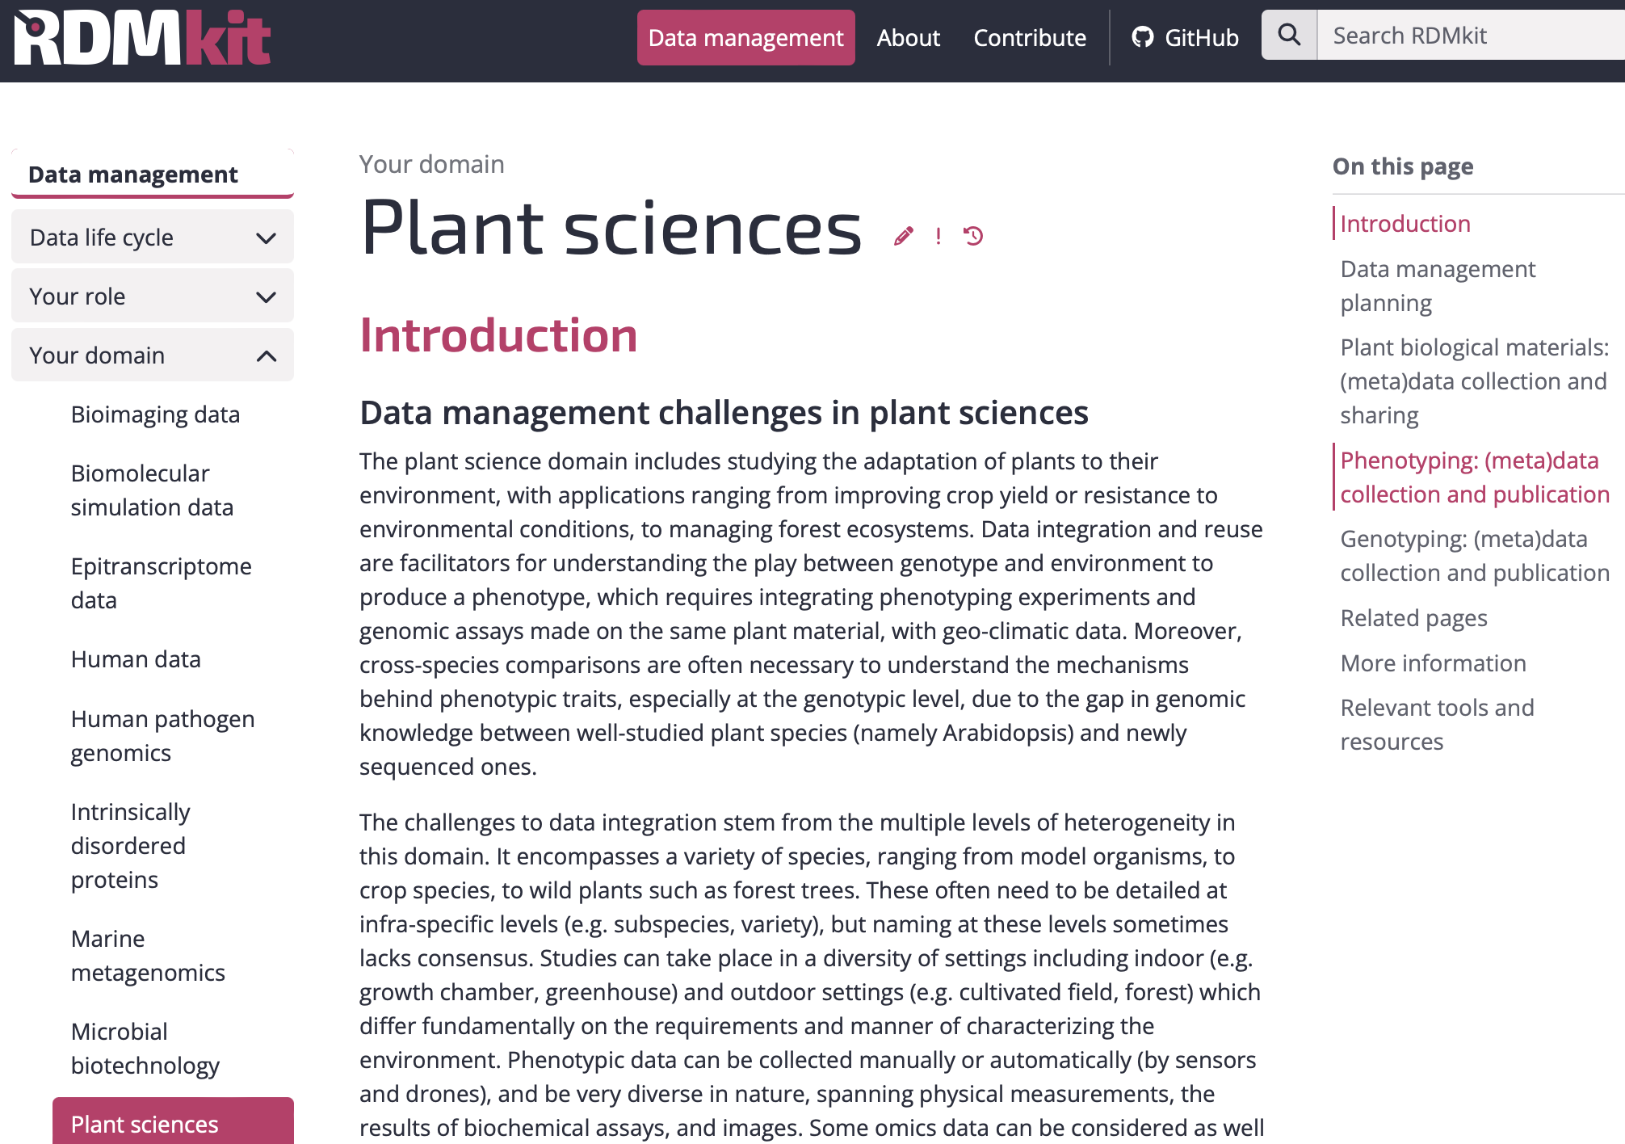
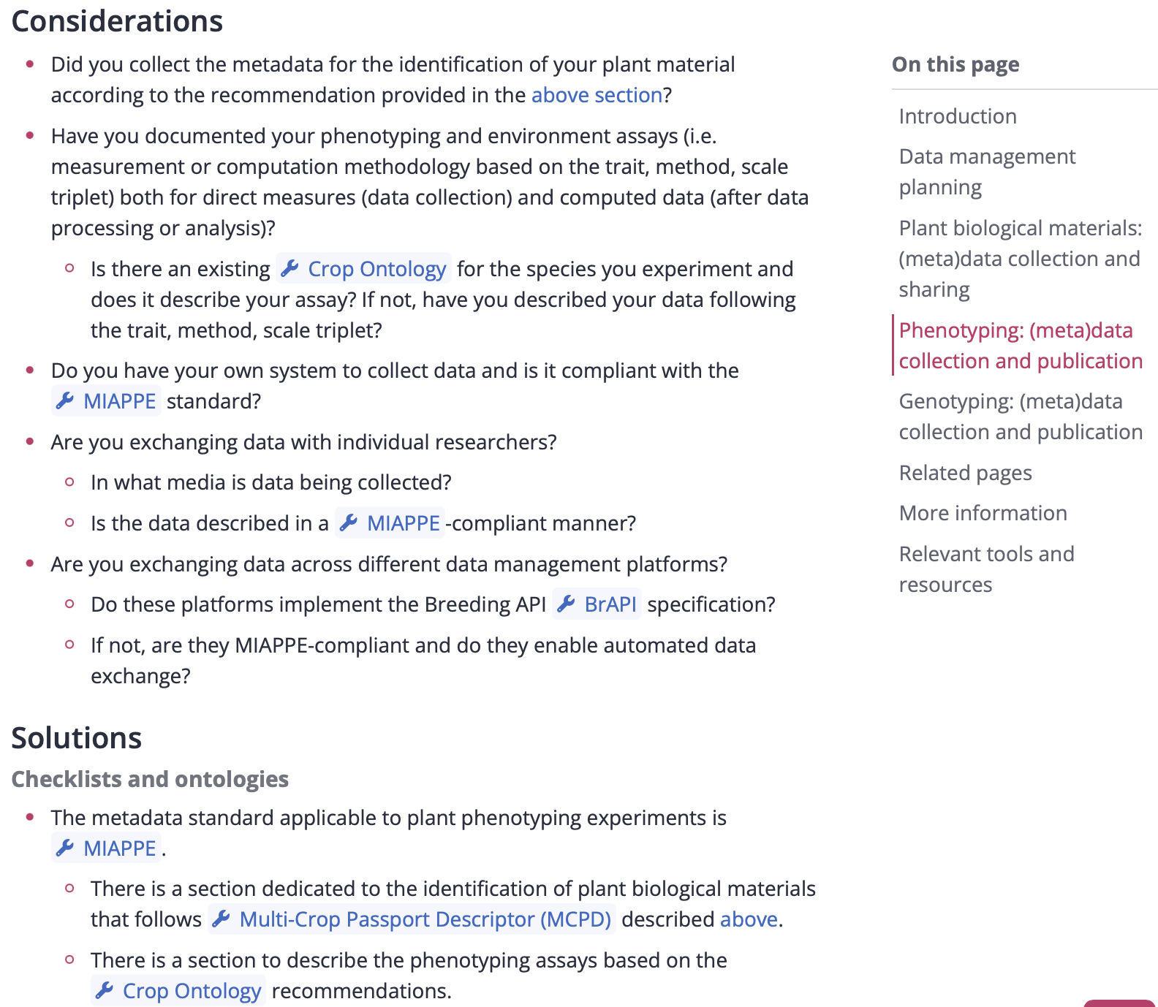
Your domain
DA
Data management practices in a domain
what aspects should be taken into account (considerations)
available solutions
links to tools and resources explained in clear context (when to use them and for what purpose)

Slide 19
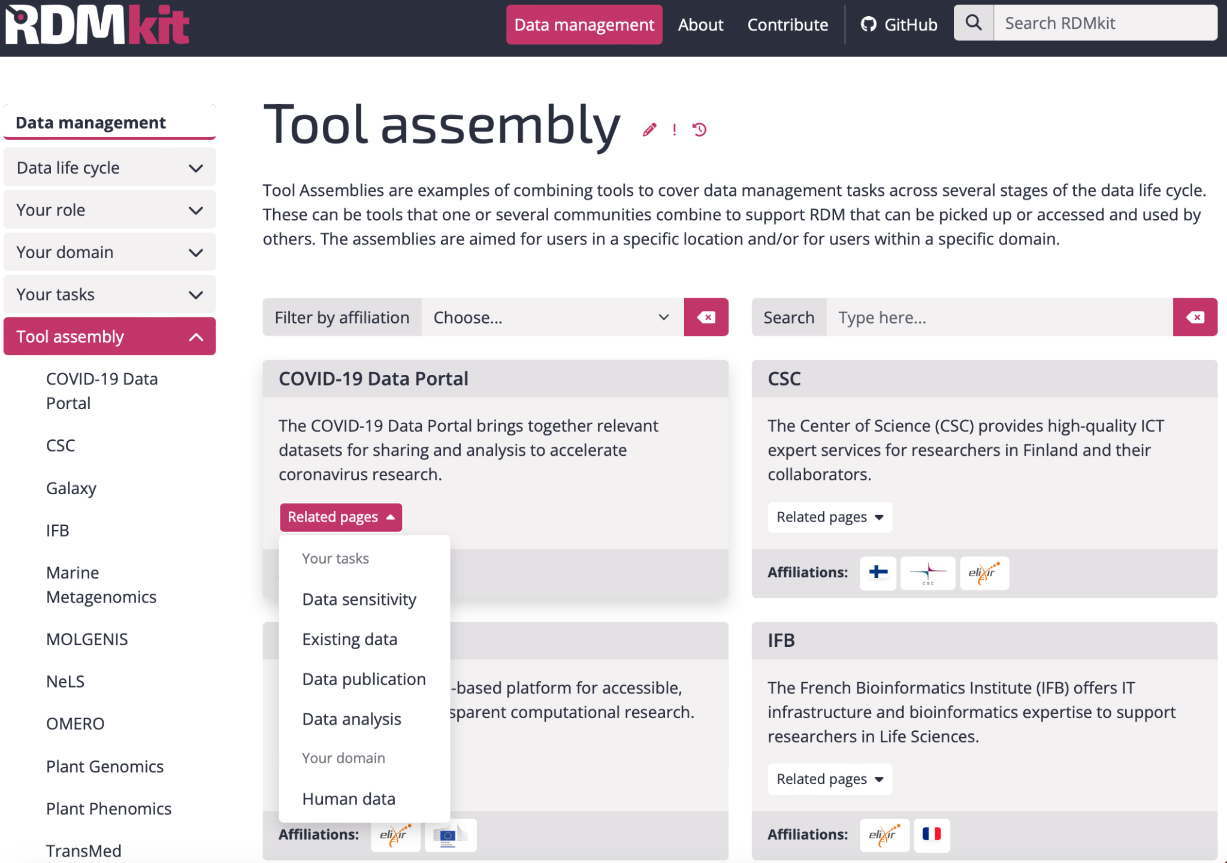
Tool assembly
DA

Slide 20
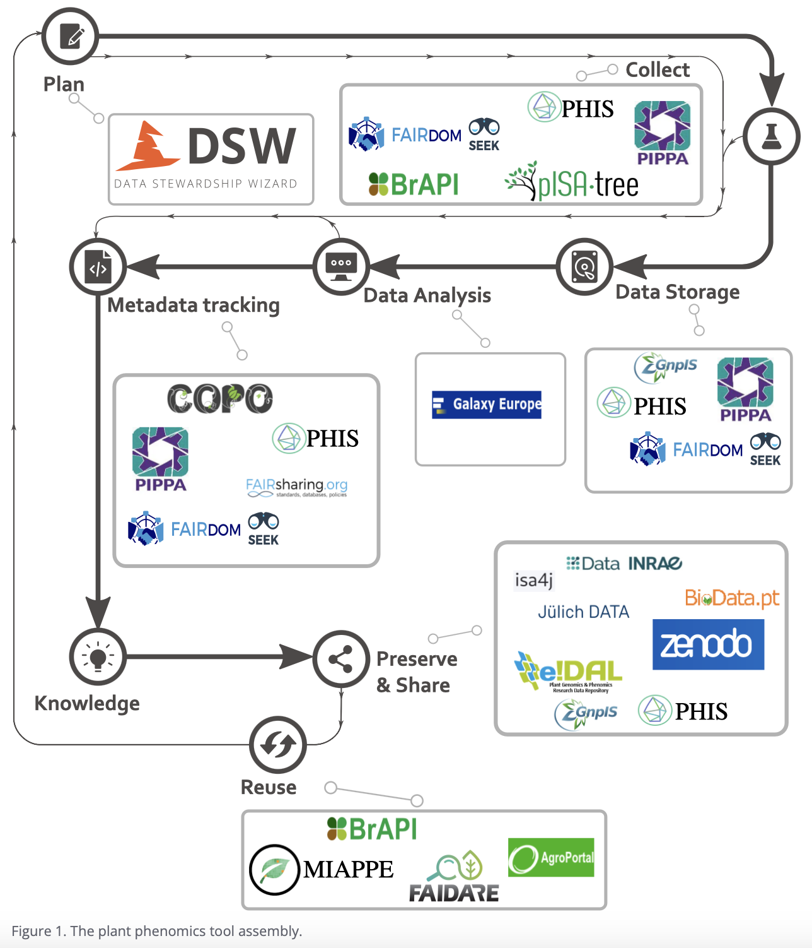
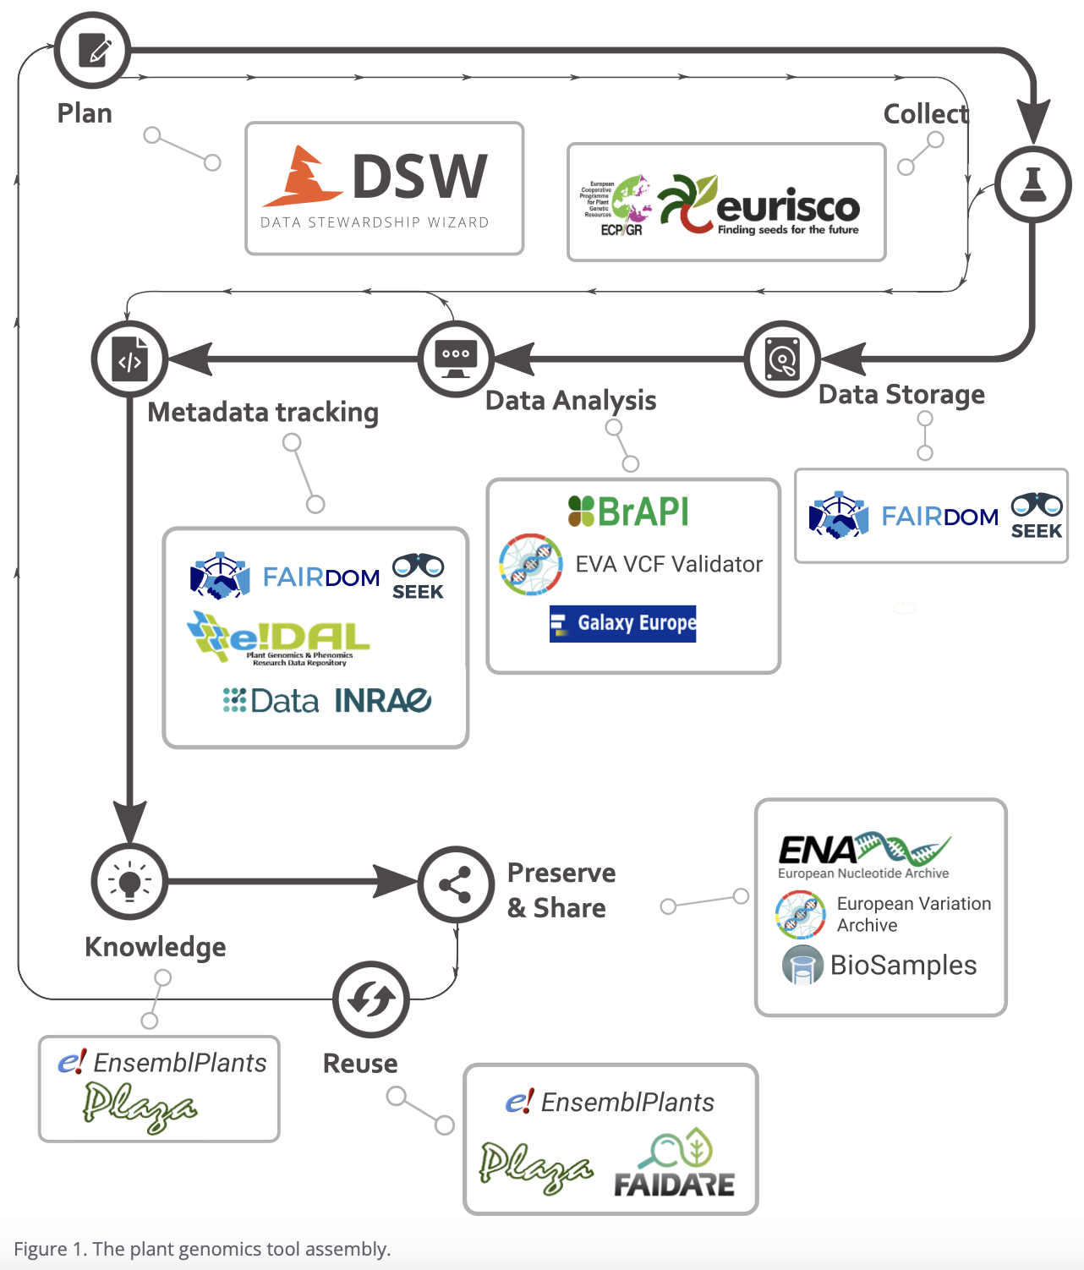
Tool assembly: examples
DA
Plant phenomics
Plant genomics

Slide 21
Your tasks - Data Storage: links to related recipes in FAIR Cookbook

Slide 22
Plant RDMKit Page: Entry point
DA

Slide 23
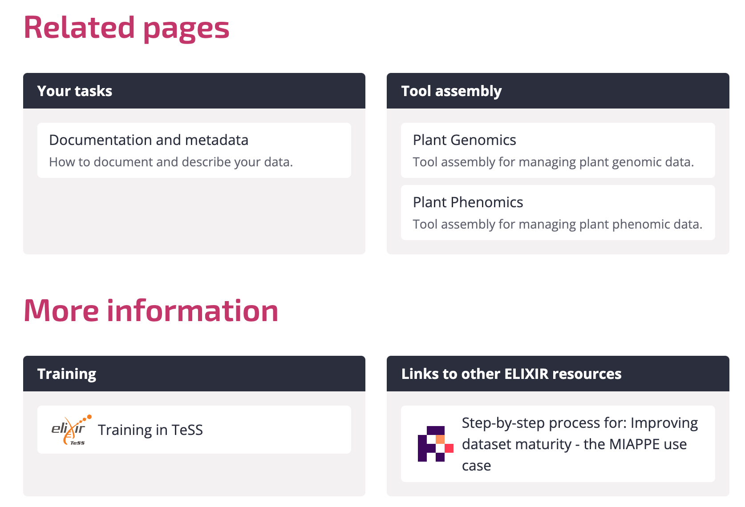
Plant RDMKit Page: Entry point
DA

Slide 24
Plant RDMKit Page: Entry point
DA
Data management planning
Plant biological materials:
Identification of plant biological materials
Checklists & metadata standard
Tools for (meta)data collection, sharing & publication
Phenotyping:
Checklists & ontologies
(meta)data collection & publication
Genotyping:
Checklists, ontologies & file formats
Data sharing & publication
https://rdmkit.elixir-europe.org/plant_sciences

Slide 25
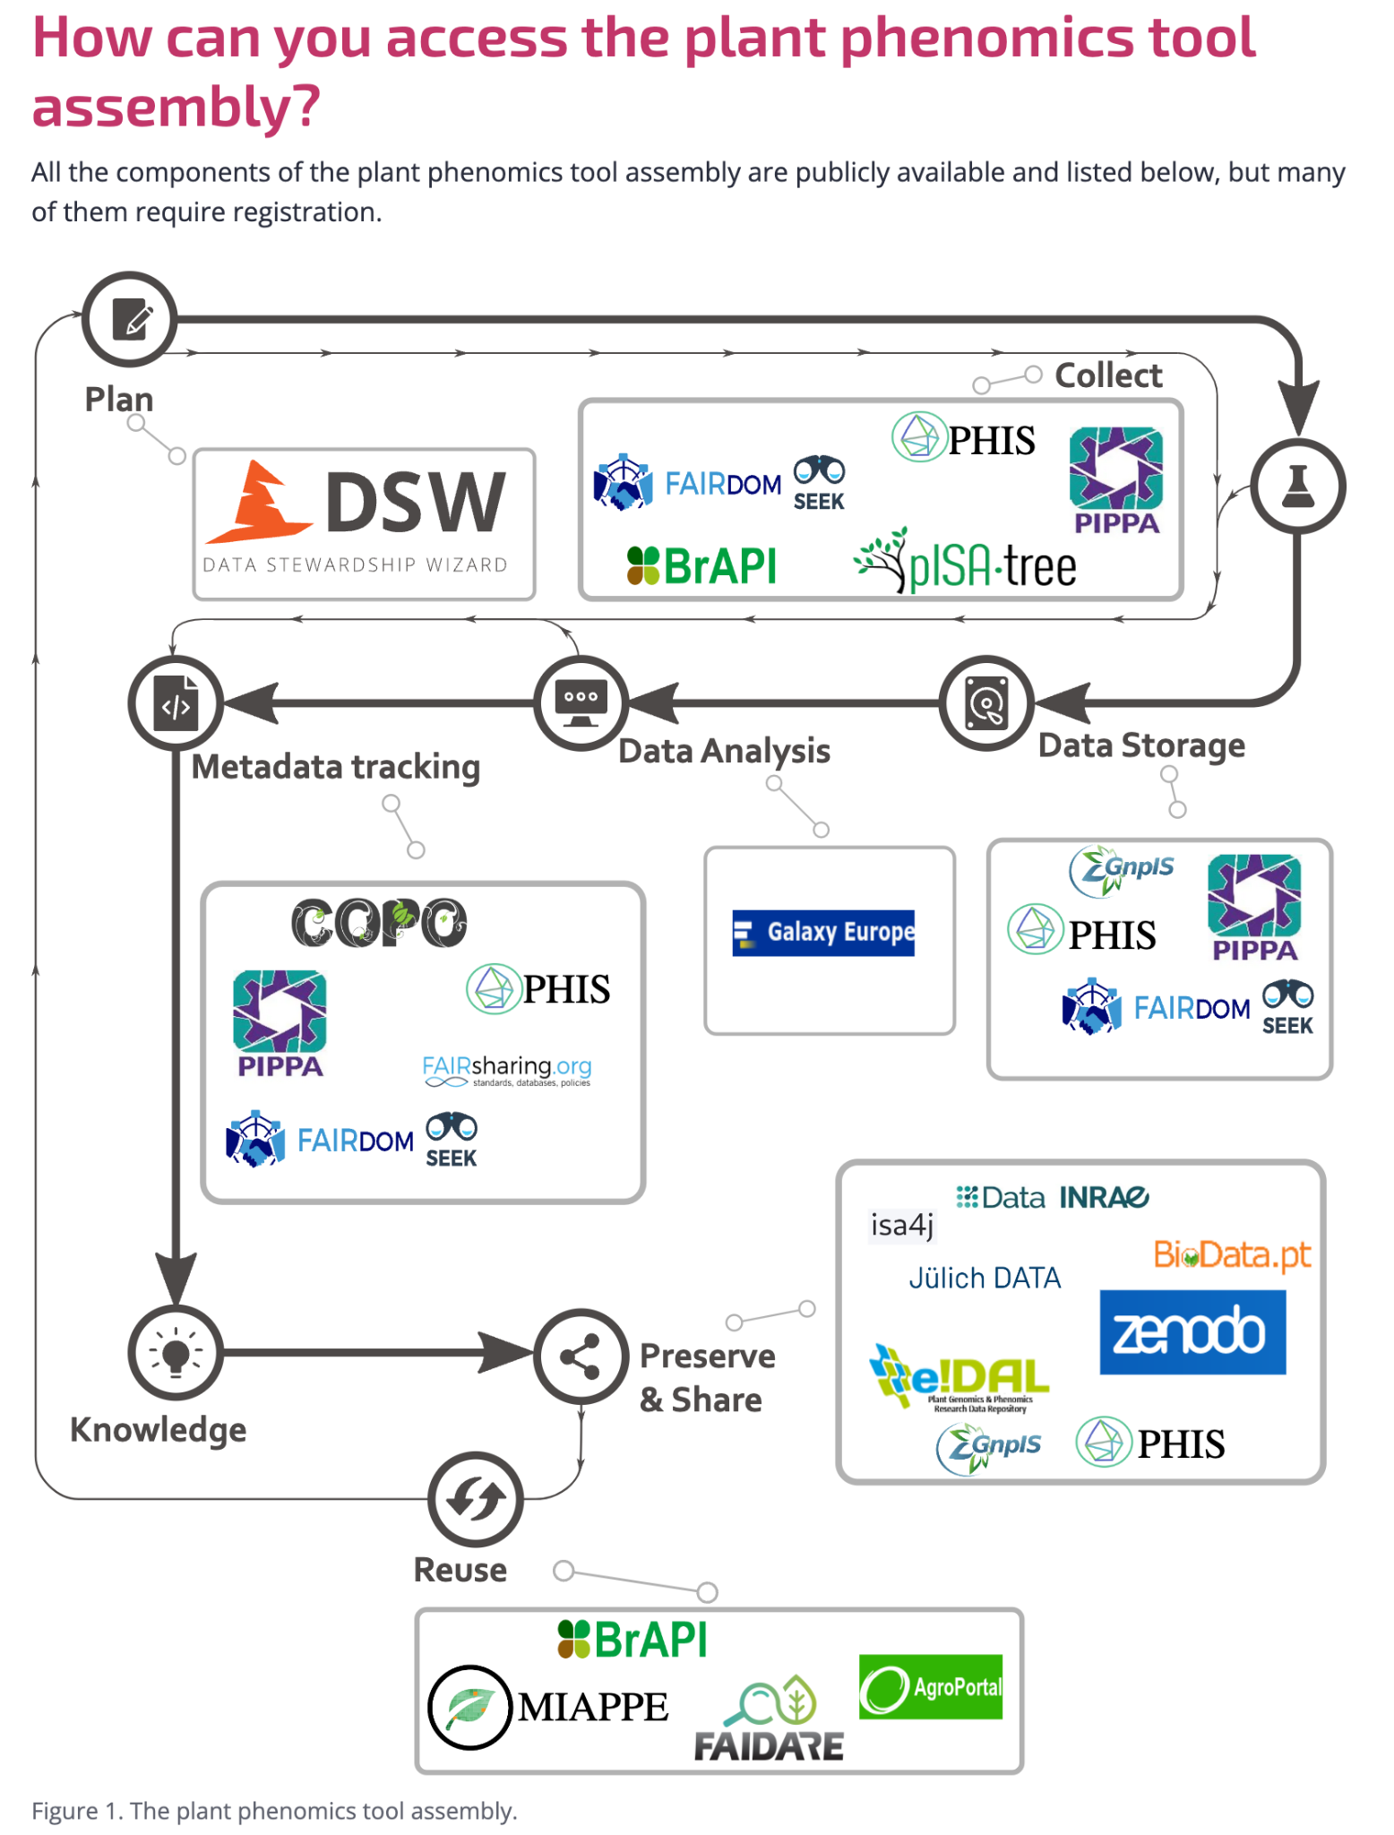
Plant Phenomics Tools assembly
DA
Data management planning
Data Stewardship Wizard
Experimental data gathering and management
MIAPPE Template
File based: FAIRDOM-SEEK, pISA-tree, COPO
High throughput: PHIS, PIPPA
Data sharing
Metadata management
Repositories
Dataverses
e!DAL-PGP
Zenodo
GnpIS

Slide 26
FAIR Cookbook
DA
lack of concrete examples and guideline on how to deal with different data types
collection of widely applicable step-by-step descriptions for dealing with FAIR research data
major goal: learn to improve your FAIRness

Slide 27
Data Publication Guideline Overview
ElF
Publication of plant experimental data in generic data repositories

Slide 28
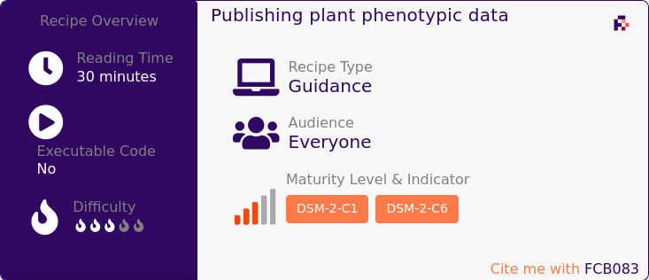
Publication of plant experimental data in generic data repositories
ElF
URL: https://faircookbook.elixir-europe.org/content/recipes/reusability/plant-pheno-data-publication.html
Permanent Identifier: https://w3id.org/faircookbook/FCB083

Slide 29
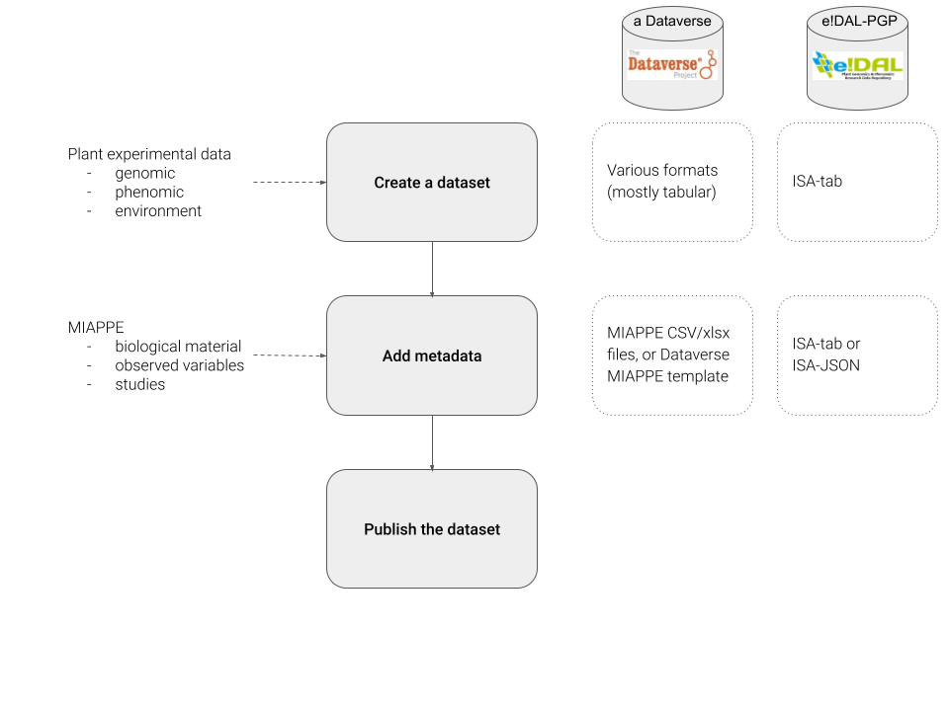
ElF

Slide 30
Questions

Slide 31
FAIR Cookbook recipe: Publication of plant experimental data in generic data repositories
ElF
https://faircookbook.elixir-europe.org/content/recipes/reusability/plant-pheno-data-publication.html

Slide 32
ElF

Slide 33
Plant Phenotyping data publication using e!DAL-PGP
DA

Slide 34
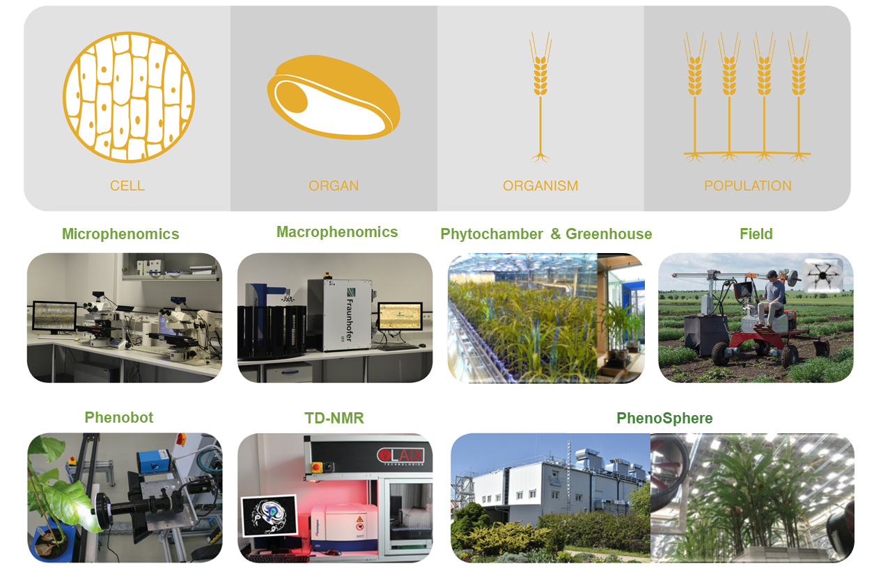
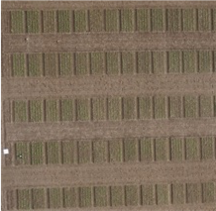
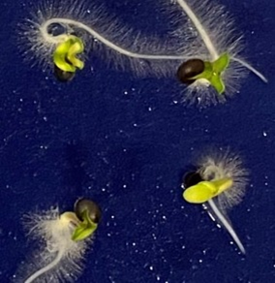
Stewardship of Plant Phenotypic Research Data
Phenotyping means the quantitative analysis of plant structures and functions
* IPK Gatersleben - RG AAN
* IPK Gatersleben/NPZi
* IPK Gatersleben/NPZi
* IPK Gatersleben - RG AAN
* IPK Gatersleben/NPZi
‹#›
* IPK Gatersleben - RG HET
* IPK Gatersleben - RG AAN

Slide 35
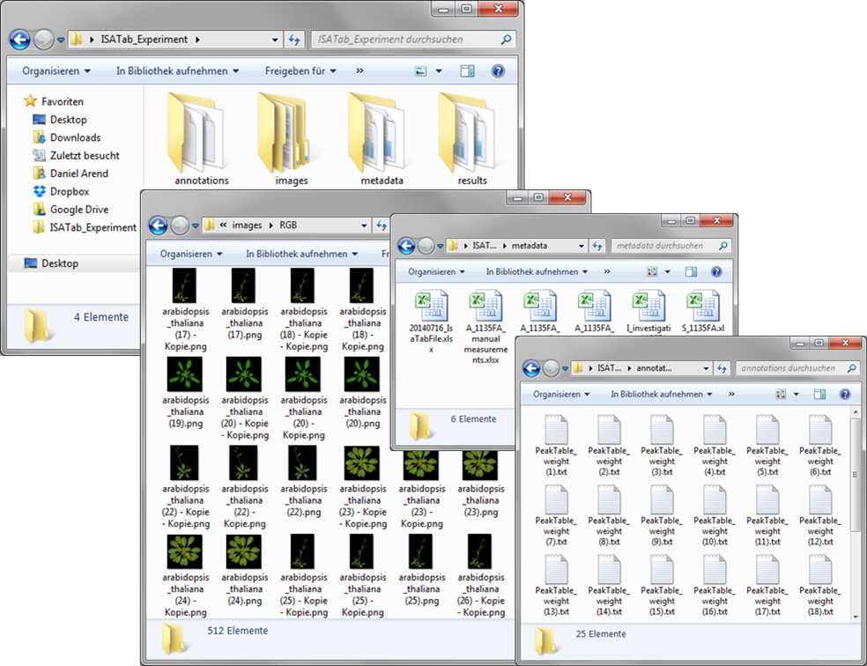
Stewardship of Plant Phenotypic Research Data
huge, complex, heterogeneous
nested folder hierarchy
many small data files (e.g. camera/microscopy images)
single files with huge volume (e.g. hyperspectral pictures)
large text files (e.g. sensor data, measurement)
diverse data formats
proprietary metadata/annotation formatS
‹#›

Slide 36
Bringing the Infrastructure to the Data
‹#›

Slide 37
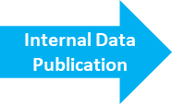
Bringing the Infrastructure to the Data
‹#›

Slide 38
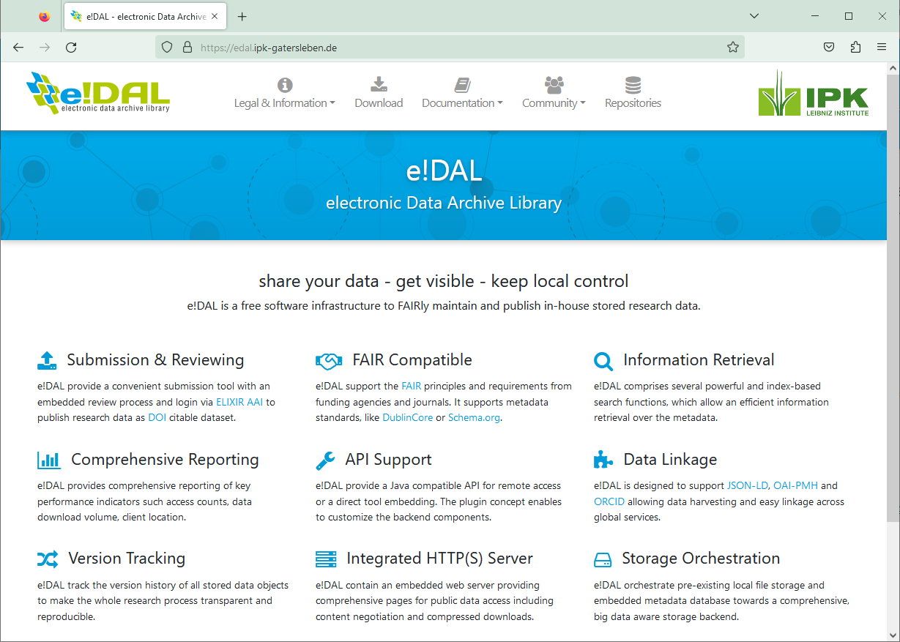
e!DAL - electronic Data Archive Library
generic software infrastructure for archiving & publishing research data in a FAIR-way
platform-independent (Java-based)
open-source
comprehensive set of features
DOI publication
embedded review procedure
comprehensive indexing & search capabilities
everything fully embedded; low maintenance effort/ easy set-up
www.edal.ipk-gatersleben.de
‹#›

Slide 39
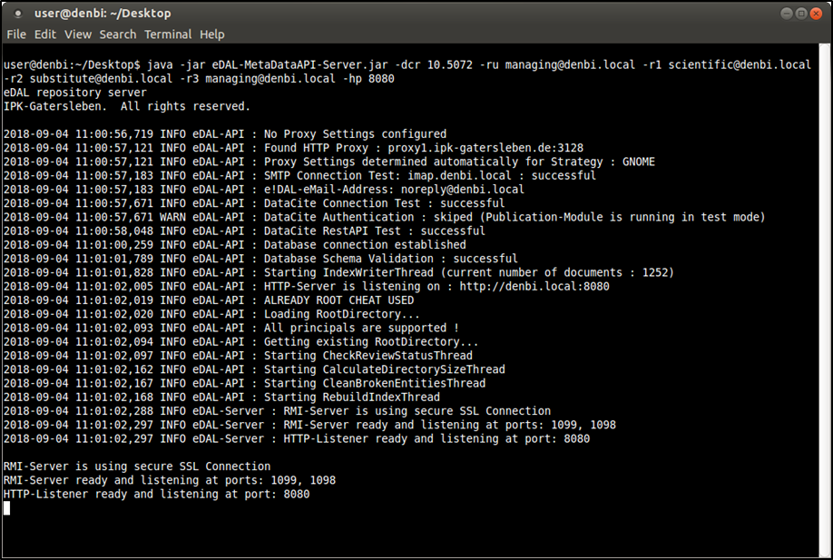
e!DAL - electronic Data Archive Library
designed for large volume & heterogeneous data
installation & self-configuration without prior knowledge
everything fully embedded; low maintenance effort/ easy set-up
www.edal.ipk-gatersleben.de
‹#›

Slide 40
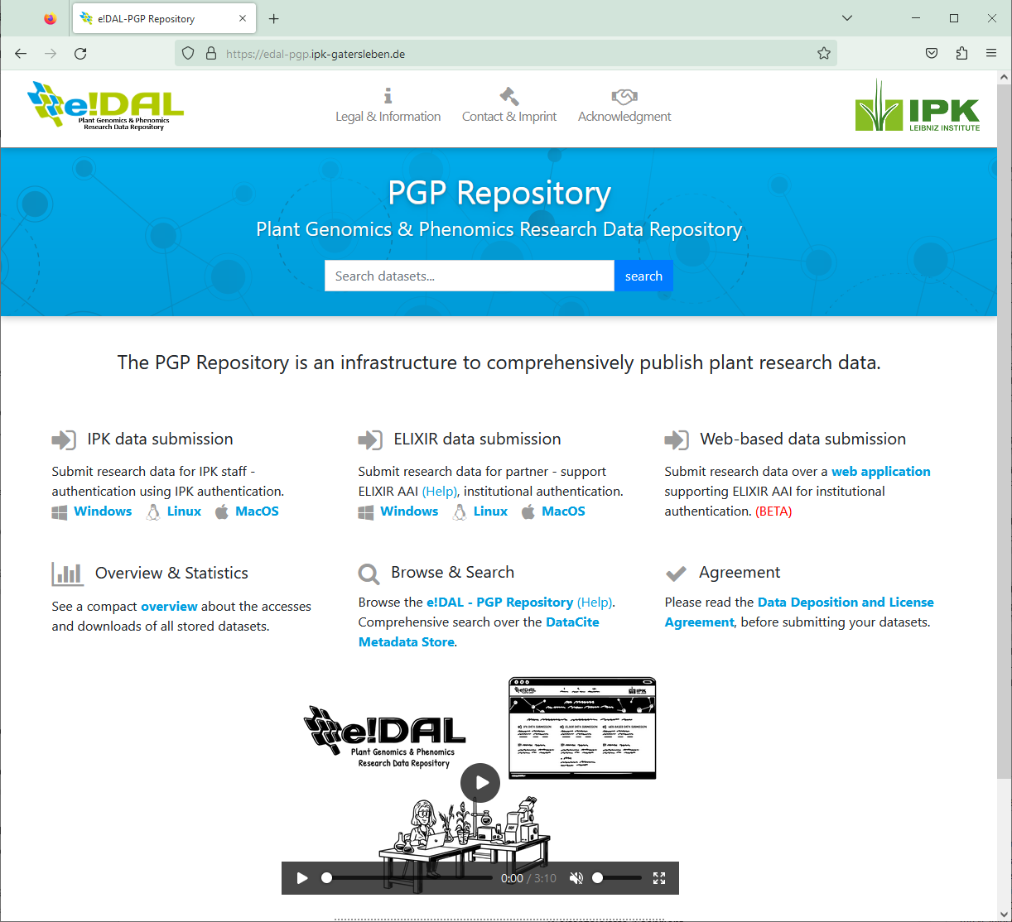
e!DAL - PGP Plant Genomics & Phenomics Research Data Repository
based on e!DAL storage infrastructure
publish large & cross-domain research data
no data type or data volume limitation
FAIR compliant → DOIs, DublinCore, BioSchema…
integrated peer-review like approval process
→ provide data with the highest possible quality
www.edal-pgp.ipk-gatersleben.de
‹#›
Arend et al. 2016, Database (DOI: 10.1093/database/baw033)

Slide 41
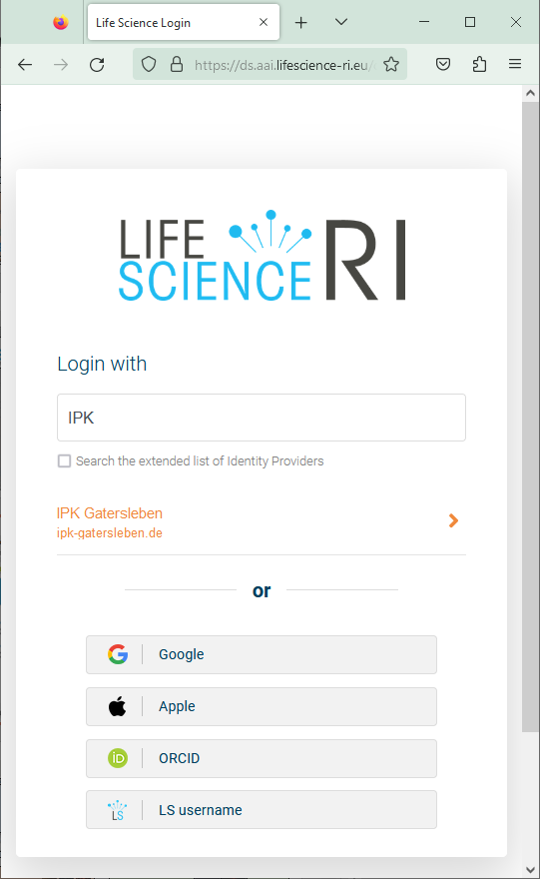
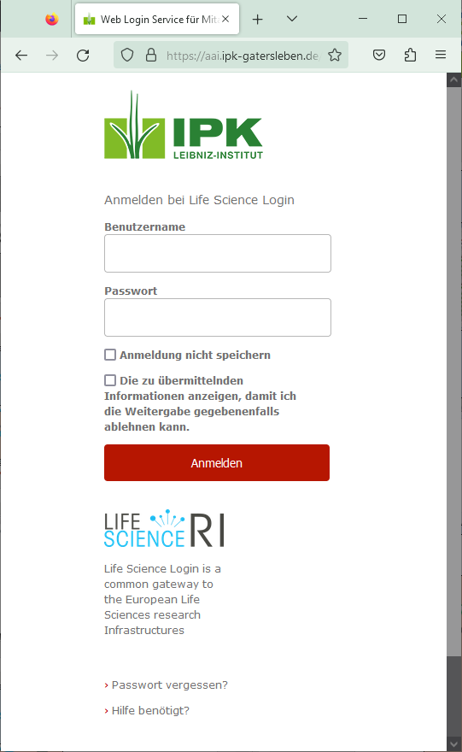
e!DAL - PGP Plant Genomics & Phenomics Research Data Repository
based on e!DAL storage infrastructure
publish large & cross-domain research data
no data type or data volume limitation
FAIR compliant → DOIs, DublinCore, BioSchema…
integrated peer-review like approval process
→ provide data with the highest possible quality
www.edal-pgp.ipk-gatersleben.de
‹#›

Slide 42
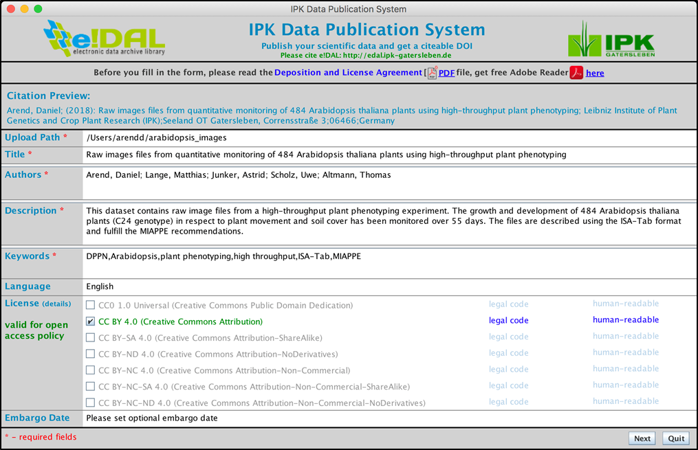
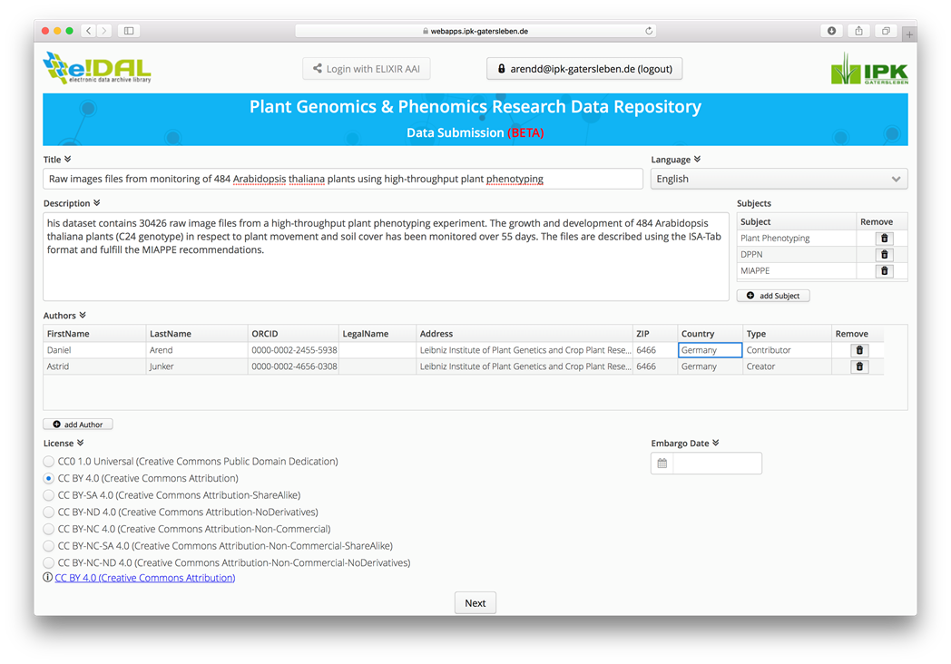
e!DAL - PGP Plant Genomics & Phenomics Research Data Repository
desktop-app & web client
form-based submission dialog
upload datasets & provide technical metadata
‹#›

Slide 43
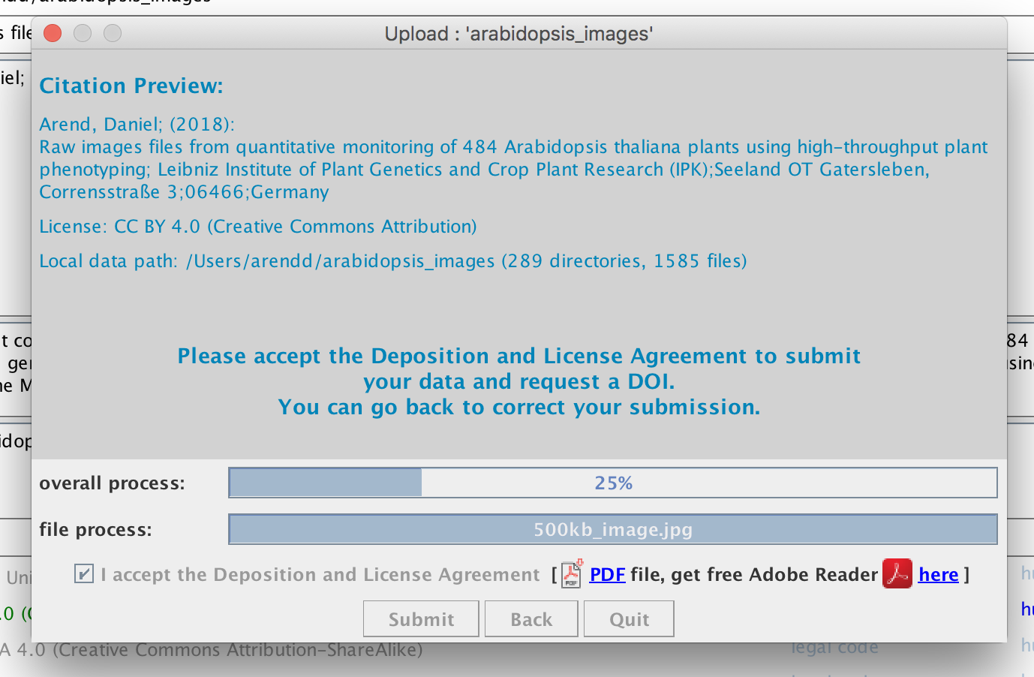
e!DAL - PGP Plant Genomics & Phenomics Research Data Repository
desktop-app & web client
form-based submission dialog
upload datasets & provide technical metadata
‹#›

Slide 44
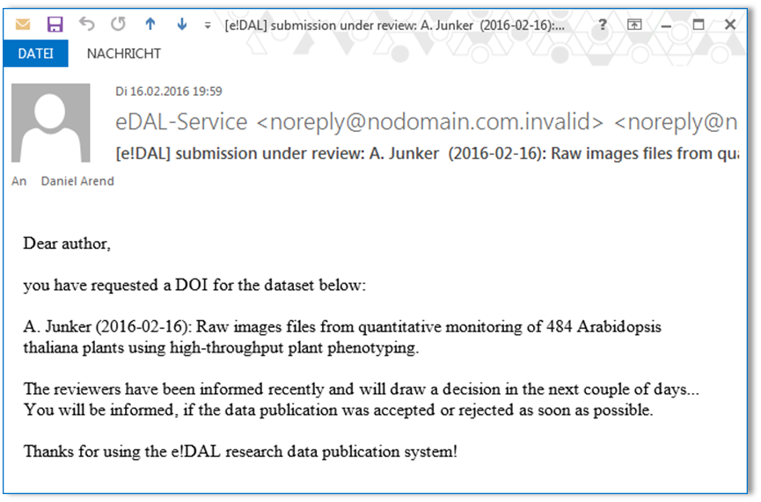
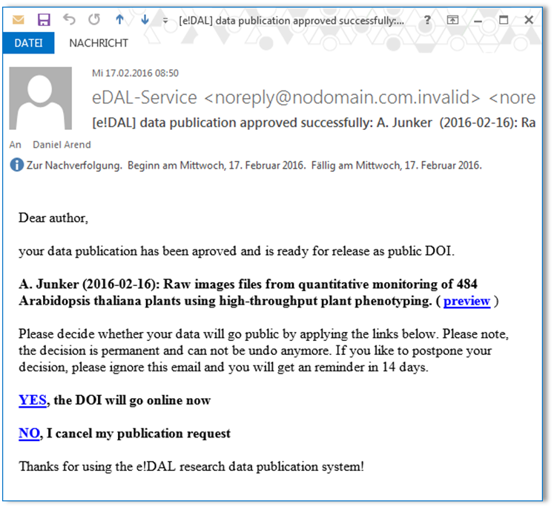
e!DAL - PGP Plant Genomics & Phenomics Research Data Repository
submission automatically initiate review process
check general metadata & file formats
optionally give back suggestions to the data provider
intermediate step to give the data provider the opportunity to change or cancel his submission
data provider decide when the datasets should be published finally
‹#›

Slide 45
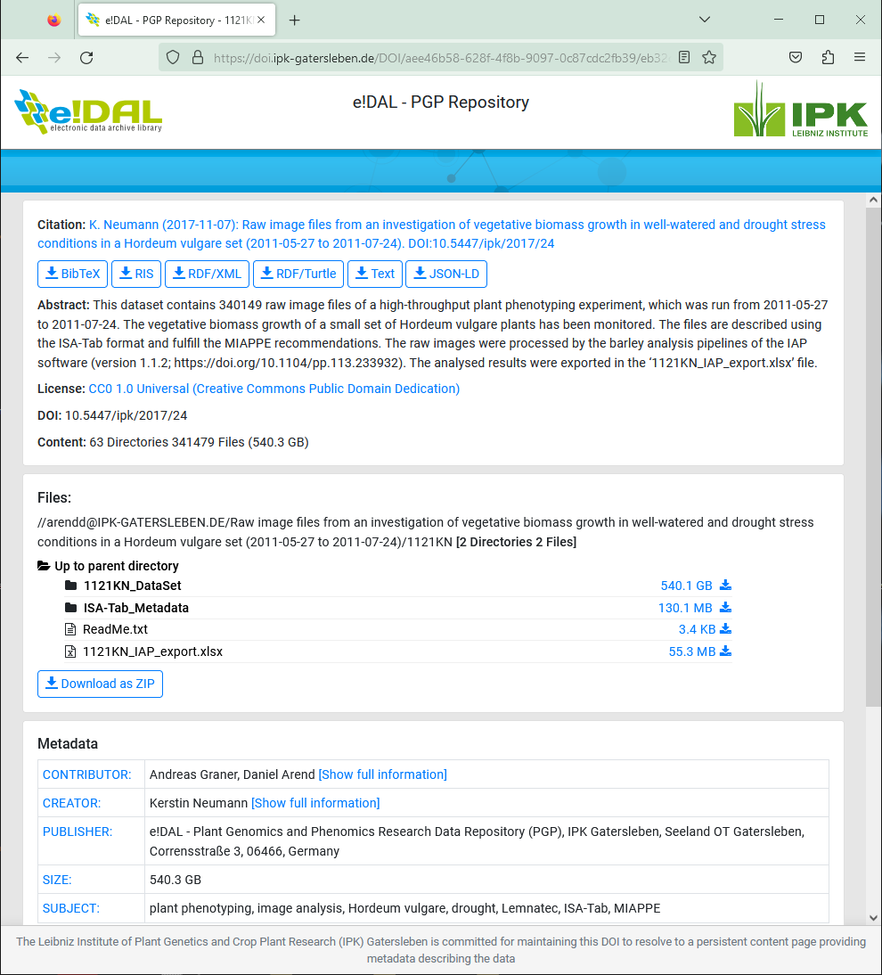
e!DAL - PGP Plant Genomics & Phenomics Research Data Repository
every dataset is accessible via DOI
infrastructure can handle large & comprehensive datasets
content page allow navigation & data download
embedded metadata (schema.org/BioSchemas) allow harvesting and make data interoperable
enables re-usability & visibility of the datasets for data users, publishers, search engines…
www.edal-pgp.ipk-gatersleben.de
‹#›

Slide 46
Dataverse
ElF
https://faircookbook.elixir-europe.org/content/recipes/reusability/plant-pheno-data-publication.html#step-by-step-process-for-data-submission-and-publication-in-dataverses
https://demo.dataverse.org/

Slide 47
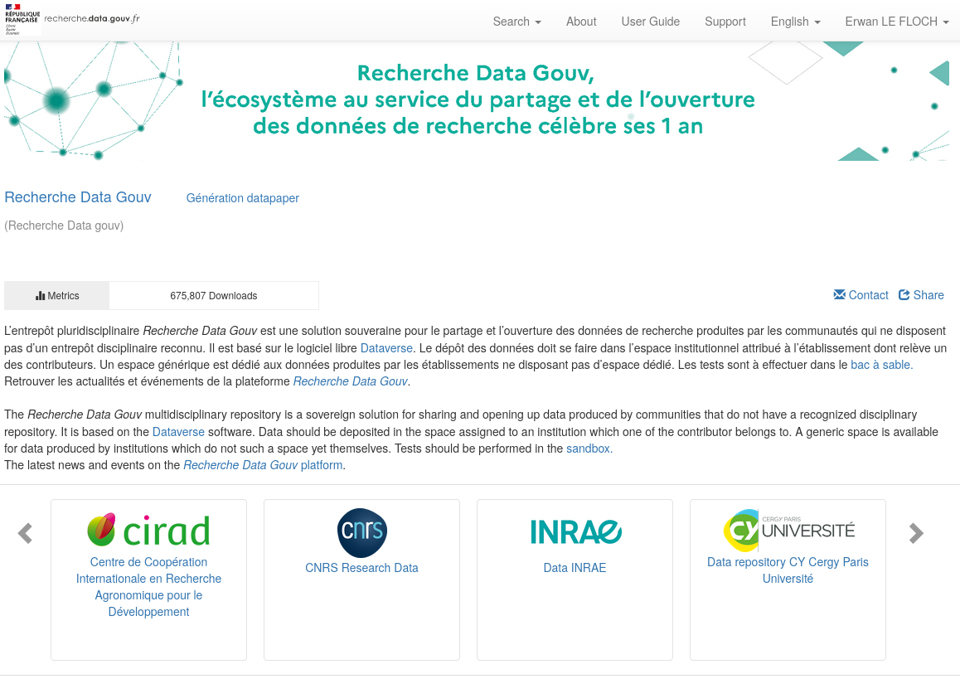
Step 1: Dataset creation
ElF
sub-dataverse

Slide 48
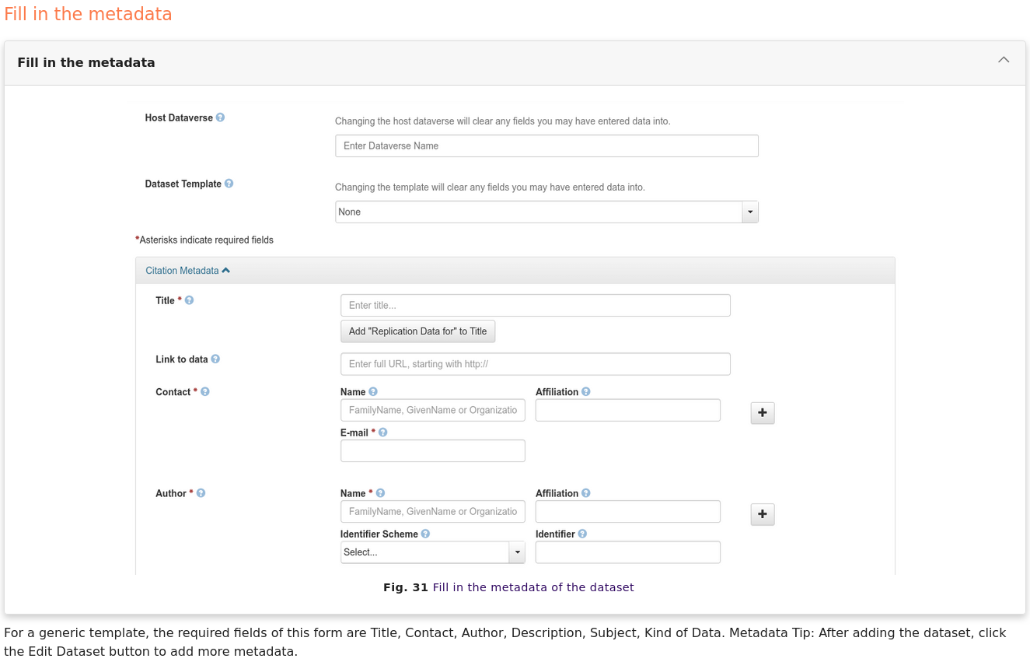
Step 1: Dataset creation
ElF

Slide 49
Step 2: Add mandatory metadata for plant phenotyping data
ElF

Slide 50
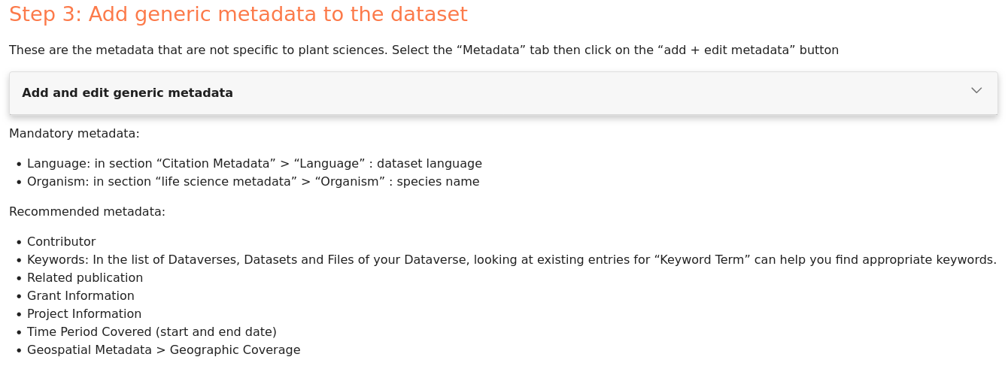
Step 3: Add generic metadata to the dataset
ElF

Slide 51
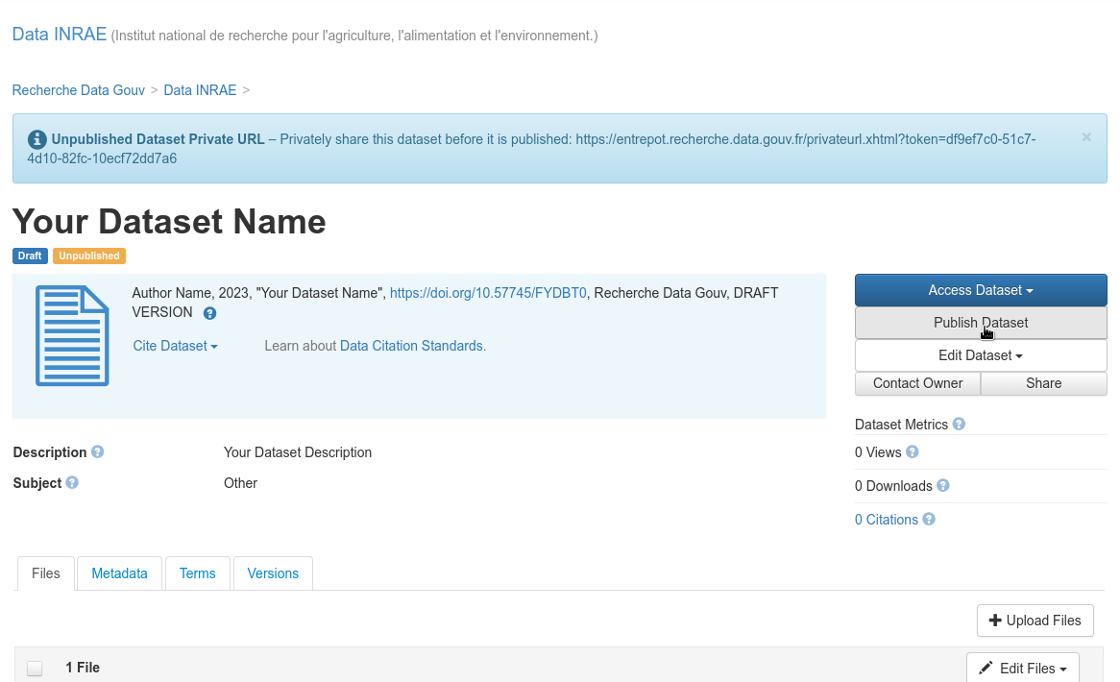
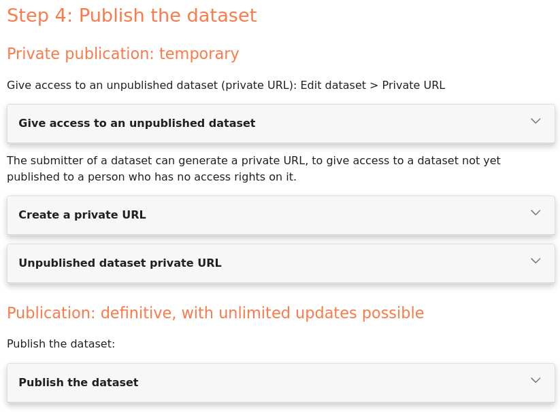
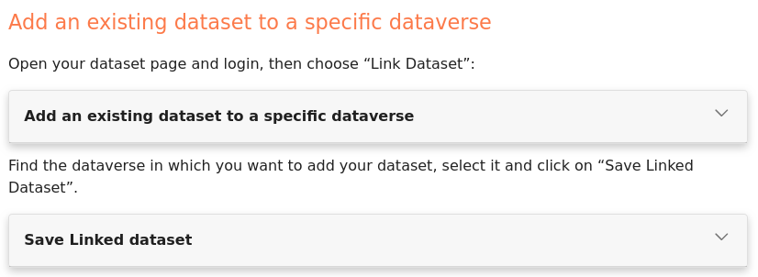
Step 4: Publish the dataset
ElF

Slide 52
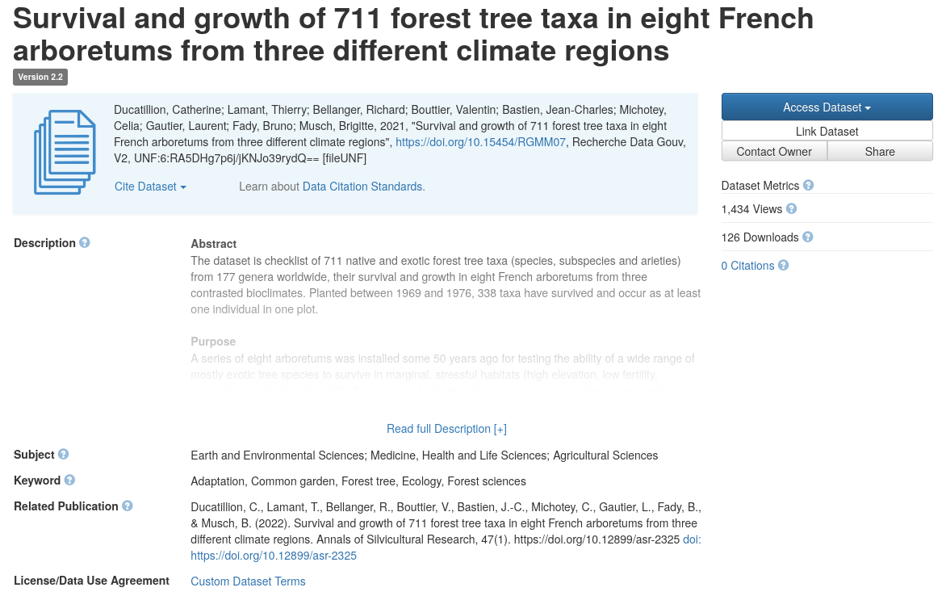
Dataverse dataset example
ElF
https://doi.org/10.15454/RGMM07

Slide 53
Questions

Slide 54
MIAPPE Overview
CP

Slide 55
Generic data repositories limitations
CP
(Too) broad metadata
Year, Data type, Author
Organism: no controlled vocabulary
Keyword, Subject
Lacking plant phenomic specific metadata
Biological material, from species to genetic resource accession
Traits
Experiment locations
…
Need of dedicated metadata scheme, added to generic data repositories
As additional metadata → Filling long list in the repository form is not an option
As companion files
Complete MIAPPE presentation linked here:
https://docs.google.com/presentation/d/17vIXWJ1GZObDk6bPtcXWwU0-Adz5iipg/

Slide 56
MIAPPE @ Dataverse
CP

Slide 57
Maize Example
CP
DROPS project dataset: https://doi.org/10.15454/IASSTN

Slide 58
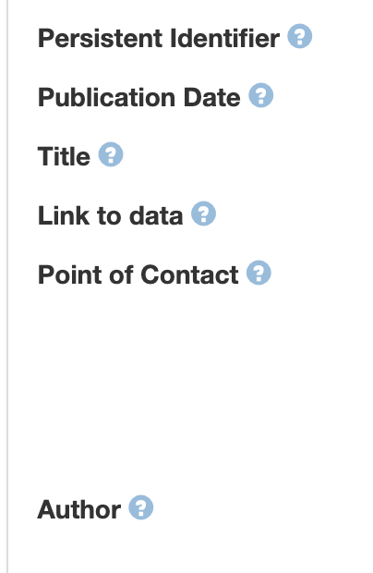
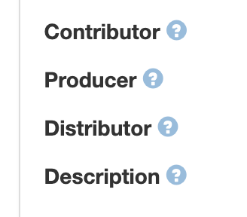
General Metadata
CP
Filled in dataverse

Slide 59
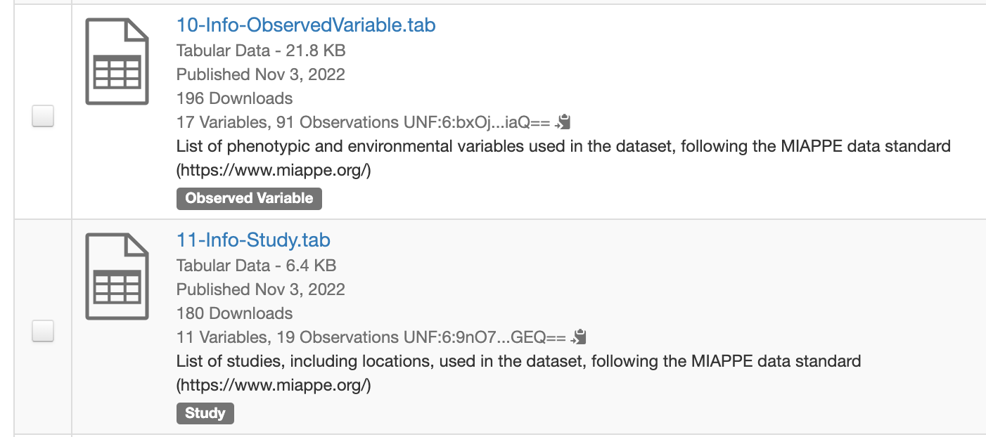
MIAPPE Metadata
CP

Slide 60
MIAPPE Metadata
CP

Slide 61
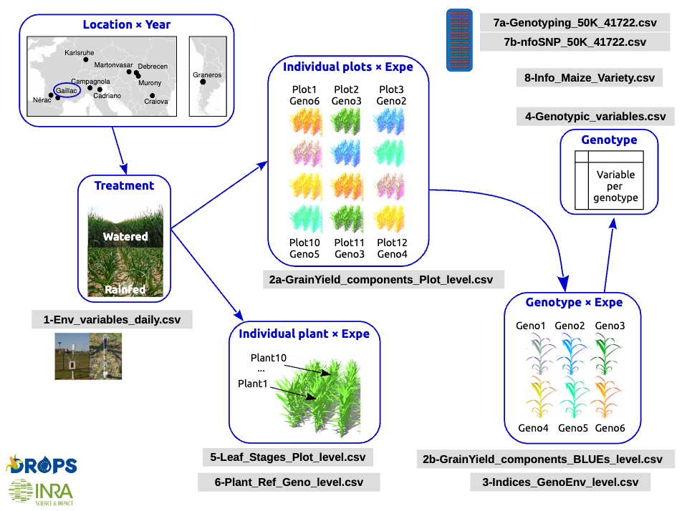
Good practice: Human friendly Provenance
CP
Links between files

Slide 62
Publication of plant experimental data in generic data repositories
CP
https://faircookbook.elixir-europe.org/content/recipes/reusability/plant-pheno-data-publication.html#step-2-add-mandatory-metadata-for-plant-phenotyping-data

Slide 63
Publication of plant experimental data in generic data repositories
CP

Slide 64
Publication of plant experimental data in generic data repositories
CP

Slide 65
Publication of plant experimental data in generic data repositories
CP
Used by Metadata indexer in the future
Notes:
Mark W to Everyone (6 Oct 2023, 15:47)
So.... you've created a MIOMIAPPE? Minimal information Of Minimal Information About a Plant Phenotyping Excperiment :-)
Can you link me to the ontology that you abbreviated as "EIPO"? THanks!
(and MIPO too, thanks!)
You to Everyone (6 Oct 2023, 15:56)
MIPO in the Crop Ontology template : https://forgemia.inra.fr/urgi-is/ontologies/-/tree/develop/Maize
Mark W to Everyone (6 Oct 2023, 15:56)
thanks !
You to Everyone (6 Oct 2023, 15:57)
And the browser : https://urgi.versailles.inra.fr/ephesis/ephesis/ontologyportal.do#termIdentifier=MIPO
EIPO : https://forgemia.inra.fr/urgi-is/ontologies/-/tree/develop/Environment
and EIPO browser : https://urgi.versailles.inra.fr/ephesis/ephesis/ontologyportal.do#termIdentifier=EIPO
Mark W to Everyone (6 Oct 2023, 15:58)
thank you!

Slide 66
MIAPPE @ e!DAL-PGP
DA

Slide 67
Questions

Slide 68
Perspectives

Slide 69
MIAPPE Template, Frictionless validator and FAIRDOM-SEEK
ElF
https://github.com/MIAPPE/MIAPPE/tree/v1.2/Templates
https://framework.frictionlessdata.io/
https://seek4science.org/

Slide 70
MIAPPE Template, Frictionless validator and FAIRDOM-SEEK
ElF
A way to handle confidential project data
Based on ISA, and MIAPPE compliant
MIAPPE metadata option in SEEK / or inside the spreadsheet template
Coming soon: the MIAPPE xlsx template validator

Slide 71
AGENT Data File Validator Demo

Slide 72
What is the validator
Developed by Reinhoud de Blok & Matthijs Brouwer (WUR)
Based on the Frictionless framework
Uses the API to communicate with FAIRDOM
The code is on the AGENT GitHub (but still private)
The instance in use is deployed in a container, on a server at INRAE
Checks every 5 min for new files, corrects them, tags them ‘Valid’ or ‘Invalid’ and creates detailed validation reports.
If you encounter bugs or would like to request a feature, please contact us: agent-helpdesk@inrae.fr

Slide 73
Validator demo
1: Choose an invalid file to correct.
The “Invalid” tag is selected

Slide 74
Validator demo
2: Look at the corresponding generated validation report (it is in the same assay as the datafile).
The datafile
The latest report for the datafile

Slide 75
Validator demo
3: Compare the report to the datafile, and correct the datafile accordingly in a spreadsheet editor like ms excel or libreoffice calc.
An error
The cell causing the error
(here, the error is that it is empty whereas it’s a mandatory field)

Slide 76
Validator demo
4: Upload the corrected file to fairdom as a new version of your datafile. (1/2)

Slide 77
Validator demo
4: Upload the corrected file to fairdom as a new version of your datafile. (2/2)
Select your file
Insert your revision comments

Slide 78
Validator demo
5: The new report is generated automatically, within 5 to 15 minutes. Use this time to take a small break, then have a look at the new report. Then go back to step n°3 if necessary.
Back to step n°3
5-15 min
Go ahead to step n°6
public domain picture

Slide 79
Validator demo
6: The datafile metadata are validated !! 🥳

Slide 80
MIAPPE Wizard
DA

Slide 81
MIAPPE Wizard
DA
in future we also need better tools to facilitate the usage of MIAPPE and make it more convenient
→ first try: developing a MIAPPE Wizard (https://doi.org/10.37044/osf.io/ekhdw)
→ continue development in frame of
2nd BioHackthon Germany (https://www.denbi.de/de-nbi-events/1547-biohackathon-germany-2)
→ registration is still open

Slide 82
Take Home message
Generic data repositories
Easy submission
Any data type, any innovation
Any step of the datalifecycle.
Probably not the most complex multidimensional datasets
Open, national (+ global partners) focused
Guideline extension to Zenodo on the way
Additional Metadata are paramount
Biological Material
Studies/Experiment
Observation Variables
Easy, file based management approach
Entry points as reference, including future updates
https://rdmkit.elixir-europe.org/plant_phenomics_assembly

Slide 83
Acknowledgments & Questions
MIAPPE community
ELIXIR Plant Community,
Krajewsky P, Cwiek H, Tardieu F, Usadel B, Arend D, Arnaud E, Junker A, King G, Laporte MA, Poorter H, Reif J, Rocca-Serra P, Sansone SA, Kersey P,
And many more!
Crop Ontology
Arnaud E, Laporte MA, …
Breeding API
Selby P, Mueller L, Robbins K, Backlund JE, … ,
And many more!
Emphasis
Tardieu F, Usadel B, Arend D, Junker A, Poorter H, Neveu P, Pierushka R, Shur U…
And many more!
Thanks
Elixir Plant community & platforms
Beier S., Gruden C., Pommier C., Coppens F, Scholz U., Lange M., Contreras B., Adam Blondon AF, Faria D, Chavez I, Miguel C, Droedsbek B, Finkers R, Papoutsoglou E, Olster R, Ramsak Z, …

