Slide 1
Minimum Information for Plant Phenotyping Experiments (MIAPPE)
Plant science data management and integration

Slide 2
Why should we standardize phenotyping data?
To enable anyone (including yourself) to reuse it: metadata about the experiment (who did it, for what purpose, where and how)
To enable the (automatic) integration with other types of data: Linked data between datasets using identification of pivot objects
Phenotype 1 = measurement on a cultivar in an environment-GPS1-time1
Phenotype 2 = measurement on a cultivar in an environment-GPS2-time2
Genotype = observed marker’s alleles on a cultivar
Climate 1 = climatic data at GPS1-time1
To enable knowledge discovery: metadata about the experiment, controlled vocabularies, ontologies

Slide 3
Data standards for FAIR
Structure
Formatting and Organizing the data
Data Models
Standards : CSV, VCF, GFF, MIAPPE (www.miappe.org) , etc…
Biologist & Computer scientist driven
Semantic
Description of the data
Controlled vocabularies: term name and definitions
Ontologies: semantic links between terms
Biologist driven
Persistent Unique Identifiers
URI, gene ID, accessions ID, Trait ID, DOI,…
Technical
Data integration and sharing
Interoperability : tools and systems
GA4GH
Breeding API www.brapi.org
Computer scientist driven

Slide 4
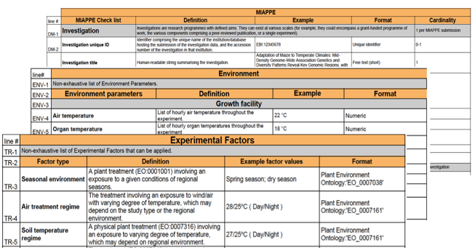
Phenotype Structure Standard
Minimal Information About Plant Phenotyping Experiment : version 1.1 (Jan 2019)
www.miappe.org
Many stakeholders
Elixir, Emphasis, Bioversity, North American PPN
Open Community:
Request for comments
Github Feature requests
Mailing lists
Meetings & Workgroups
Crops and woody plants
Papoutsoglou et al. (2020) Enabling reusability and interoperability of plant phenomic datasets with MIAPPE 1.1. New Phytol, 227:260-273; https://doi.org/10.1111/nph.16544

Slide 5
Phenotype Structure Standard : MIAPPE
Biologist Friendly
Clear definitions and examples
Excel templates
Trainings
Minimal and sufficient list of metadata:
The objective of the experiment
Who contributed to the experiment
What were the experimental procedures
What was the biological material experimented
...
Collaborating with other standards
MCPD for Biological Material identification & description
Crop Ontology for trait description
Breeding API for Web services
ISA for data exchange container, ROCrate soon

Slide 6
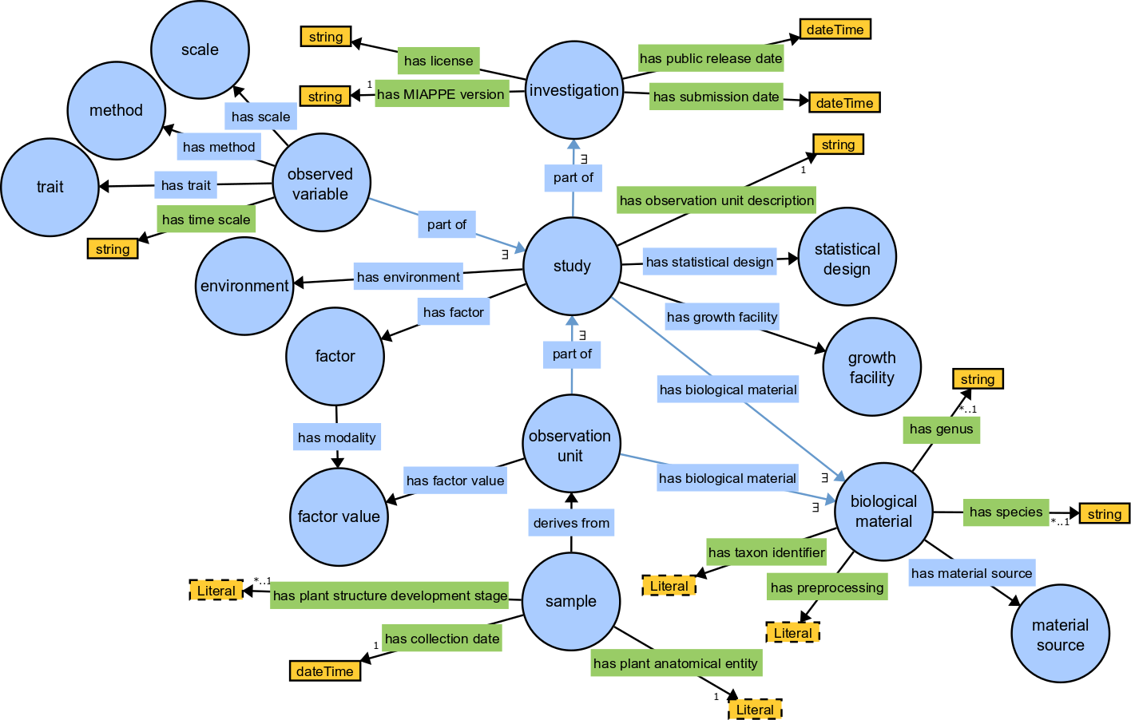
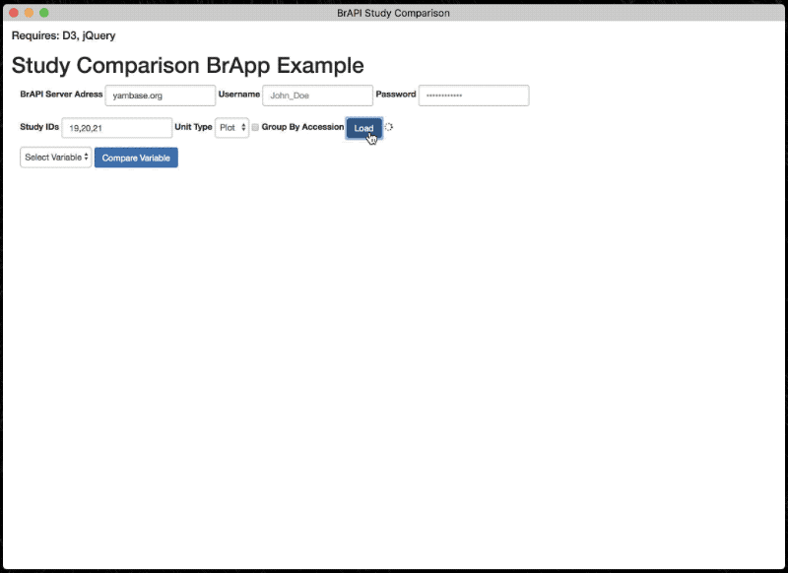
MIAPPE Implementations
Ontology, OWL Implementation
https://github.com/MIAPPE/MIAPPE-ontology
File Archive
ISA Tab: data + metadata
RO Crate studies
Web Services
Breeding API
Databases
PIPPA (Collecting)
PHIS (Collecting)
GnpIS (Publishing)
Data.inae.fr datasets (Publishing)
eDALE! (Publishing)
Biosamples
…
Data portals
See RDM Kit Plant Pheno assembly
end of the year
https://rdmkit.elixir-europe.org/tool_assembly
Poster n°

Slide 7
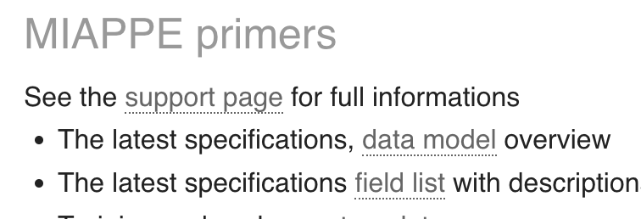
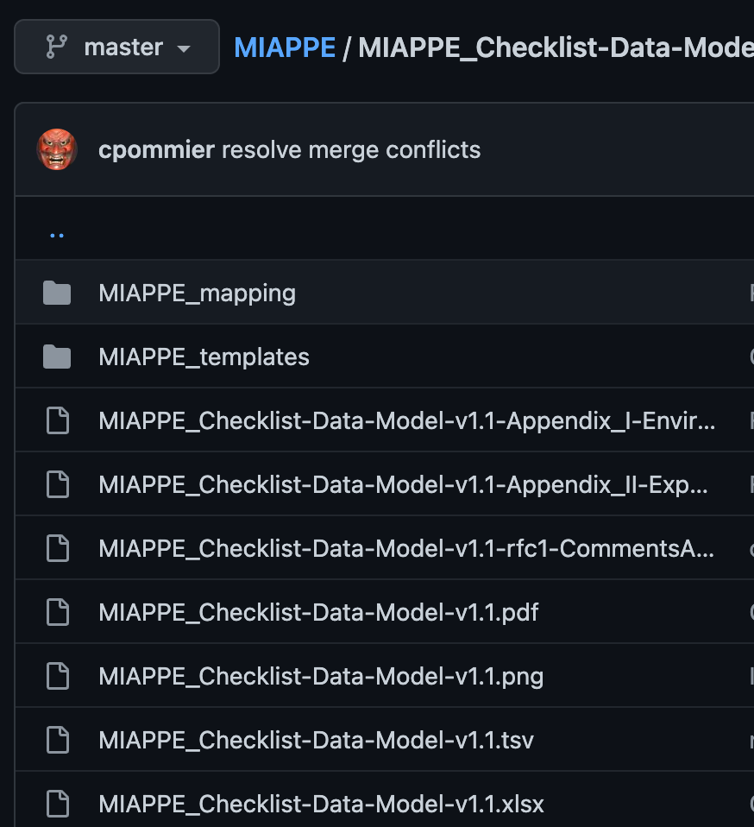
MIAPPE Specifications
www.miappe.org
To github
https://github.com/MIAPPE/MIAPPE/tree/master/MIAPPE_Checklist-Data-Model-v1.1

Slide 8
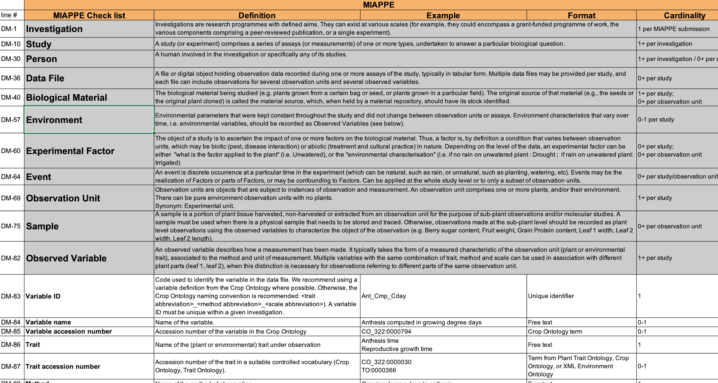
MIAPPE Specifications
Specification table
Sections
Metadata Fields

Slide 9
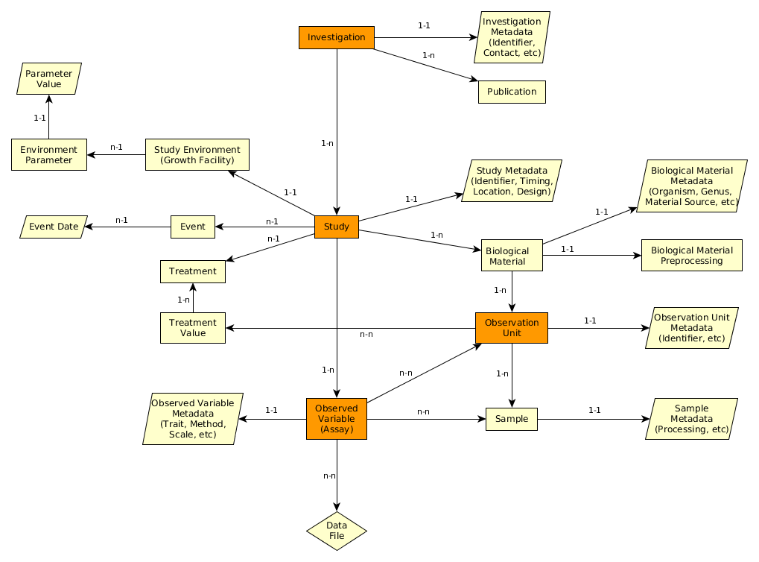
MIAPPE Specifications
Specification table
Sections
Metadata Fields
Linked and organized

Slide 10
MIAPPE V1.1 Overview the (ISA) backbone
Investigation: whole dataset
Study : one experiment in one location for one to several year
Assay:
trait or indice (Pheno or Env) observed
Level + Trait + Method + Scale/Unit
Level:
Plant
Microplot
Block
Trial
…
Investigation
Study
Assay
(Observed variable)
Data file

Slide 11
MIAPPE V1.1 Overview Data file content
Any format (Near Infra Red Spectrum, Images, Image Archives references, ….)
Mostly tabular
Metadata on each column header

Slide 12
MIAPPE main sections – Biological material
Plant Material
Identification
Description
Multi Crop Passport Descriptor
Biological material
MCPD identification system:
Genebank/Lab + Species + accession number
DOI
Observation Unit
Material Source: accession, cultivar/variety, region of provenance, laboratory cross, ...
Sample
Biological material used in the study: seed lot, cuttings…
Lab + internal accession number
URI
Lab + internal accession number (mandatory)
BioSample ID
Plant Samples used in the study: detached leaves, ...

Slide 13
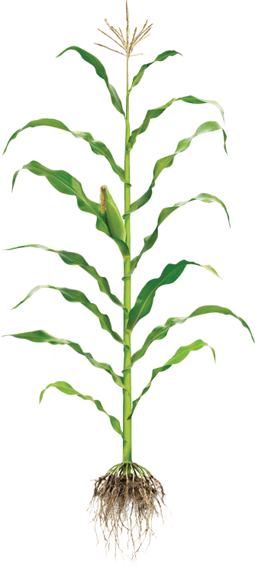
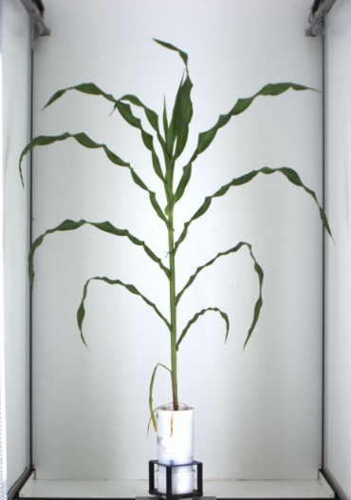
MIAPPE main sections – Observed Variable (Assay)
General : *omics, genomic (Gene Ontology)
Plant Specific:
Phenotyping/environment variable = Trait + Method + Unit/Scale
+
+
Trait
Method
Unit
M1: Total height
M2: First tassel branch
Slide:
L Cabrera-Bosquet
M3: Last expanded leaf
M4: Youngest growing leaf
U1: cm
U2: mm
T1: Plant Height
M5: Highest pixel corresponding to plant
U3: pixel
L Cabrera

Slide 14
MIAPPE – Other Important sections
Investigation
Files: data,…
Environment
Events
Study
Biological material
Expe Factor
Observation Unit
Assay
(Observed variable)
Sample

Slide 15
Aknowledgments
Elixir Plant community & platforms
Beier S., Gruden C., Pommier C., Coppens F, Scholz U., Lange M., Contreras B., Adam Blondon AF, Faria D, Chavez I, Miguel C, Droedsbek B, Finkers R, Papoutsoglou E, Olster R, Ramsak Z, …
H2020 AGENT
N. Stein (IPK, coord), P. Kersey (RBGK), M. Alaux (INRAE), S. Weise (IPK), C. Pommier (INRAE), M. Lange (IPK), R. Finkers (WUR), J. Destin (INRAE)
MIAPPE community
ELIXIR Plant Community,
Krajewsky P, Cwiek H, Tardieu F, Usadel B, Arend D, Arnaud E, Junker A, King G, Laporte MA, Poorter H, Reif J, Rocca-Serra P, Sansone SA, Kersey P,
And many more!
Crop Ontology
Arnaud E, Laporte MA, …
Breeding API
Selby P, Mueller L, Robbins K, Backlund JE, … ,
And many more!
Emphasis
Tardieu F, Usadel B, Arend D, Junker A, Poorter H, Neveu P, Pierushka R, Shur U…
And many more!

