Slide 1
Plant Orthology Bundle
INCREASING Implementation study
Pedro Barros, ITQB NOVA, PT

Slide 2
Agenda
Introduction | Pedro Barros, ITQB NOVA, Oeiras, Portugal
Presentation of Gene Orthology Tools (~ 15 min + 5 min Q&A)
Ensembl Plants | Guy Naamati, EMBL, European Bioinformatics Institute, Cambridge, UK
PLAZA | Michiel Van Bel / Klaas Vandepoele, Ghent University/VIB, Ghent, Belgium
Mercator4 | Sebastian Beier, Forschungszentrum Jülich GmbH, Jülich, Germany
GoMapMan | Špela Baebler, National Institute of Biology, Ljubljana, Slovenia
Break (10 min)
Case study (~40 min) | Hugo Rodrigues, ITQB NOVA, Oeiras, Portugal
Gene functional data retrieval and visualization based on Orthology predictions, in a non-model plant
Notes:
Principles, benefits and drawbacks of three different plant orthology detection tools

Slide 3
Increasing Plant data findability and reuse beyond ELIXIR
Plant data services and tools available within ELIXIR
Adapt and integrate related tools through service bundles
Improve/develop training materials and use cases
Leverage the use of these tools by a broader community
Plant Gene orthology tools
Comparative approaches based on sequence similarity and homology are often used to explore gene function
Contrasting levels of detail in gene/protein functional annotations between model and non-model plant species.

Slide 4
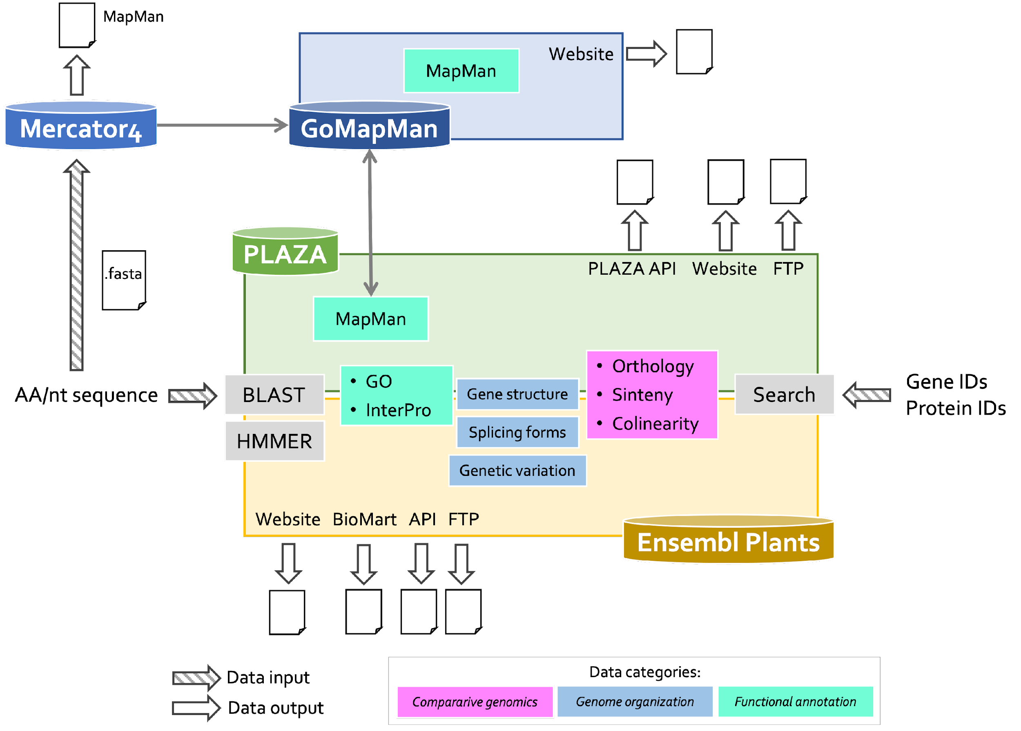
Plant Gene Orthology tools
Ensembl Plants
PLAZA
Mercator4 | Mapman
GoMapMan

Slide 5
Ensembl Plants

Slide 6
Ensembl Plants -
an overview
Guy Naamati
Elixir Plant Orthology workshop
October 5th

Slide 7
Outline of this talk
Introduction to EBI and Ensembl Plants
A brief tour of Ensembl Plants
Variation data
Alphafold in Ensembl Plants
API and bulk data (inc. Biomart)
Rapid release and archives

Slide 8
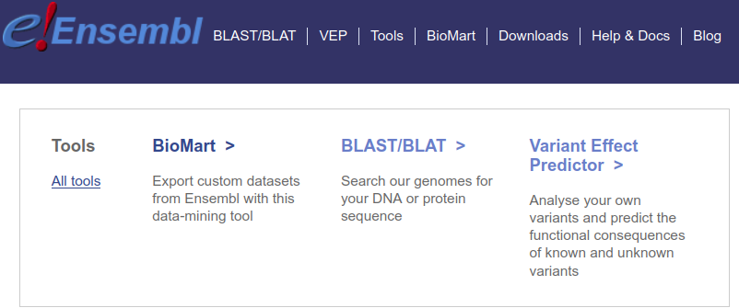
What is Ensembl ?
An open access platform for genomic data and annotation.
Completely free and open source.

Slide 9
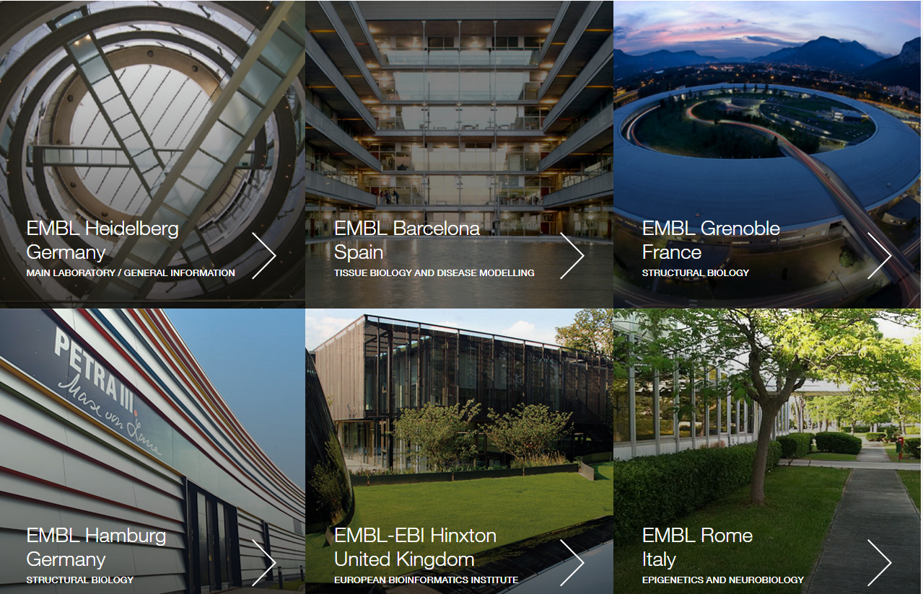

Slide 10
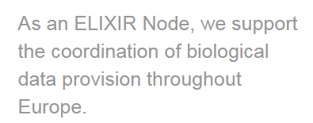
What we do in the European Bioinformatics Institute (EBI) ?

Slide 11
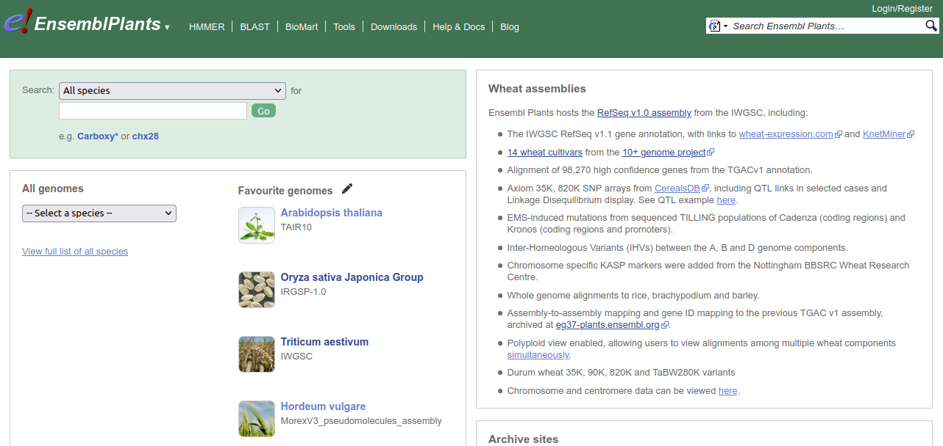
Ensembl Plants
125+ plant species
https://plants.ensembl.org

Slide 12
Ensembl Plants ??
Over 125 genome assemblies
Comparative Genomics
Variation
Training
EBI suite of tools
Free and open source
APIs (programmatic access)
3 releases per year (currently Version 57)
57

Slide 14
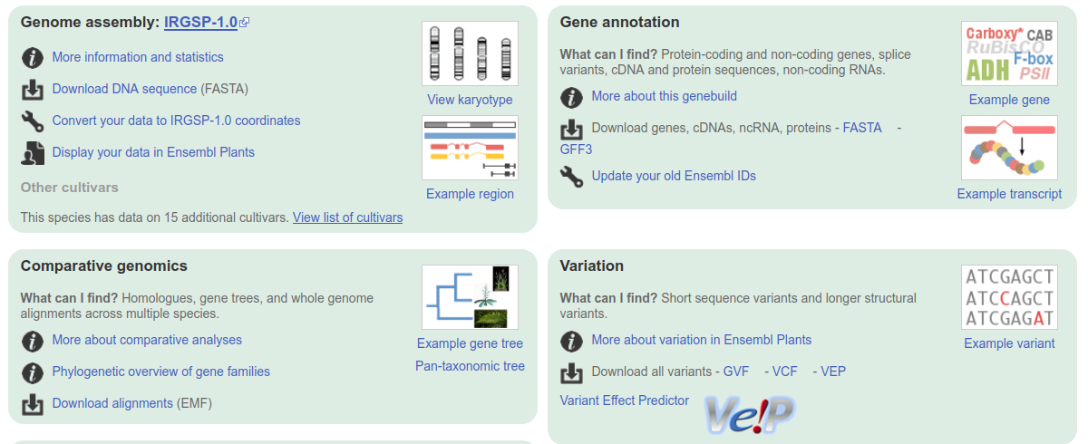

Slide 16
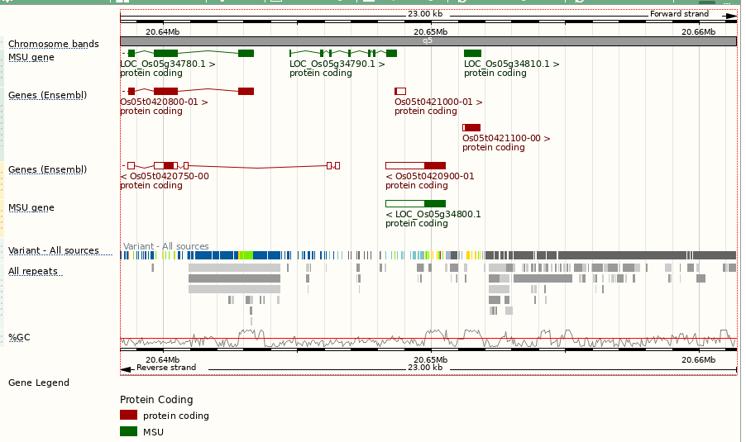
The Ensembl Plants Genome Browser
Intron
Genes from different shown in different colours
Non-coding exons
Coding exon
Variants

Slide 18
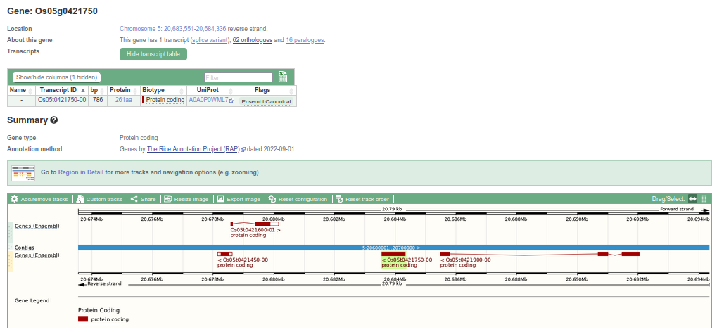
From Genome Browser to Gene
Gene info
Transcript info
Genome browser

Slide 19
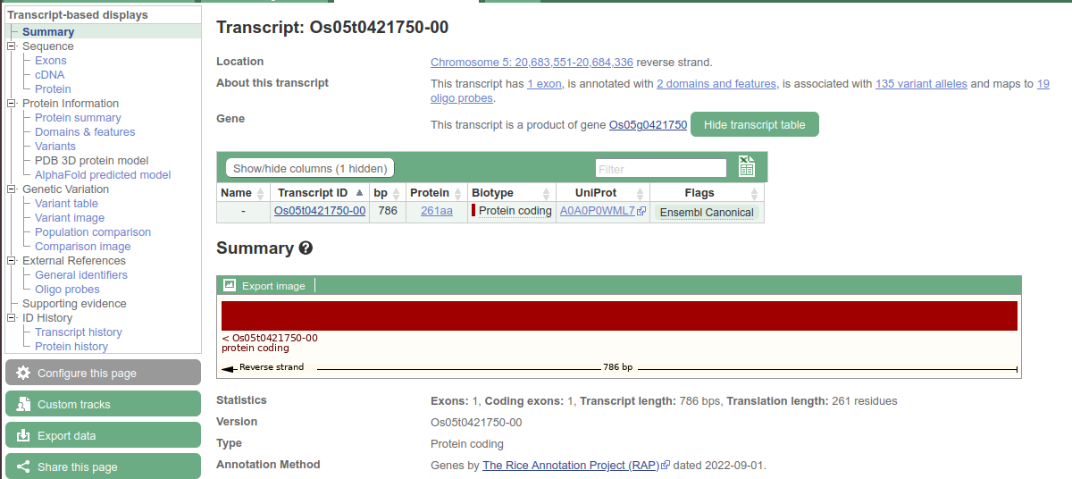
From Gene to Transcript
Sequence information

Slide 20
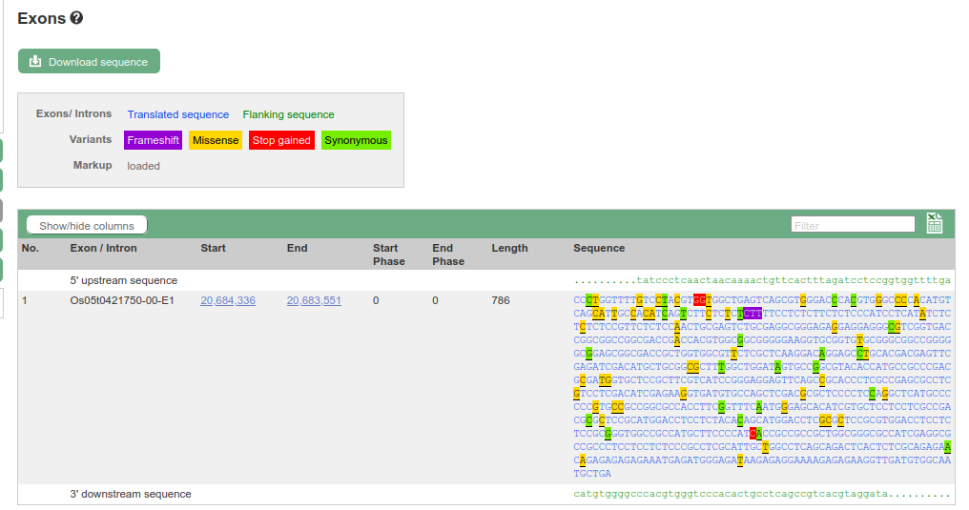
From Transcript to Exon Sequence
Variation in sequence

Slide 21
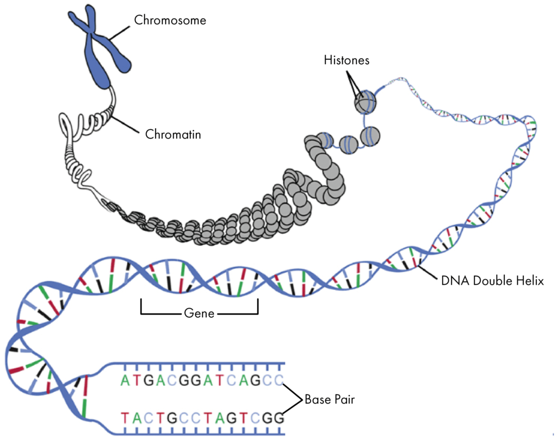
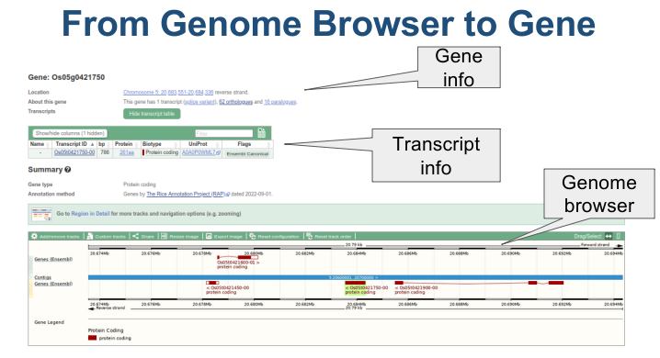
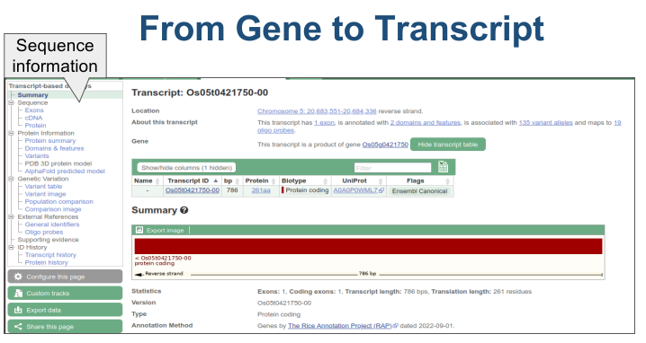

Slide 23
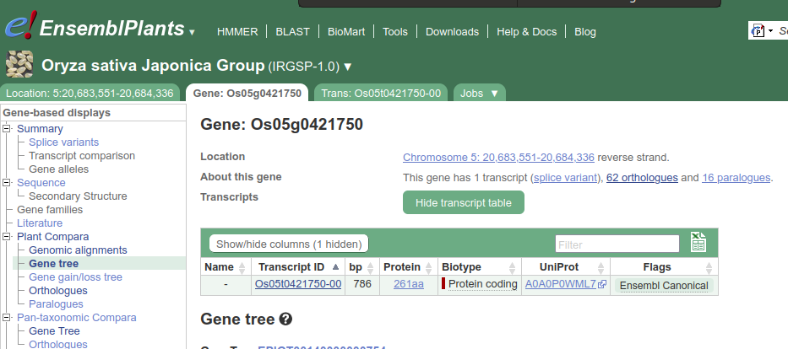
Comparative Analysis

Slide 24
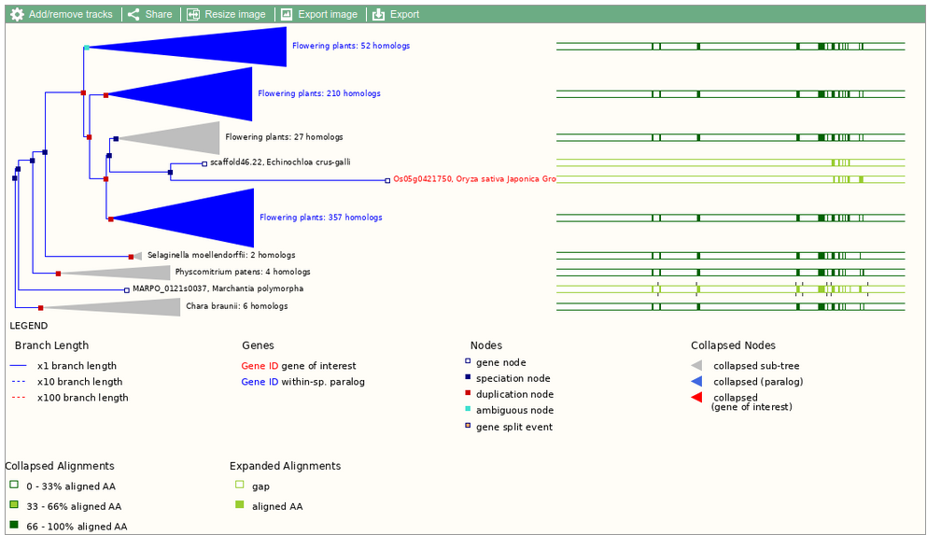
Gene Tree

Slide 25
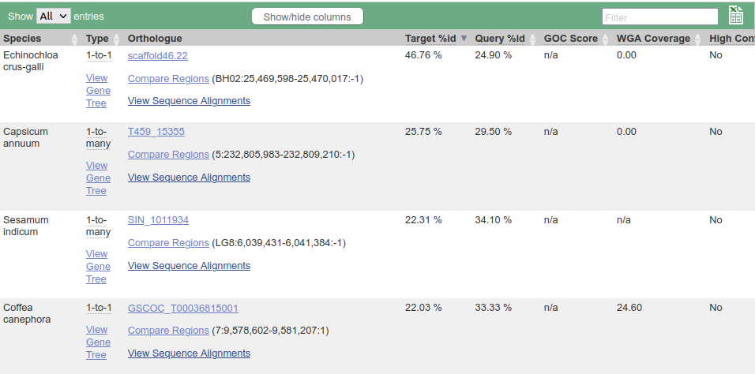
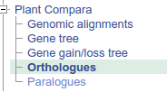
Gene: TraesCS3D02G273600

Slide 26
Variation in Ensembl Plants
Notes:
31,779 (out of 35,143) markers from the 35K Axiom SNP array and 768,664 (out of 819,570) markers from the 820K Axiom SNP array were aligned to the assembly.
The 35K set includes genotype data from 1,963 samples while the 820K has 475 samples.

Slide 27
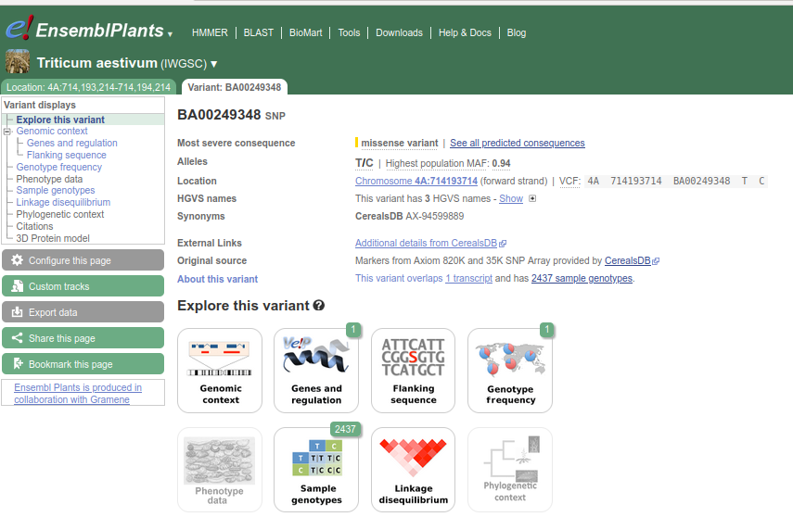

Slide 28
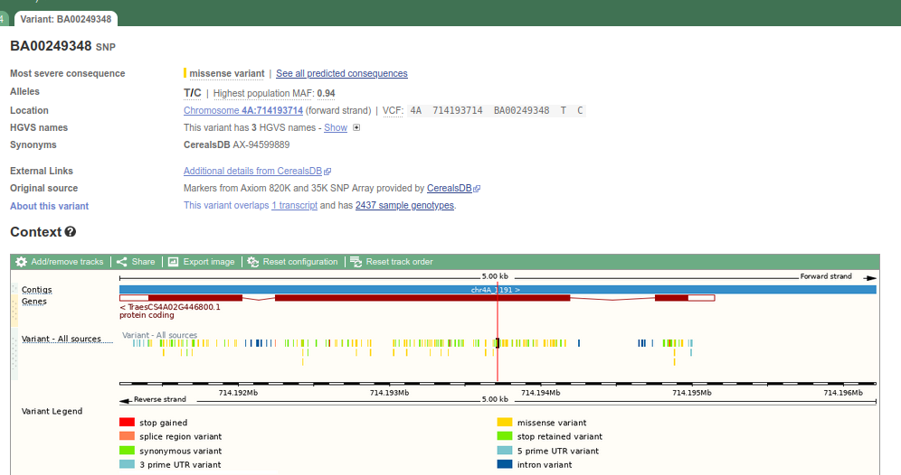
Genomic Context

Slide 29
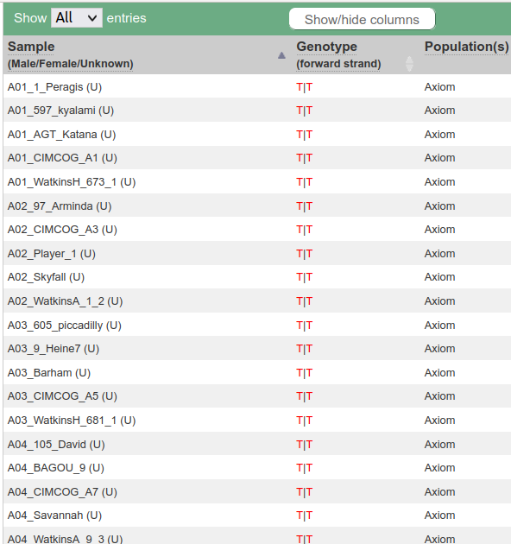
Sample genotype

Slide 30
Genotype frequency

Slide 31
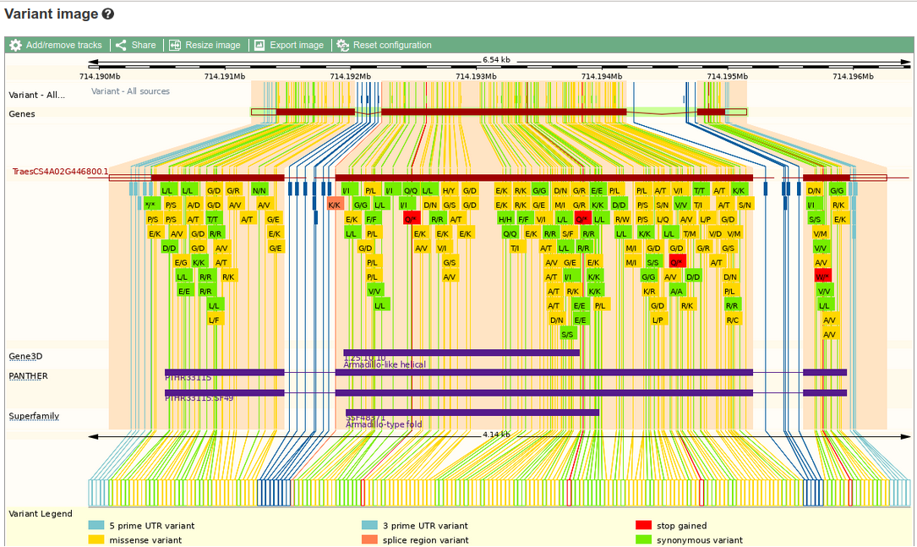
Variant image for a given gene

Slide 32
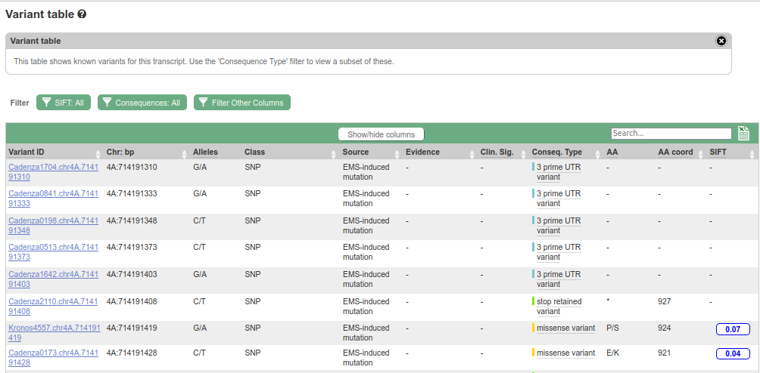
Variant table for a transcript

Slide 33
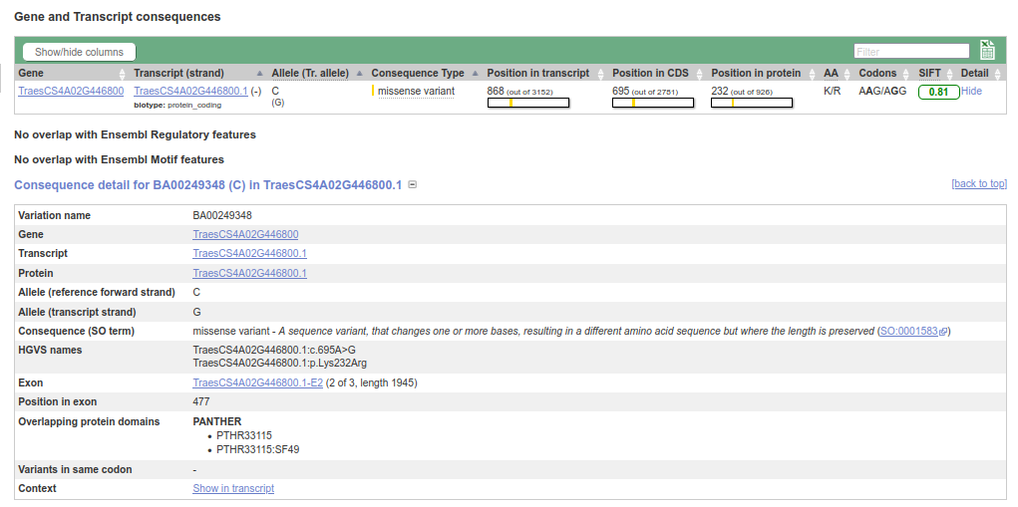
Variant consequence
Notes:
SIFT predicts whether an amino acid substitution affects protein function based on sequence homology and the physical properties of amino acids.
SIFT scores and predictions (whether 'tolerated' or 'deleterious') have been calculated for all missense variants across all bread wheat variation datasets.

Slide 34
Outline of this talk
Introduction to EBI and Ensembl Plants
A brief tour of Ensembl Plants
Variation data
Alphafold in Ensembl Plants
API and bulk data (inc. Biomart)
Rapid release and archives

Slide 35
Alphafold in Ensembl Plants (Zea mays)

Slide 36
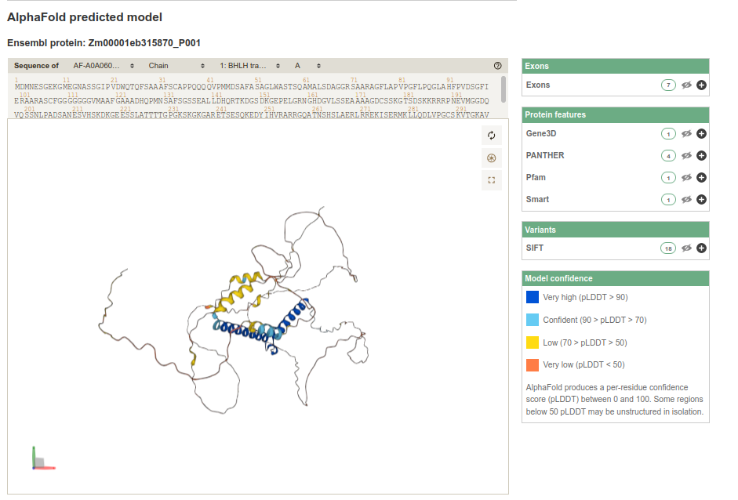
Alphafold in Ensembl Plants (Zea mays)
https://alphafold.ebi.ac.uk/

Slide 37
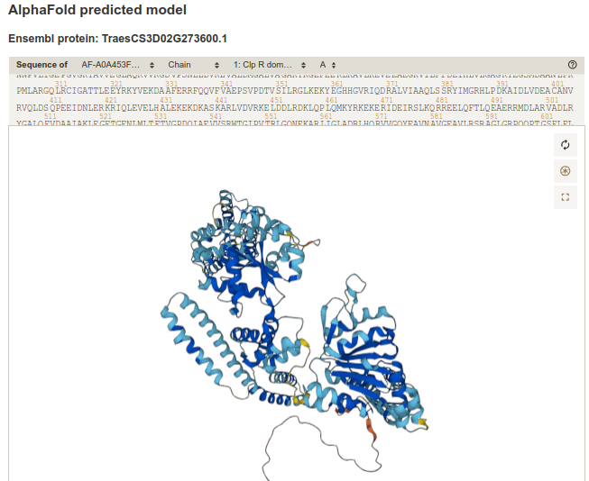
Alphafold in Ensembl Plants (Triticum aestivum)

Slide 38
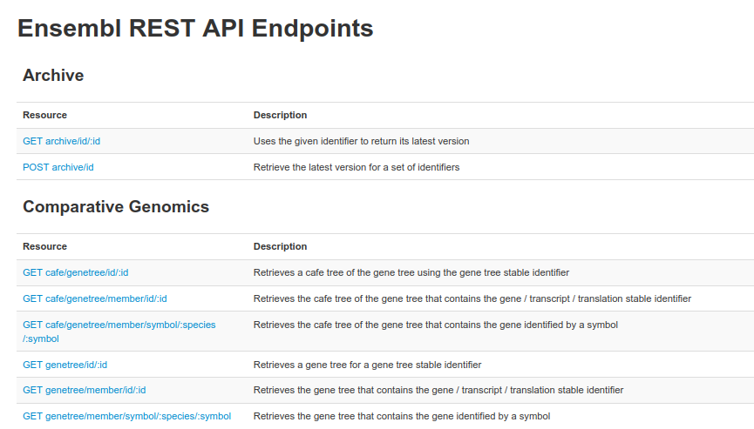
Ensembl RESTful API
http://rest.ensembl.org/documentation/

Slide 39
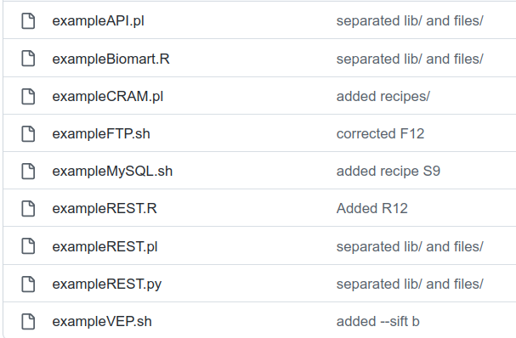

Slide 40
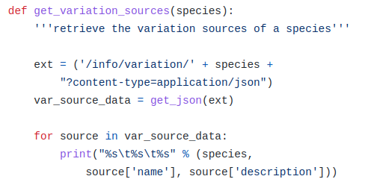

Slide 41
Getting Bulk Data in Ensembl
Download data from the Ensembl browser
Download data from the Ensembl using Biomart
Programmatic data access and bulk download using REST API, Perl API, public MySQL client and FTP site
Scripting Analyses of Genomes in Ensembl Plants Contreras-Moreira et al. 2022

Slide 42
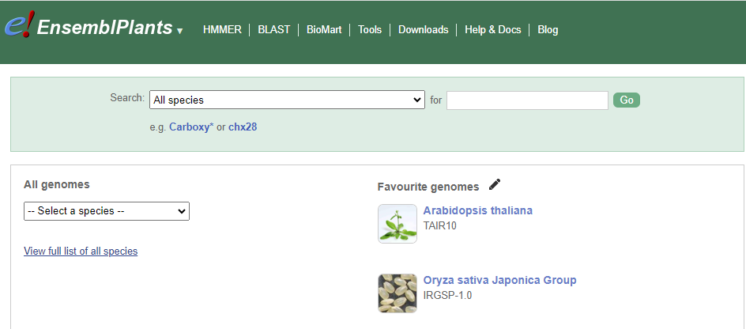

Slide 43
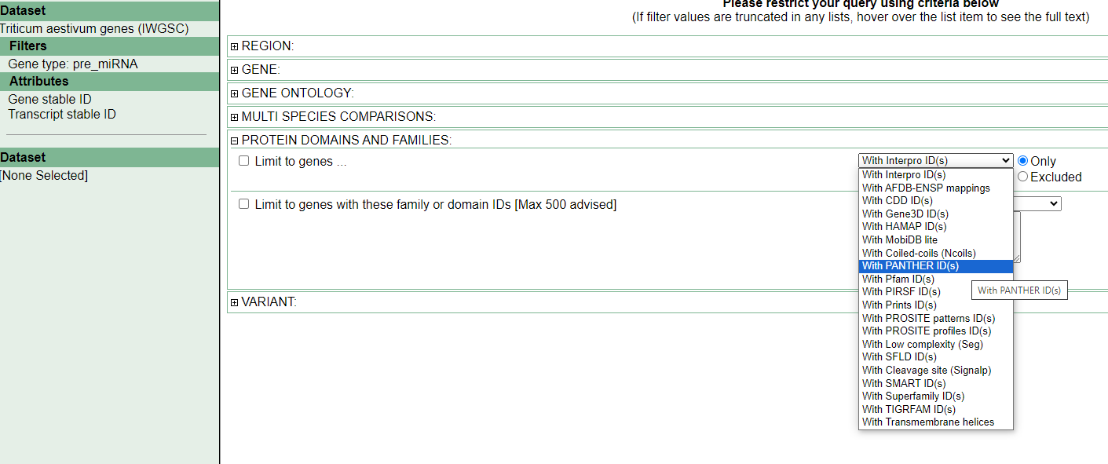
You can search and filter genes

Slide 44
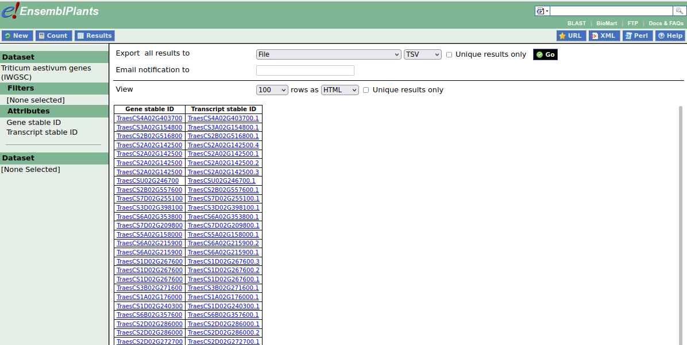
Getting Bulk Data in Ensembl - Biomart
https://plants.ensembl.org/biomart/martview/

Slide 45
Outline of this talk
Introduction to EBI and Ensembl Plants
A brief tour of Ensembl Plants
Variation data
Alphafold in Ensembl Plants
API and bulk data (inc. Biomart)
Rapid release and archives

Slide 46
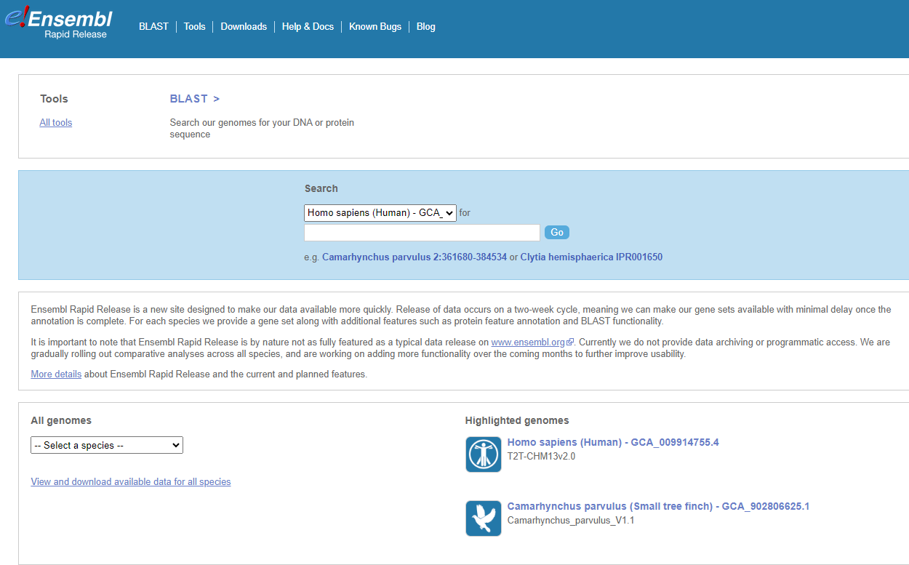

Slide 47
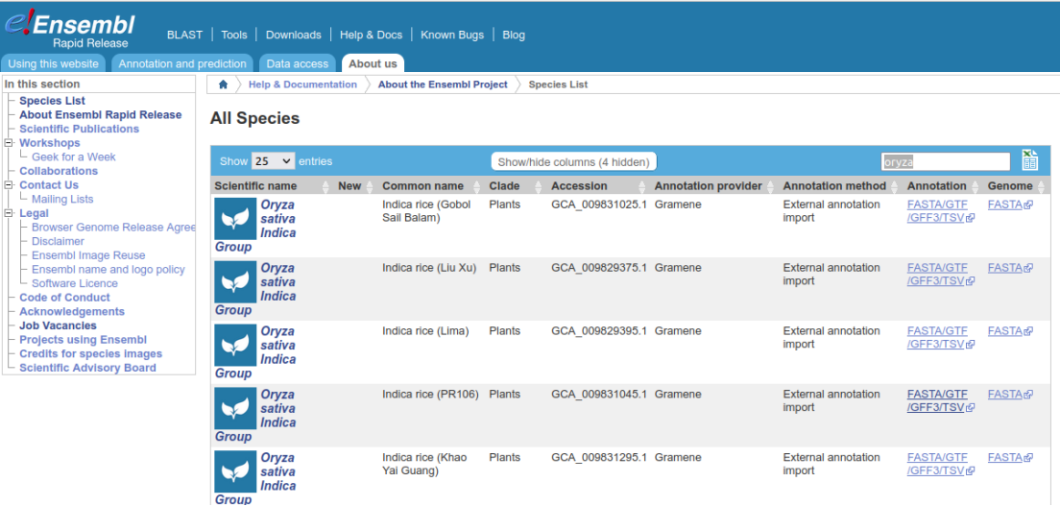
PanOryza genomes on Ensembl Rapid Release
Ensembl Rapid Release is a new, lightweight genome browser designed to allow quick release of the latest genome annotation every two weeks.
https://rapid.ensembl.org/index.html

Slide 48
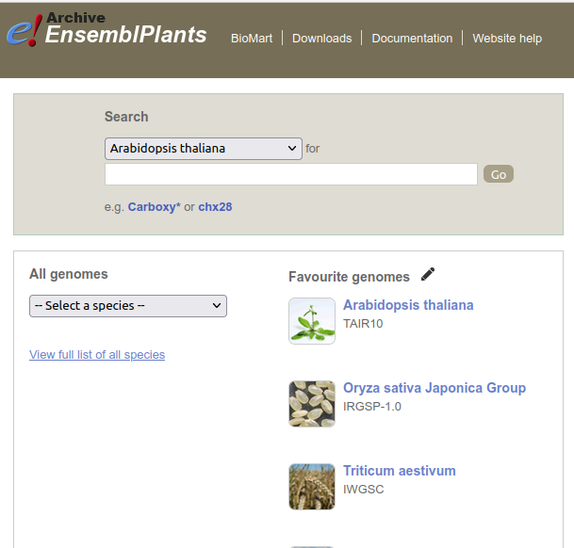
Archives in Ensembl Plants

Slide 49
Adding new genomes to Ensembl
We are happy to add a genome in Ensembl if it is in the public archives (ENA/NCBI)
Requires a full gene annotation
Get in touch with helpdesk@ensembl.org or plants team

Slide 50
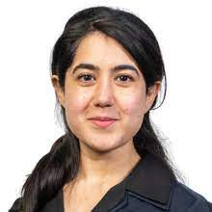
Would you like to know more?
Our outreach team gives workshops and courses for organizations and institutions
Online workshops are free
Face to face workshops for the cost of travel
helpdesk@ensemblgenomes.org (also for Ensembl issues)
Or just email me (Guy EBI)

Slide 51
Ensembl Plants Team

Slide 52
Thanks for listening!
Funding
National Human Genome Research Institute (NHGRI)
National Institute of Allergy and Infectious Diseases (NIAID)
Funded by the European Union

Slide 53
PLAZA
Identifying orthology using the PLAZA platform
Michiel Van Bel / Klaas Vandepoele, Ghent University/VIB, Ghent, Belgium

Slide 54
PLAZA
PLAZA is a platform for plant comparative, functional, and evolutionary analyzes.
Complete PLAZA presentation linked here:
https://docs.google.com/presentation/d/1sg7SXmpFLSZEAq9IZOX59UYD2Zo9MU5j/

Slide 55
Mercator4
Plant Protein Classification and Annotation
Sebastian Beier, Oct-05-2023, ELIXIR-DE

Slide 56
Motivation and History
Many available protein function prediction tools available
Often tailored to the human data use case (e.g. Gene Ontology)
Generally okay-ish results but sometimes very difficult to interpret
Assigned (GO:0042220) - response to cocaine ???
Need for specialised software that caters to plant use cases linking protein activity to biological context

Slide 57
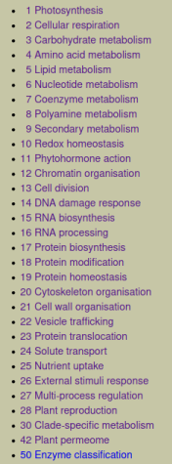
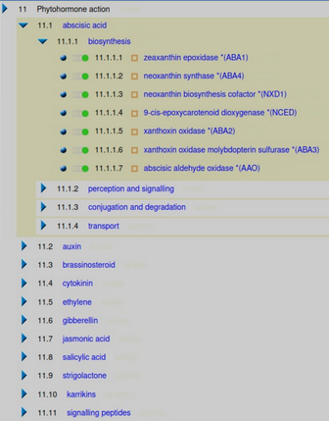
The MapMan4 framework & Top Level Domains
Hierarchical framework consisting of 31-top-level categories (also called BINs). One additional pseudo top-level category for proteins that could not be classified „35 not assigned“.

Slide 58
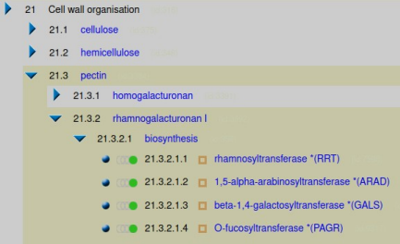
BIN Structure
top-level context category
Each child node is more specialised than its parent BIN. Protein sequences are assigned to leaf level.
branch-level context category
context descriptions
protein descriptions
leave-level protein categories

Slide 59
Comparison to other Systems
➔PFAM01505 glycosyltransferase family 8 domain
➔ Transferase activity: transferring hexosyl groups
➔ UDP-glycosyltransferase activity
➔ Polygalacturonate 4-alpha-galacturonosyltransferase activity
➔Galacturonan metabolic process
➔ Pectin metabolic process
➔ Pectin biosynthetic process
➔ Cell wall pectin biosynthetic process
➔ Rhamnogalacturonan biosynthetic process
➔Cell wall organisation
.pectin
.rhamnogalacturonan I
.biosynthesis
.rhamnosyltransferase *(RRT)
protein contains conserved domain …
protein has … activity …
protein is involved in …
protein is active in compartment …
protein is a … within the context of …

Slide 60
Version History
Annual release cycle (Autumn)
version | 0.6 (2017) | 1.0 (2018) | 2.0 (2019) | 3.0 (2020) | 4.0 (2021) | 5.0 (2022) | 6.0 (Oct. 2023)
protein categories + context nodes | 3395 + 1068 | 4145 + 1339 | 4500 + 1491 | 4869 + 1608 | 5251 + 1702 | 5783 + 1817 | ~ 6180 + 1940

Slide 61
Annotations based on Hidden Markov Models
Quality of HMMs depends on
availability of diverse reference protein sequences
quality of individual protein sequences
quality of multiple sequence alignment
selection of conserved regions within the MSA
conserved region shared by
many protein categories
conserved regions typical
for a specific protein category
Multiple sequence alignment (MSA)
of reference protein sequences
MSA region translated into HMM

Slide 62
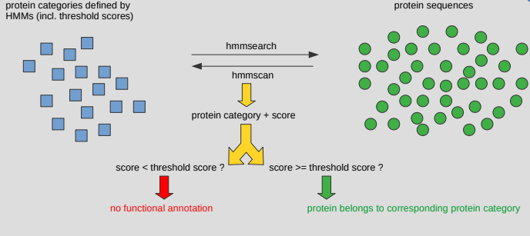
Functional Annotation of Plant Proteomes
hmmsearch (protein HMM query vs protein database) & hmmscan (protein query vs protein HMM database)

Slide 63
Queck Quality of Proteome

Slide 64
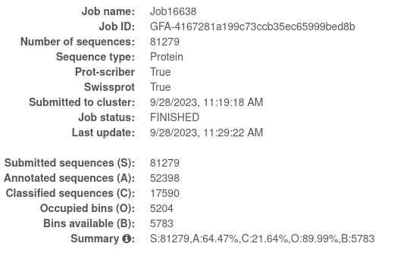
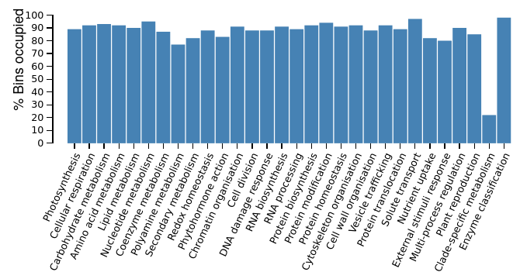
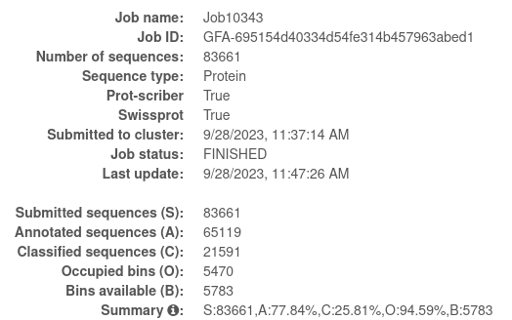
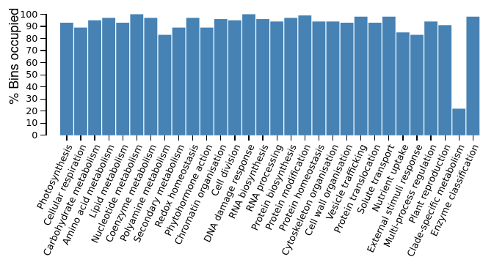
Example of a Quality Comparison
Barley Morex v1
Barley Morex v3

Slide 65
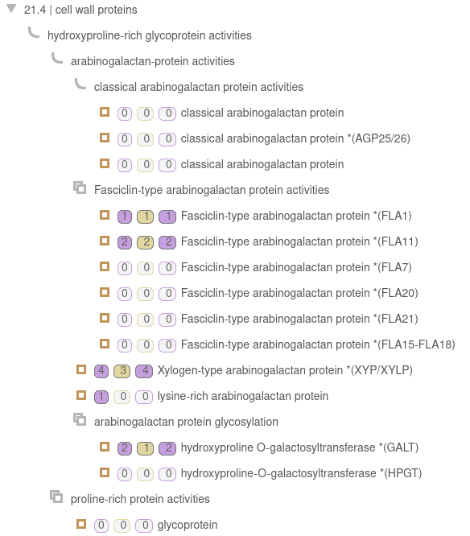
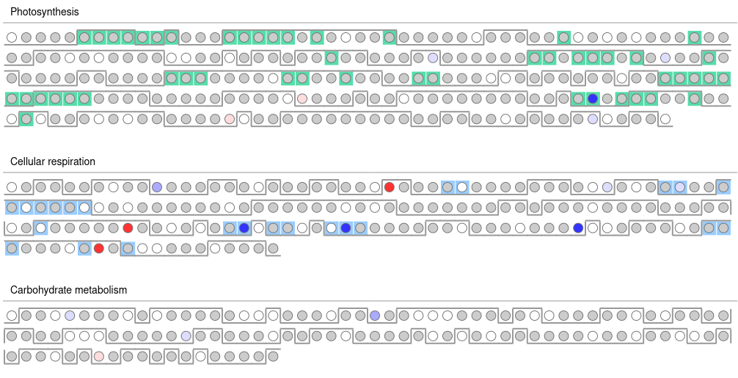
Comparative Genomics with Mercator4
Result Tree Viewer
(broad comparison of x proteomes)
Result Heatmap Viewer
(compare two proteomes in detail)

Slide 66
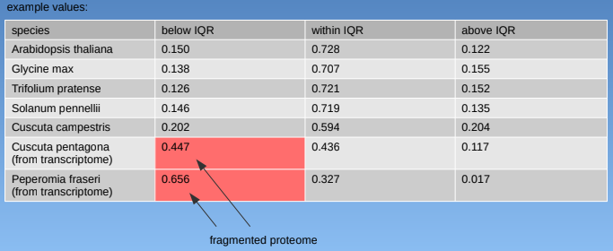
New Quality Category in Version 6 - Fragmented Sequences

Slide 67
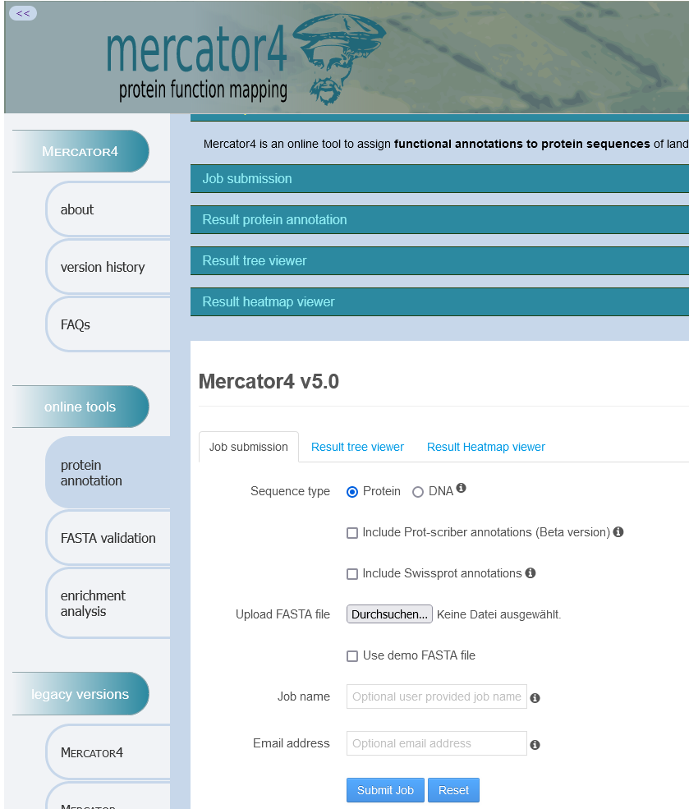
References and Acknowledgements
https://www.plabipd.de/mercator_main.html
Rainer Schwacke
Marie Bolger
Anthony Bolger
Björn Usadel
Schwacke et al. (2019)
Mapman4: a refined protein classification and annotation framework applicable to multi-omics data analysis. Mol Plant. 2019 Jun 3, 12(6): 879-892.
Bolger et al. (2021)
MapMan visualization of RNA-Seq data using Mercator4 functional annotations.
Methods Mol Biol. 2021, 2354: 195-212.

Slide 68
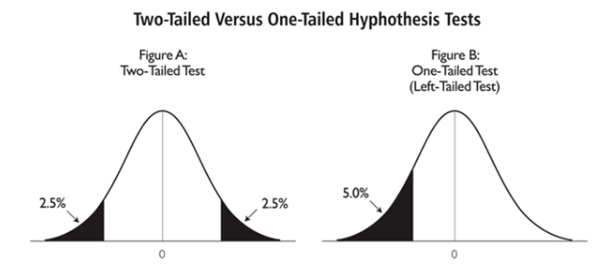
Enrichment Analysis Basics
„Statistical analysis to calculate the significance of enrichment by comparing distribution to background distribution“
Specific for 2-group experiments (treatment x control)
Input:
List of genes of interest (GI)
List of background genes (BG)
Structure of gene clusters, f.e.: BINs or GO (S)
Determine whether members of GI are randomly distributed in S. We expect sets of genes related to phenotypic distinction to not be random but cluster in specific BINs.
All genes of the organism
Causal genes for phenotype
Background genes
Genes of interest
Test for Enrichment:
Fisher‘s exact test
Hypergeometric test
Binomial
Chi²
Kolmogorov-Smirnov
Permutation
Multiple testing → Correction with False Discovery Rate (FDR) by Benjamini-Hochberg

Slide 69
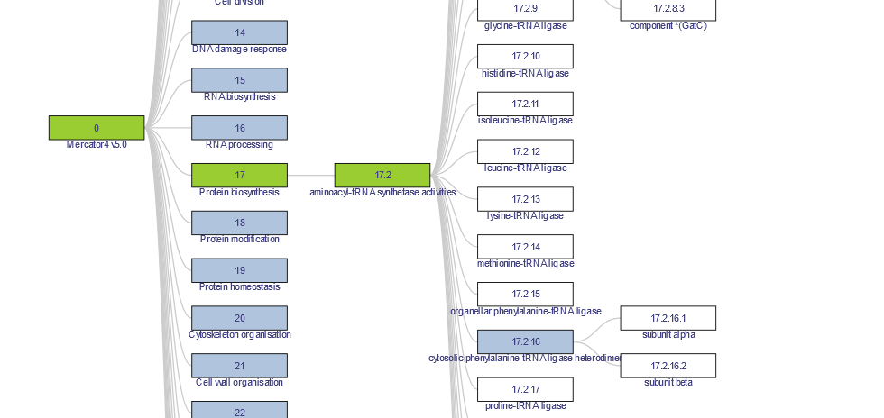
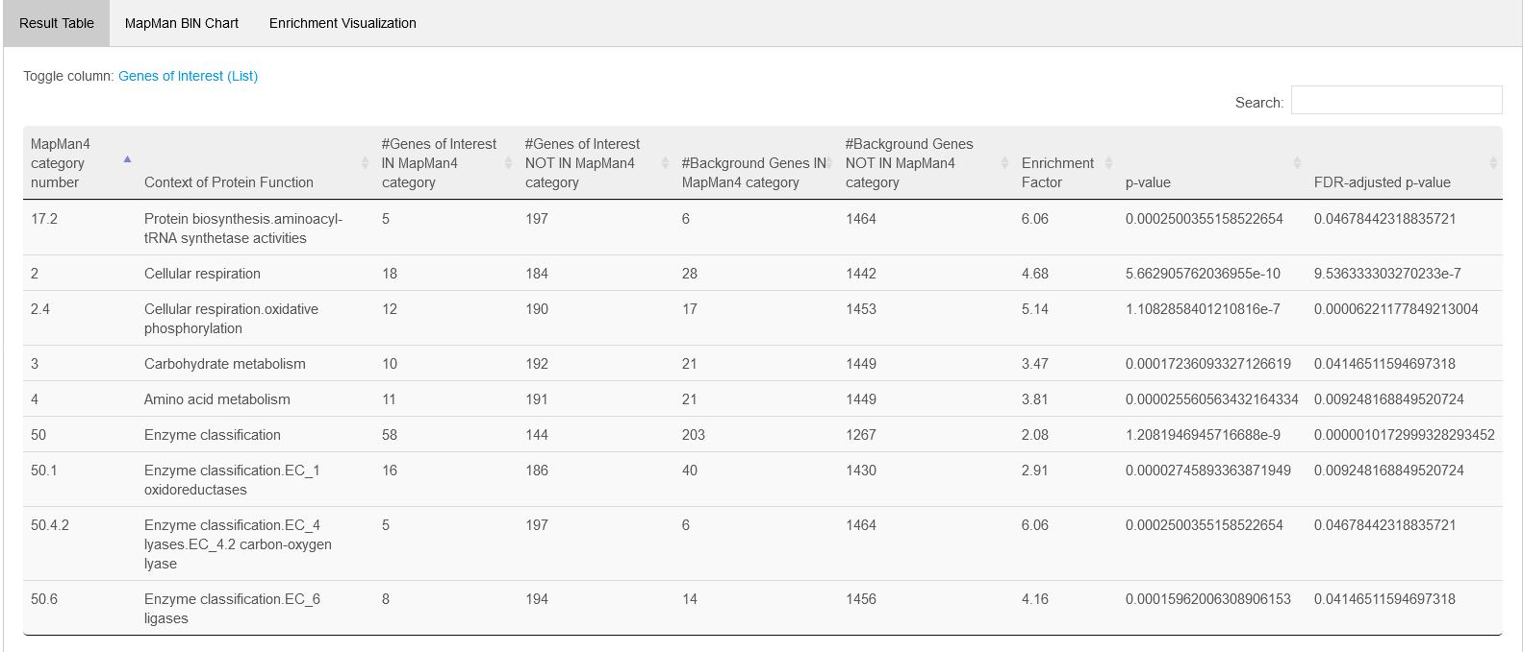
Mercator4 Enrichment Analysis
Input and Parameters:
Mercator4 mapping file
List of genes of interest
List of background genes
What test should be performed? Over-representation analysis / Under-representation analysis / Two-tailed test
Cutoff threshold for FDR

Slide 70
GoMapMan
https://gomapman.nib.si
Špela Baebler National Institute of Biology, Ljubljana, Slovenia

Slide 71
GoMapMan
GoMapMan is an open web-accessible resource for gene functional annotations in the plant sciences. It was developed to facilitate improvement, consolidation and visualization of gene annotations across several plant species. GoMapMan is based on the plant specific MapMan ontology, organized in the form of a hierarchical tree of biological concepts, which describe gene functions.
Complete GoMapMan presentation linked here:
https://drive.google.com/file/d/1rgIrpQw4j1FDnDE8YaN_0NWZb0cvUJG4/

Slide 72
Cork Oak Use Case
Plant Data Orthology Bundle
Training Materials

Slide 73
Cork Oak Use Case
Brief Introduction to Cork Oak
Cork Oak (Quercus suber) excels in cork production
Cork is a valuable raw material with multiple industrial applications
Seasonal growth: Active in Spring | Slow growth in Summer
vs
April
July
Cork
Transcriptomic Dynamics of Cork Oak in the months of April, June and July (Piñán et al., 2021) https://doi.org/10.1038%2Fs41598-021-90938-5)
Differential expression of cell wall related genes
1

Slide 74
Tasque Tasque
Increasing
Task Overview
Cork Oak Use Case
Use Case provided online:
https://corkoak-usecase.readthedocs.io/en/latest/
Task 1 – Plant Data Annotation
Task 2 – Metabolic Pathway Visualization
Task 3 – Ensembl Plants Query
Task 4 – Dynamic Network Visualization
2

Slide 75
Cork Oak Use Case
Task 1 – Plant Data Annotation
Non-model woody plant
Incomplete/absent functional annotation
Orthology analysis to infer gene/protein function
Retrieve MapMan Ontology annotations
Goal – Functional annotation of the reference genome
Input:
FASTA File with Cork Oak sequences
3

Slide 76
Cork Oak Use Case
Task 2 – Metabolic Pathway Visualization
Goal - Explore how specific metabolic pathways are being regulated based on the DEGs list
Inputs:
1. Mercator annotation results
3. Experimental data
Gene | Log2FC
CFP56_23532 | 1.998
CFP56_24732 | 1.376
CFP56_18234 | 2.052
CFP56_15101 | 2.543
CFP56_24670 | 1.104
CFP56_55251 | 2.290
... | ...
2. Metabolic pathway
Log₂ Fold Change between April and July
4

Slide 77
Cork Oak Use Case
Task 3 – Ensembl Plants Query
Goal – Retrieve useful information from the Ensembl Plants database
BioMart Query Tool
Option 1: Using it from the Ensembl Plants website
Simple and occasional searches
Option 2: Using it from the command line
Automated queries
Custom outputs
Retrieve:
Gene descriptions
GO terms
Homologs
…
5

Slide 78
Cork Oak Use Case
Task 4 – Dynamic Network Visualization
Goal – Generate a dynamic network visualization using all timepoints
April
June
July
Networks of cork oak differentialy expressed genes (Piñán et al., 2021)
6

Slide 79
Cork Oak Use Case
Task 4 – Dynamic Network Visualization
April -> June -> July
7

Slide 80
Cork Oak Use Case
Task 4 – Dynamic Network Visualization
Goal – Generate a dynamic network visualization using all timepoints
Inputs:
3. Experimental data
Gene expression in 3 distinct timepoints
1. Node table
2. Edge table
geneID | Expression_April | adj.P.Val
CFP56_57155 | -0.801 | 0.01
CFP56_24732 | -0.511 | 0.01
CFP56_18234 | -0.830 | 0.01
April
geneID
CFP56_57155
CFP56_18234
CFP56_55251
CFP56_67904
CFP56_05273
CFP56_07147
…
geneID1 | geneID2 | reactionType
CFP56_57155 | CFP56_18234 | coexpressed_with
CFP56_57155 | CFP56_55251 | coexpressed_with
CFP56_57155 | CFP56_67904 | coexpressed_with
CFP56_57155 | CFP56_61563 | coexpressed_with
CFP56_57155 | CFP56_71489 | coexpressed_with
CFP56_57155 | CFP56_05273 | coexpressed_with
… | … | …
geneID | Expression_June | adj.P.Val
CFP56_57155 | -0.319 | 0.01
CFP56_24732 | -0.641 | 0.01
CFP56_18234 | -0.280 | 0.01
June
geneID | Expression_July | adj.P.Val
CFP56_57155 | 1.121 | 0.01
CFP56_24732 | 1.152 | 0.01
CFP56_18234 | 1.110 | 0.01
July
8

Slide 81
Cork Oak Use Case
Conclusion
Thank you for participating!
Feedback is highly appreciated, please contact hm.rodrigues@itqb.unl.pt

