Slide 1
Identifying orthology using the PLAZA platform
ELIXIR Plant Orthology Workshop
2023-10-05
Michiel Van Bel

Slide 2
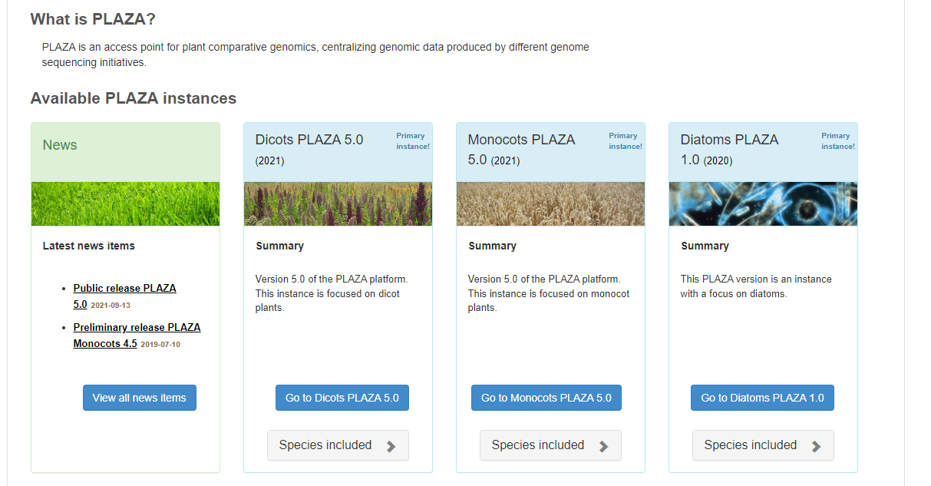
Overview
PLAZA is a platform for plant comparative, functional, and evolutionary analyzes
Multiple instances, focused on different clades
https://bioinformatics.psb.ugent.be/plaza

Slide 3
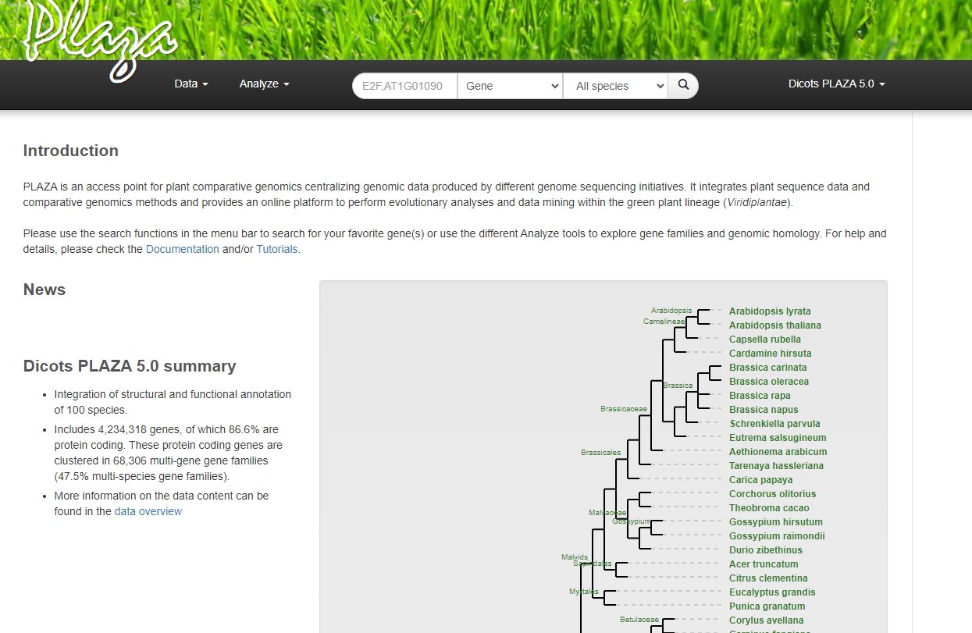
Overview
Search box
Organism selection

Slide 4
Gene families and phylogenetic trees
All coding genes are clustered in both
Homologous gene families (TribeMCL)
Orthologous gene families (OrthoFinder)

Slide 5
Gene families and phylogenetic trees

Slide 6
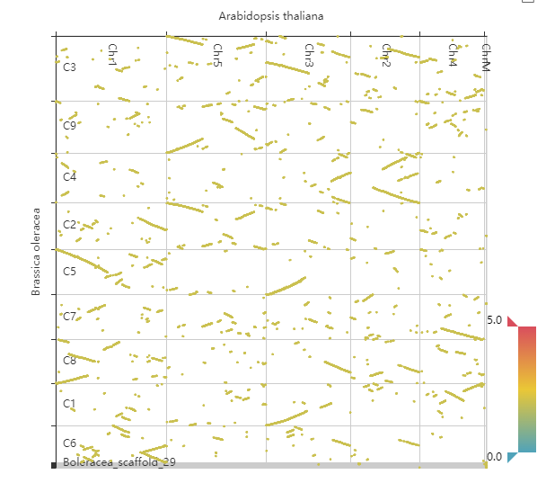
Colinearity and evolution
Colinear regions indicate conservation of gene order and content

Slide 7
Integrative Orthology
PLAZA Integrative Orthology consists of 3 main types and 1 support type:
Tree Orthologous Groups (TROG)
Orthologs based on phylogenetic trees of homologous gene families
Orthologous gene families (ORTHO)
Orthologs based on OrthoFinder clustering
Best-Hit and Inparalog Families (BHIF)
Best BLAST hit (per species) with added inparalogs for the hit
Colinearity hits (anchor_point)
Homologous genes part of collinear segments

Slide 8
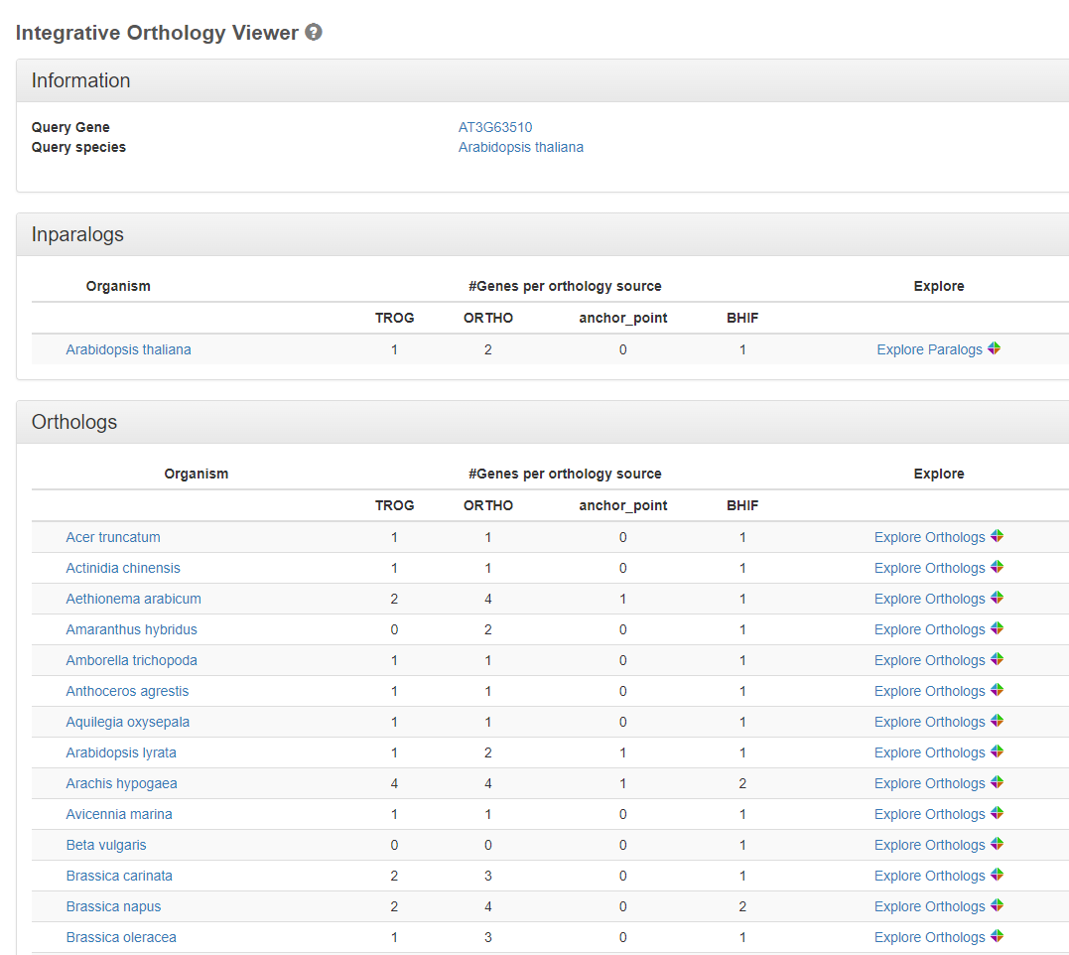
Integrative orthology
Example 1 : What are the orthologs of AT3G63510 in Brassica oleracea ?

Slide 9
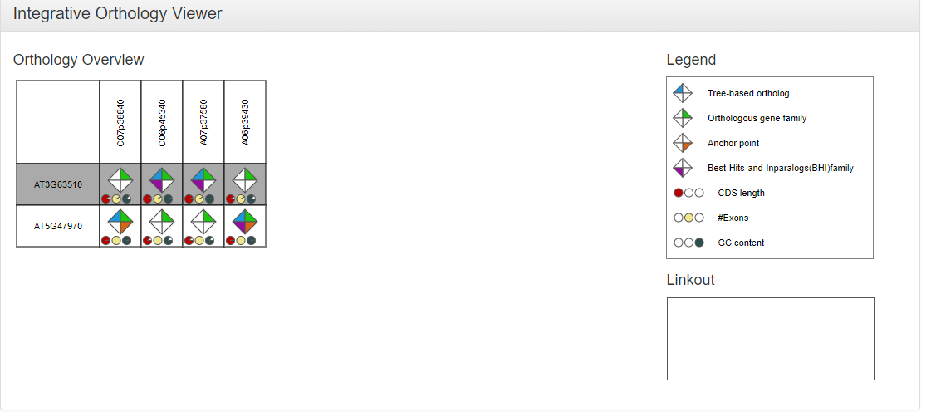
Integrative orthology
What are the orthologs of AT3G63510 in Brassica oleracea ?

Slide 10
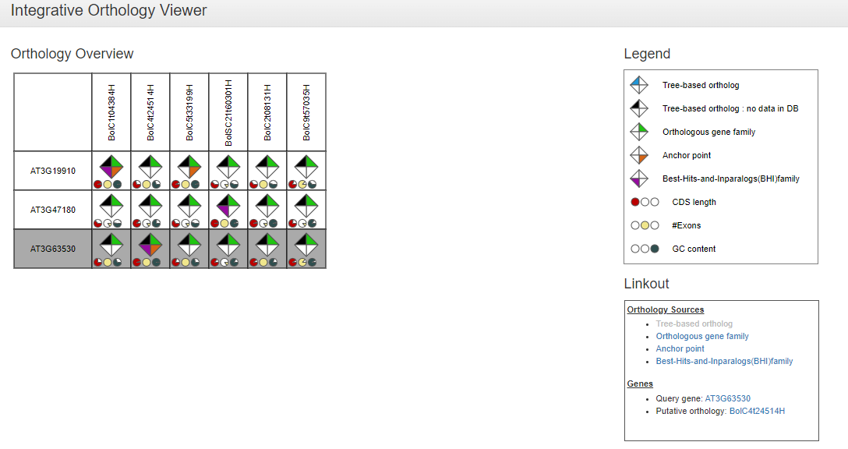
Integrative orthology
Example 2: What are the ortholog(s) of AT3G63530 in Brassica oleracea ?
Note difference between black vs white coloring:
Absence of evidence != Negative result

Slide 11
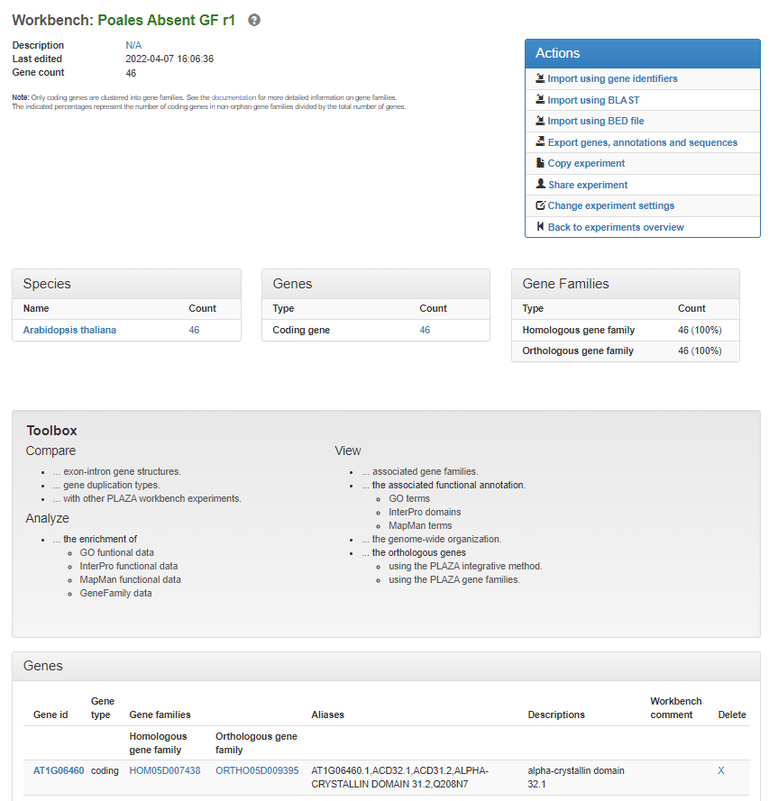
PLAZA Workbench Orthology
PLAZA supports working with sets of genes, through the concept of the PLAZA Workbench
Load sets of genes in a Workbench Experiment
Perform group-wide analyzes

Slide 12
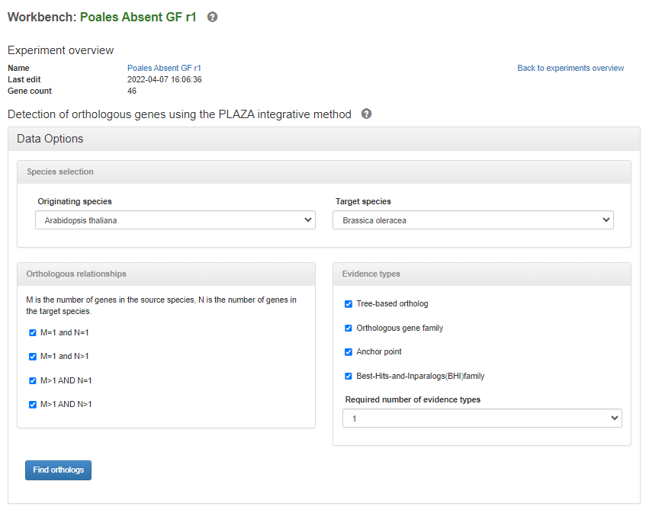
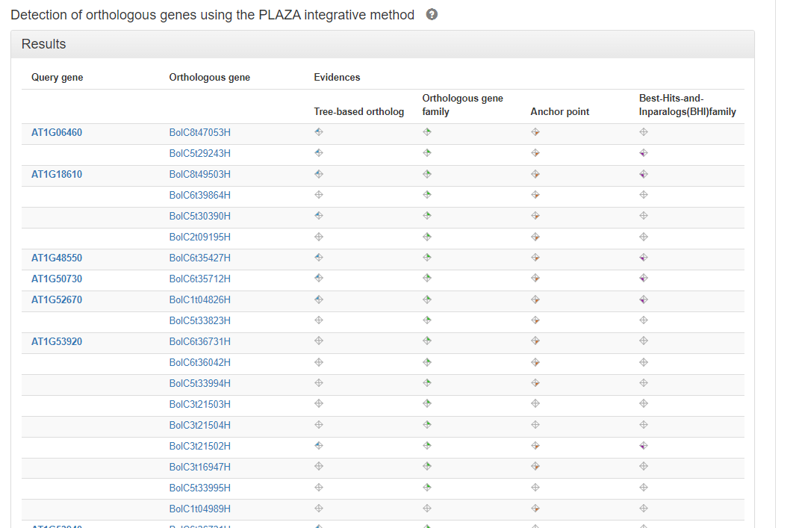
PLAZA Workbench Orthology

Slide 13
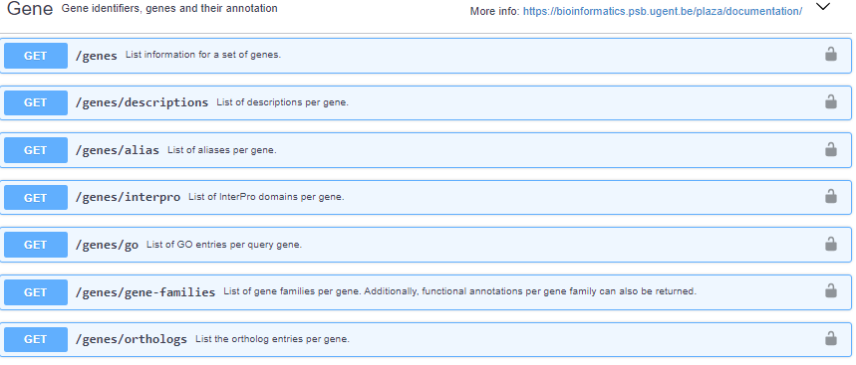
PLAZA API and Downloads
Documented API, allows the retrieval of orthologs on-the-fly
🡺https://bioinformatics.psb.ugent.be/plaza/documentation/
Data downloads available at https://ftp.psb.ugent.be/pub/plaza/

